Slide 1
Semi-Lagrangian advection, Shape-Preserving and Mass-Conservation
May 16, 2014
Monique Tanguay
Abdessamad Qaddouri
Jean de Grandpré
Collaboration: Sylvie Gravel, Saroja Polavarapu, Michael Neish, David Plummer, Mohamed Zerroukat

Slide 2
OUTLINE
Shape-Preserving and Mass-Conservative semi-Lagrangian advections (Monique)
Application in the context of the Yin-Yang grid (Abdessamad)
Application in the context of multi-year simulations with chemistry (Jean)

Slide 3
$$= \frac{ρϕ}{ρ}$$
Semi-Lagrangian advection of Tracer mixing ratio $ϕ$
$ϕ$ = $\frac{\text{Tracer} \text{density}}{\text{Air} \text{density}}$
$\frac{dϕ}{dt}$= $\frac{∂ϕ}{∂t}$ + $u\frac{∂ϕ}{∂x}$ = 0
Advection equation
$$\frac{x − x_{d}}{∆t}\text{=} u (x_{m}, t−\frac{∆t}{2})$$
Estimate departure points
$ϕ(x$, $t$) = $ϕ$($x_{d}$, $t$ $− ∆t$)
${ ϕ}_{i}^{}$ = $ϕ_{d}^{−}$
Interpolation at departure points

Slide 4
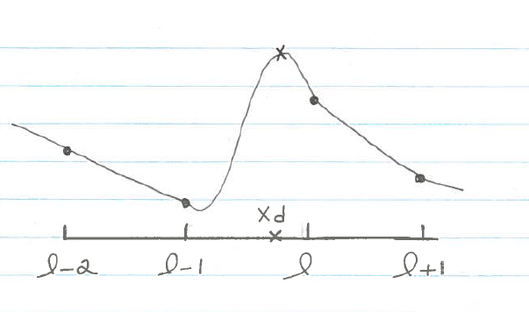
Cubic interpolation and Shape-Preserving for Tracer mixing ratio $ϕ$
Cubic Interpolation $ϕ_{}^{C}$
$$ϕ_{}^{C}$$
$ϕ_{i}^{C}$ = $\sum_{l}{ω_{i l }ϕ_{l}^{−}}$
$$ϕ_{}^{M}$$
$\sum_{l}{ω_{i l }}$ = 1
Mono $ϕ^{M} = ϕ^{C}$ + Shape-Preserving
$ϕ^{M}$ = max [$ϕ_{l}^{−}$,min ($ϕ_{l}^{−}$, $ϕ^{C}$)]

Slide 5
ρ = Air density
Semi-Lagrangian advection of Tracer density ρ$ϕ$
$\frac{d\text{ρ}}{dt}$+ $\text{}$ $\frac{∂u}{∂x}$ = 0
$\frac{dϕ}{dt}$= 0
$\frac{d\text{(}\text{ρ}ϕ\text{)}}{dt}$+ $\text{(}\text{ρ}ϕ\text{)}\frac{∂u}{∂x}$ = 0
+
$\frac{∂\text{(}\text{ρ}ϕ\text{)}}{∂t}$ + $\frac{∂\text{(}\text{ρ}ϕu\text{)}}{∂x}$ = 0
Divergence term
Flux form
Local Mass Conservation of Tracer density ρ$ϕ$
Global Mass Conservation of Tracer density ρ$ϕ$
$$\int_{a(x,t)}^{b(x,t)}{\left[\frac{∂\text{(}\text{ρ}ϕ\text{)}}{∂t} \text{ + }\frac{∂\text{(}\text{ρ}ϕu\text{)}}{∂x}\right]dx=0}$$
$$\int_{0}^{L}{\left[\frac{∂\text{(}\text{ρ}ϕ\text{)}}{∂t} \text{ + }\frac{∂\text{(}\text{ρ}ϕu\text{)}}{∂x}\right]dx=0}$$
$\frac{d}{dt}$ $\int_{a(x,t)}^{b(x,t)}{\text{ρ}ϕ dx=0}$
Leibniz integral rule
$\frac{∂}{∂t}$ $\int_{0}^{L}{\text{ρ}ϕ dx=0}$
$\left(\text{}ϕ\right)$ ΔV = ${\left(\text{}ϕ\right)}^{−}$ $∂V$
$$\sum_{i}{{{(\text{ρ}ϕ)}_{i}^{} dV}_{i}}= \sum_{i}{{{(\text{ρ}ϕ)}_{i}^{−} dV}_{i}}$$
$$\text{}\text{M}$$
i
$ϕ$ΔM = $ϕ^{−}$ $∂$M
$$\sum_{i}{ϕ_{i}^{}{dM}_{i}^{}}= \sum_{i}{ϕ_{i}^{−}{dM}_{i}^{−}}$$
$$∂\text{M}$$
time
$$dM=ρdV$$
with
with
$$∂M=ρ∂V$$
d

Slide 6
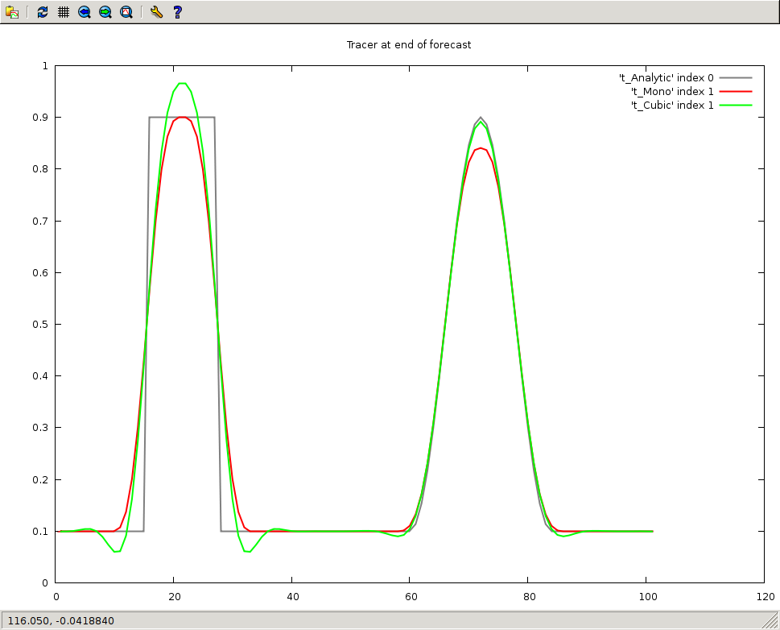
Advection 1D with U=constant: Forecasts after one revolution
CFL = 1/2
Overshoot with Cubic
Damping with Mono
Analytic
Undershoot with Cubic

Slide 7
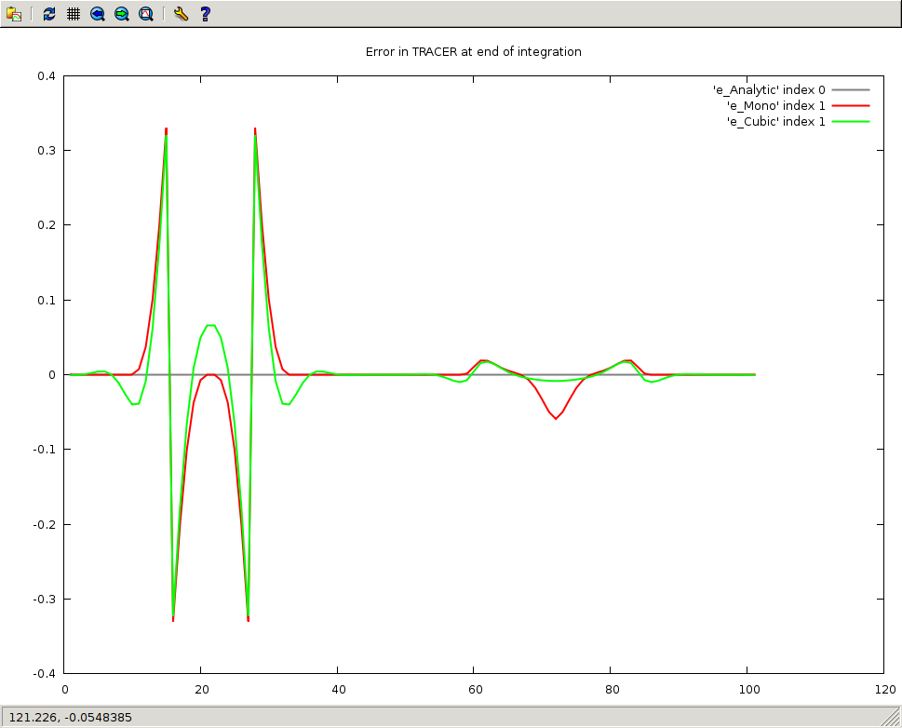
Advection 1D with U=constant: Errors after one revolution
Cubic
Mono
Cubic

Slide 8
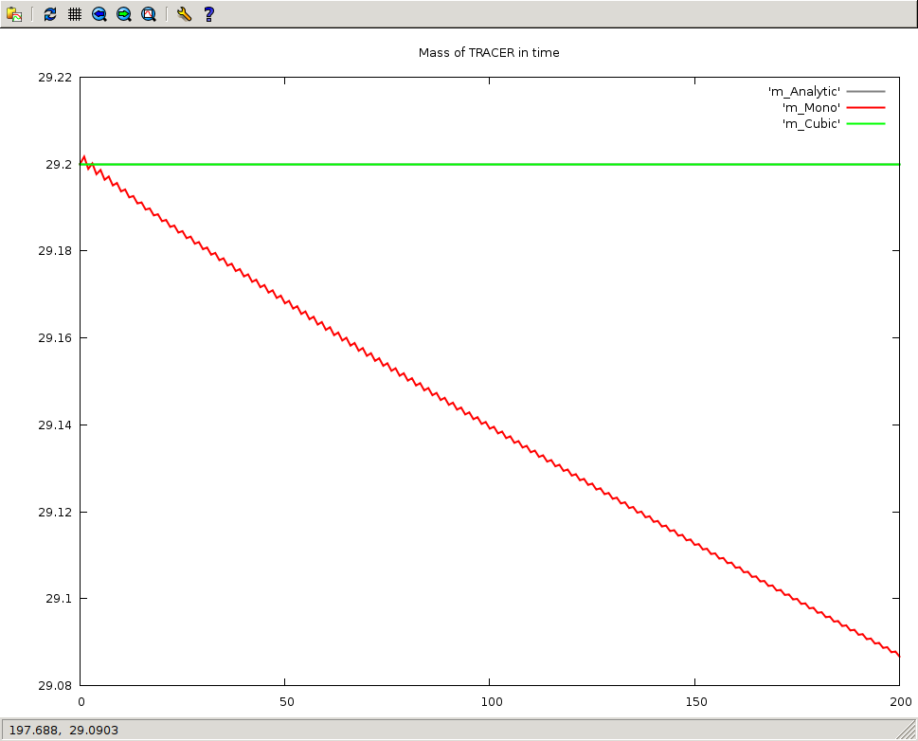
Advection 1D with U=constant: Masses in time
No change with Cubic
Lost of mass with Mono

Slide 9
Bermejo-Conde (2002): $ϕ^{M}$+ Global Mass Conservation
Subtract Mass at all i with ω_{i} > 0 to correct excess of mass dM in Global Mass
$ϕ_{i}^{B−C}$ = ${ ϕ}_{i}^{M}$ - λ ${\text{}}_{i}^{}$
λ = $\frac{dM}{\sum_{\overline{i}}{{\text{ω}}_{\overline{i}}^{} {\text{(}\text{ρ} V\text{)}}_{\overline{i}}}}$
$$ϕ_{}^{M}$$
FIGURE
$$ϕ_{}^{L}$$
$ω_{i}^{}$ = max(0, sgn(dM) , sgn${ (ϕ}_{i}^{M}$ - $ϕ_{i}^{L}$ ) ${\left|{ ϕ}_{i}^{M}\text{ − }ϕ_{i}^{L}\right|}^{p})$
$$ϕ^{L}$$
with
Linear interpolator
The corrections are related to the smoothness of the tracer
See also Gravel and Staniforth (1994)

Slide 10
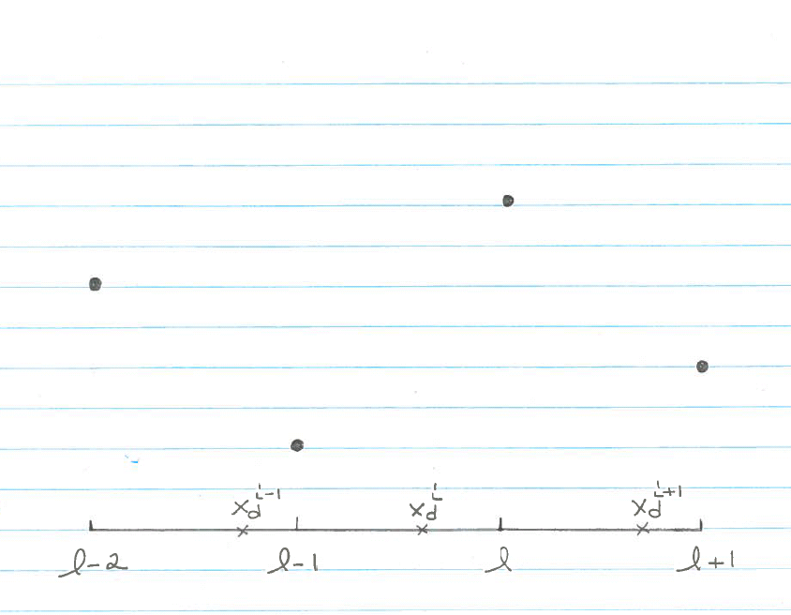
ILMC in Sorensen et al (2013): $ϕ^{C}$+ Shape-Preserving + Global Mass Conservation
ILMC = Iterative Locally Mass Conserving
$$ϕ_{}^{C}$$
x
Overshoot
At violation (i.e. Overshoot),
subtract iteratively the necessary percentage of mass in the surrounding cells
x
Iterative filter:
Look into Shell #1, Shell #2, Shell #3 …
x
x
Shell #1
Shell #2

Slide 11
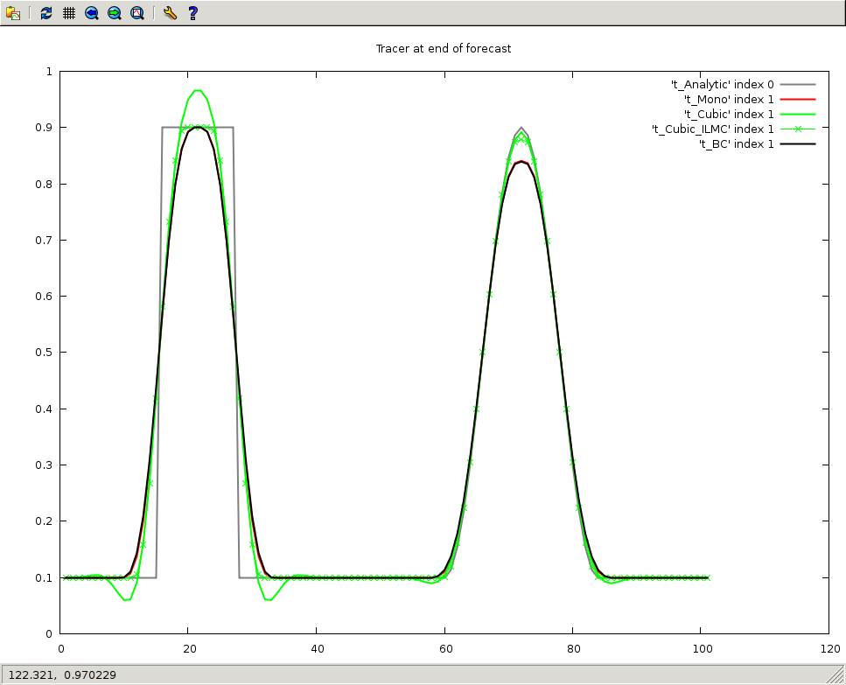
Advection 1D with U=constant: Forecasts after one revolution
Cubic
Bermejo-Conde
$≈$ Mono
x
x
No overshoot with
Cubic+ILMC

Slide 12
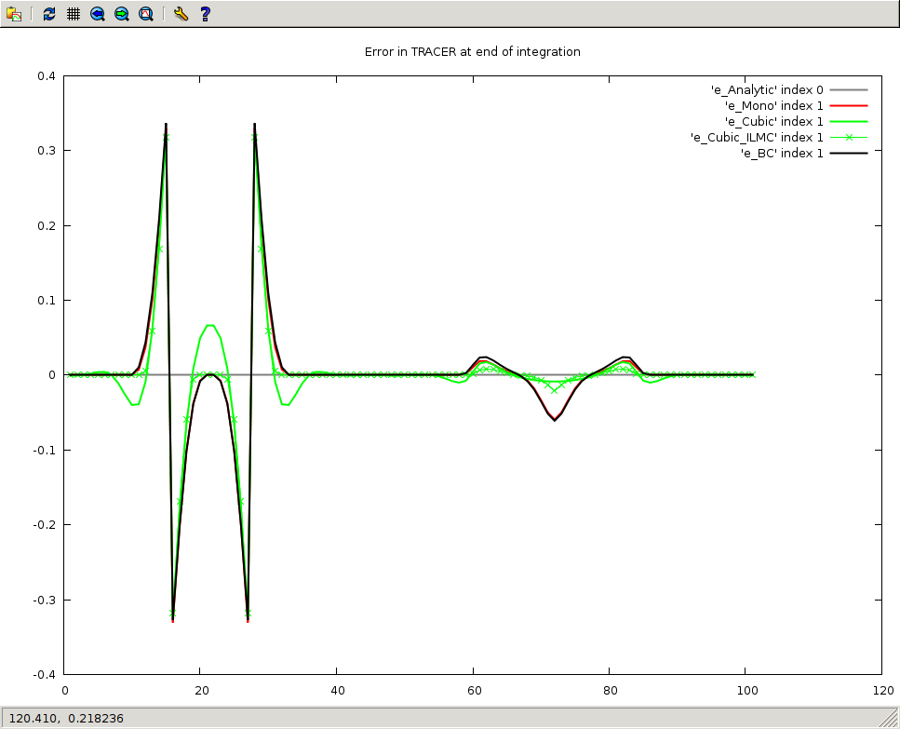
Advection 1D with U=constant: Errors after one revolution
Cubic
Bermejo-Conde:
Differences with Mono
where gradient is intense
Cubic+ILMC

Slide 13
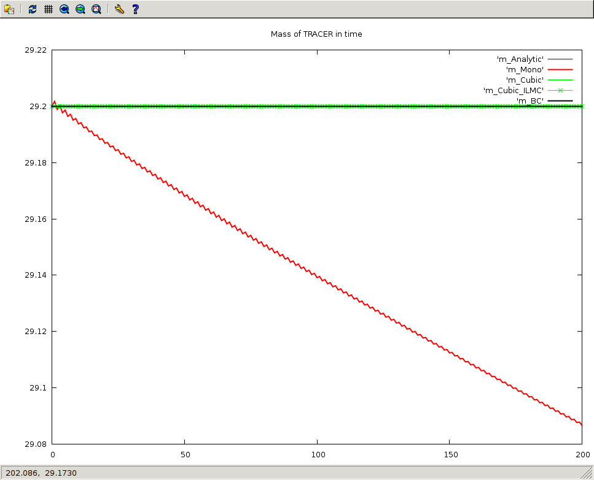
Advection 1D with U=constant: Masses in time
The others
Lost of mass with Mono

Slide 14
Kaas (2008): Local Mass Conservation (#1)
$\frac{d\text{(}\text{ρ}ϕ\text{)}}{dt}$+$\text{(}\text{ρ}ϕ\text{)}\frac{∂u}{∂x}$ = 0
$\frac{{\text{(}\text{ρ}ϕ\text{)}}_{i}^{}−{\text{(}\text{ρ}ϕ\text{)}}_{d}^{−} }{∆t}$ + $\frac{{ \left[\text{(}\text{ρ}ϕ\text{)}\frac{∂u}{∂x}\right]}_{i}^{}+{ \left[\text{(}\text{ρ}ϕ\text{)}\frac{∂u}{∂x}\right]}_{d}^{−}}{2}$ = 0
Semi-Lagrangian treatment
${\text{(}\text{ρ}ϕ\text{)}}_{i}^{}$ = $\frac{\left[\text{1 −}\frac{∆t}{2}{\left(\frac{∂u}{∂x}\right)}_{d}^{−}\right]}{\left[\text{1 +}\frac{ ∆t}{2}{\left(\frac{∂u}{∂x}\right)}_{i}^{}\right]}$ ${\text{(}\text{ρ}ϕ\text{)}}_{d}^{−}$
Divergence contribution
${\left(\text{}ϕ\right)}_{i}^{}$ = $_{i} \sum_{l}{ω_{i l }{\text{(}\text{ρ}ϕ\text{)}}_{l}^{−}}$
$\sum_{l}{ω_{i l }}$ = 1
${\left(\text{}ϕ\right)}_{i}^{}$ = $\sum_{l}{{{\hat{ω}}_{i l}^{} }_{ }{\text{(}\text{ρ}ϕ\text{)}}_{l}^{−}}$
${\hat{ω}}_{i l}^{}$ = $\frac{V_{l}}{V_{i}}$ $\frac{ω_{i l }}{\sum_{\overline{i} }{ω_{\overline{i} l }}}$
with
Local Correction of the interpolated weights $ω_{i l }$that takes Divergence into account and ensures Local Mass conservation

Slide 15
${\hat{ω}}_{i l}^{}$ = $\frac{V_{l}}{V_{i}}$ $\frac{ω_{i l }}{\sum_{\overline{i} }{ω_{\overline{i} l }}}$
Kaas (2008): Local Mass Conservation (#2)
No or little divergence: The spatial density of upstream departure points is equal or close
to the density of the Eulerian grid points
$\sum_{\overline{i} }{ω_{\overline{i} l }}$ $\sim \frac{1}{4}+\frac{3}{4}=1$
x
x
${\text{(}\text{ρ}ϕ\text{)}}_{i}^{}\sim { ω}_{i l−1 }$ ${\text{(}\text{ρ}ϕ\text{)}}_{l−1}^{−}$ + ${ ω}_{i l }$ ${\text{(}\text{ρ}ϕ\text{)}}_{l}^{−}$
Forecasted Tracer Density similar to non-divergent situation
In a situation with positive divergence in a region, the spatial density of
upstream departure points is greater than the density of the Eulerian grid points
$\sum_{\overline{i} }{ω_{\overline{i} l }}$ $\sim \frac{1}{4}+\frac{3}{4}+\frac{1}{4}=\frac{5}{4}$ > 1
x
x
x
${\text{(}\text{ρ}ϕ\text{)}}_{i}^{}\sim { ω}_{i l−1 }$ ${\text{(}\text{ρ}ϕ\text{)}}_{l−1}^{−}$ + ${\frac{4}{5} ω}_{i l }$ ${\text{(}\text{ρ}ϕ\text{)}}_{l}^{−}$
Forecasted Tracer Density smaller than non-divergent situation

Slide 16
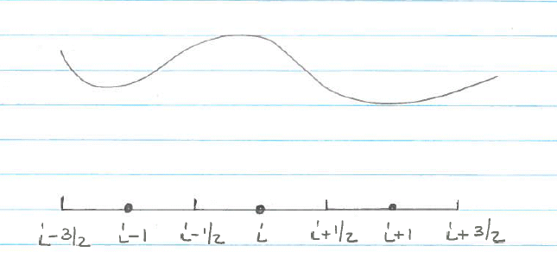
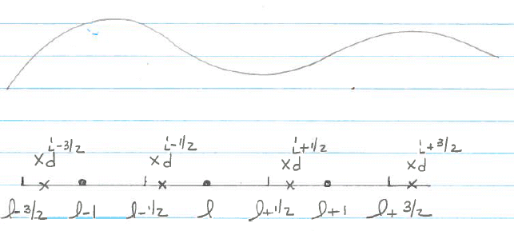
Zerroukat (2012): Local Mass Conservation (#1)
$M_{i}^{}$ = $M_{d}^{−}$
$$M_{i}^{}$$
Slice-1D
time
$$M_{d}^{−}$$
Evaluate the integral
$$M_{d}^{−}$$
x
x
using the parabolas
$ρ_{l}$($x$) = $a_{l}$ + $b_{l}$ $x$ + $c_{l}x^{2}$
x
$$ρ_{l}$$
$\int_{x_{l−3/2}^{}}^{x_{l−1/2}^{}}{ρ_{l}\text{(}x\text{)}}$ d$x$ = $ρ_{l−1}^{−}\left(x_{l−\frac{1}{2}}^{} − x_{l−\frac{3}{2}}^{}\right)$
x
x
$$ρ_{l−1}^{−}$$
$$ρ_{l}^{−}$$
$$ρ_{l+1}^{−}$$
$\int_{x_{l−1/2}^{}}^{x_{l+1/2}^{}}{ρ_{l}\text{(}x\text{)}}$ d$x$ = $ρ_{l}^{−}\left(x_{l+\frac{1}{2}}^{} − x_{l−\frac{1}{2}}^{}\right)$
$\int_{x_{l+1/2}^{}}^{x_{l+3/2}^{}}{ρ_{l}\text{(}x\text{)}}$ d$x$ = $ρ_{l+1}^{−}\left(x_{l+\frac{3}{2}}^{} − x_{l+\frac{1}{2}}^{}\right)$
As in Laprise and Plante (1995)
See also Mahidjiba et al. (2008)

Slide 17
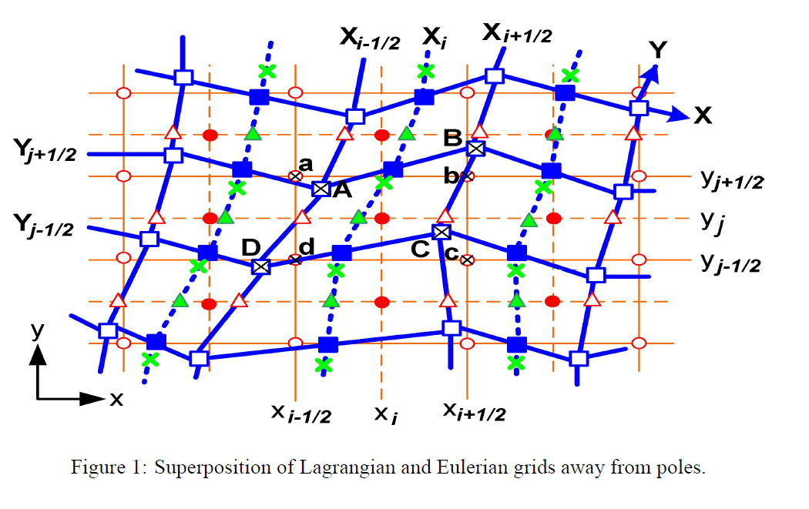
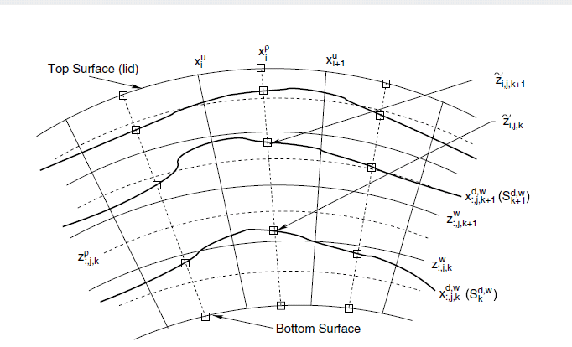
Slice-2D
From Zerroukat (SRNWP-NT, Zagreb, 2006)
Slice-3D
From Zerroukat and Allen (2012)

Slide 18
SUMMARY
Schemes | Shape-Preserving | Mass Conservation
Cubic $ϕ^{C}$
Mono $ϕ^{M}$ | YES ($ϕ^{M}$)
Mono Bermejo-Conde | YES ($ϕ^{M}$) | Global
ILMC Bermejo-Conde | YES (ILMC) | Global
Kaas |  | Local
Slice |  | Local
Cubic + ILMC | YES (ILMC) | No change with respect to Base
Kaas + ILMC | YES (ILMC) | No change with respect to Base
Slice + ILMC | YES (ILMC) | No change with respect to Base

Slide 19
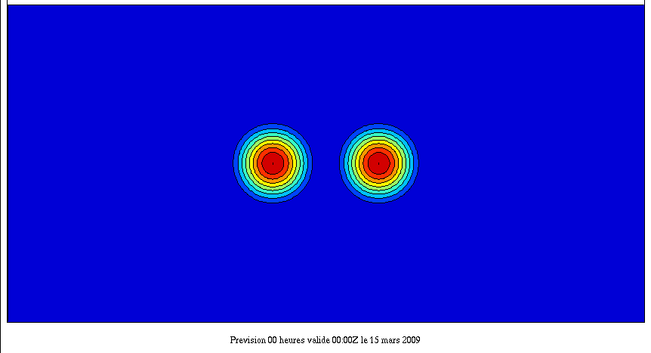
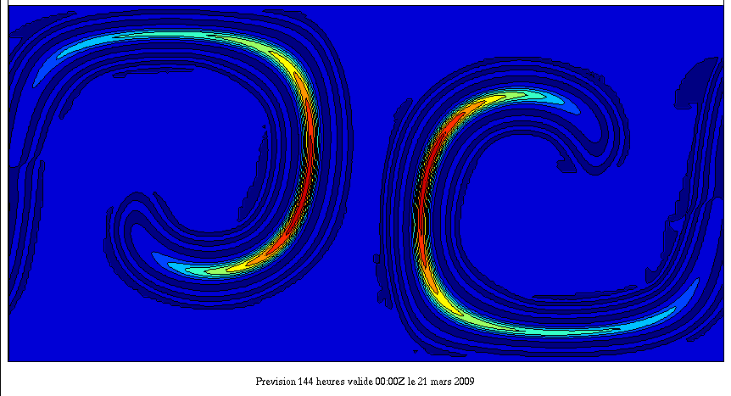
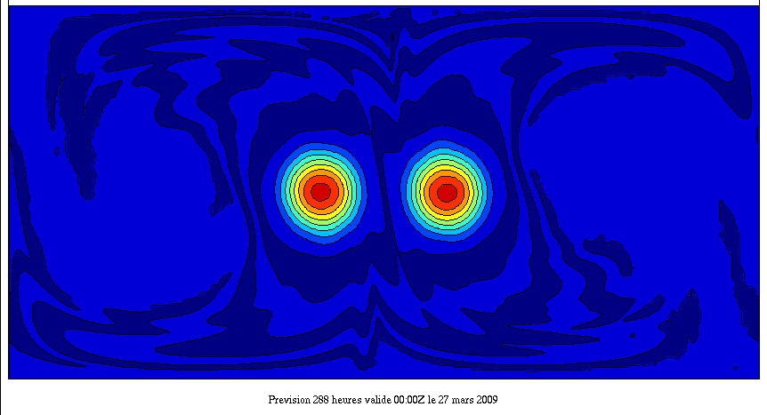
Advection 2D: Lauritzen and Thuburn (2012)
Resolution 360x180 DT=3600 s
Cubic interpolation
Tracer Q2
t=0
Non-divergent reversal winds
t=6d
t=12d

Slide 20
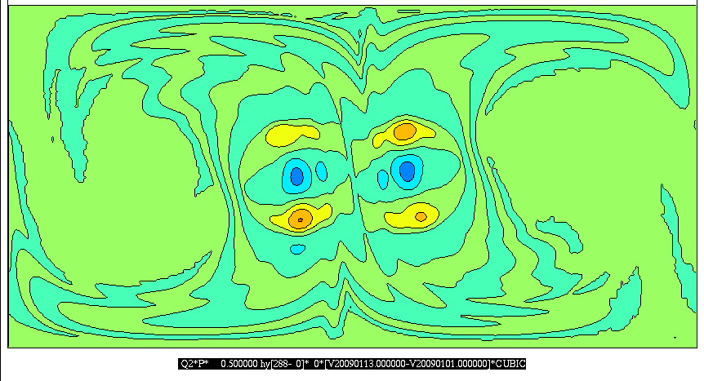
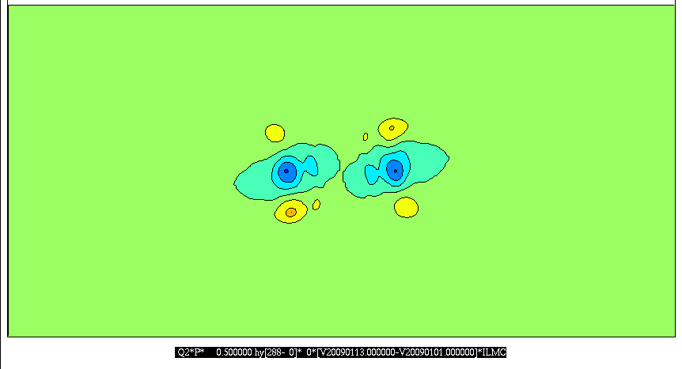
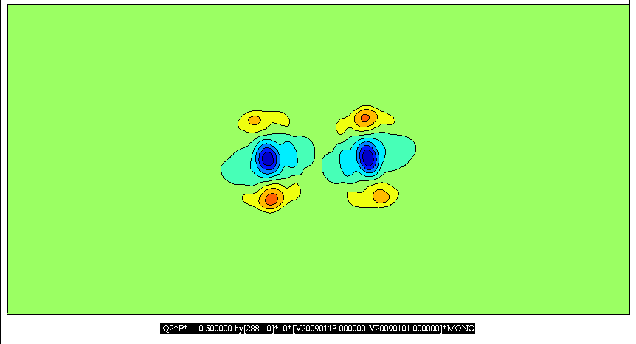
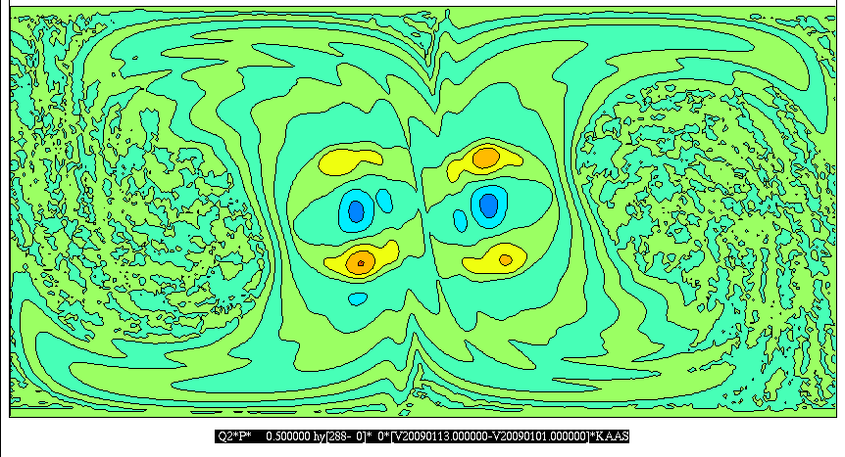
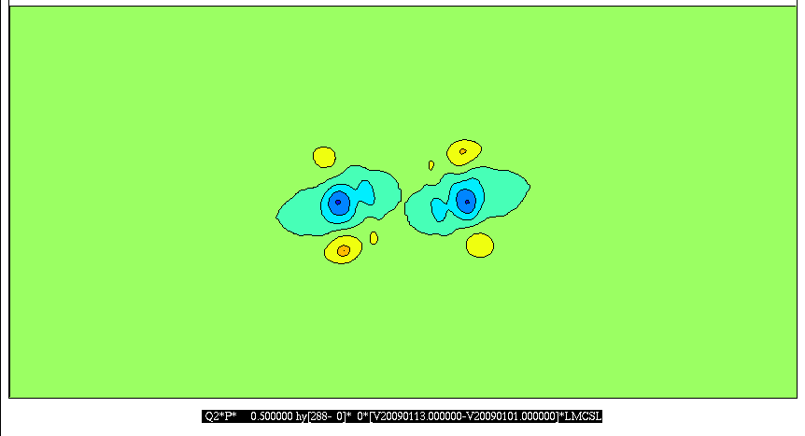
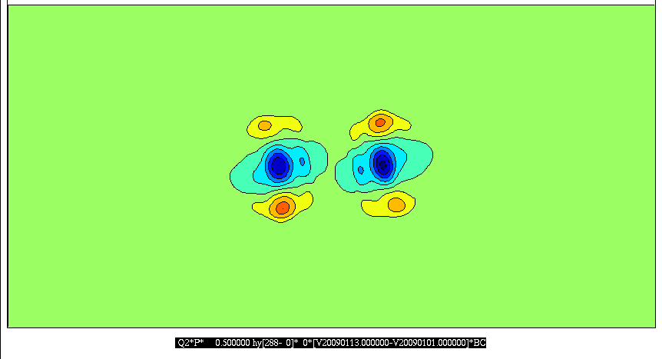
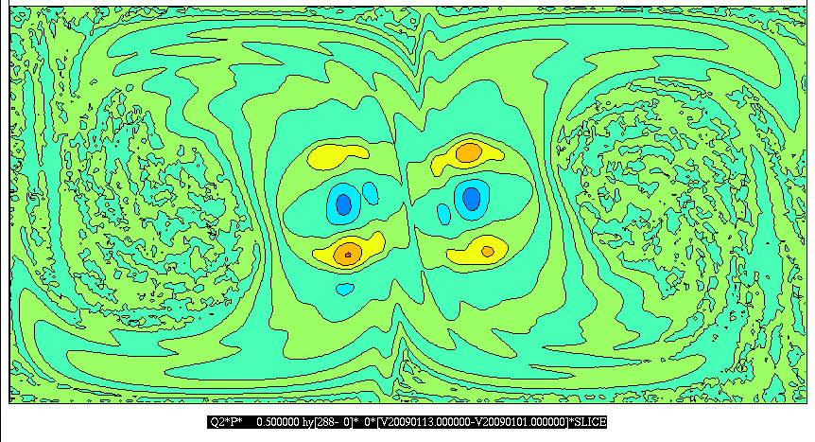
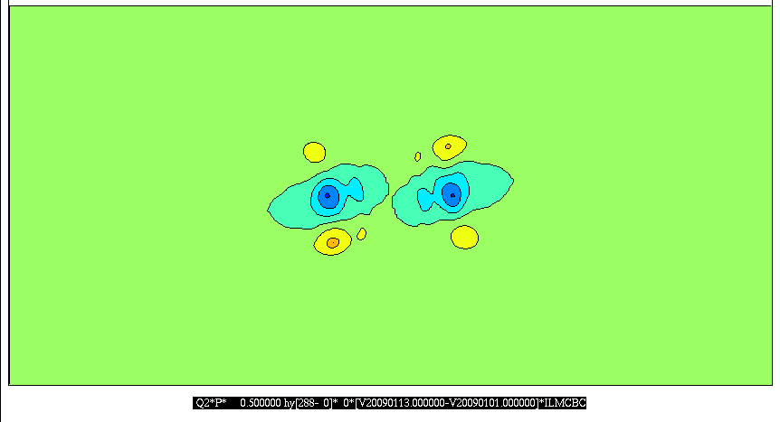
Advection 2D: Tracer Q2: Errors
t=12d
Cubic
Cubic + ILMC
Mono
Kaas
Kaas + ILMC
Mono BC
Slice
Slice + ILMC
ILMC BC

Slide 21
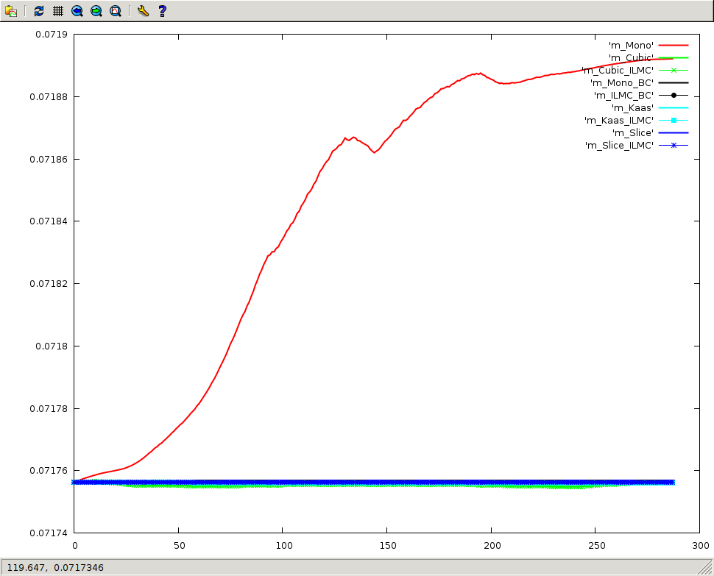
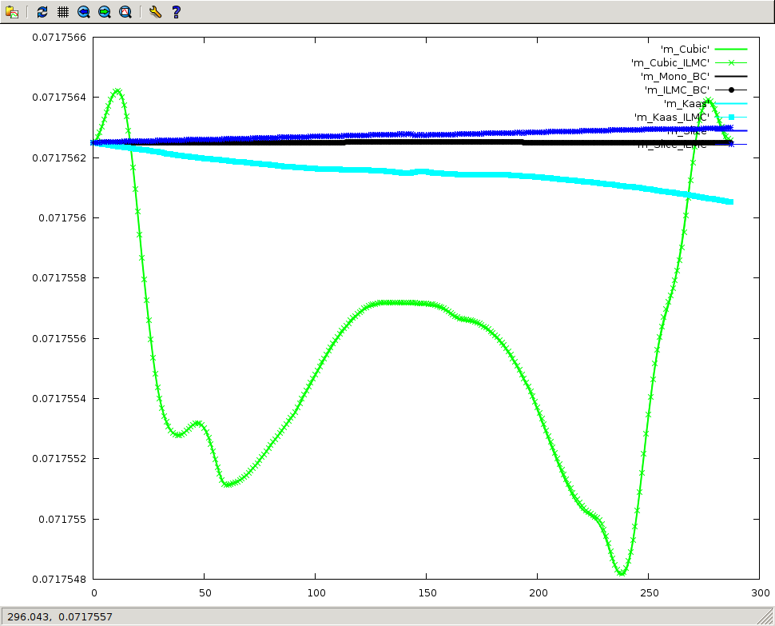
Advection 2D: Tracer Q2: Masses in time
No change in mass with
Mono BC and ILMC BC
Slice and Slice+ILMC
Kaas and Kaas+ILMC
Gain in mass with
Mono
Cubic and
Cubic+ILMC
Blow up without Mono
Small change in mass in Kaas and Slice due to use of Cubic interpolation at Poles

Slide 22
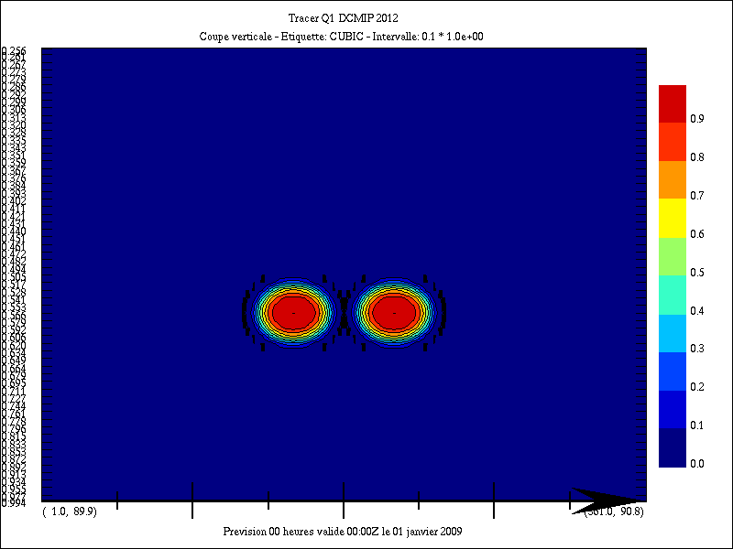
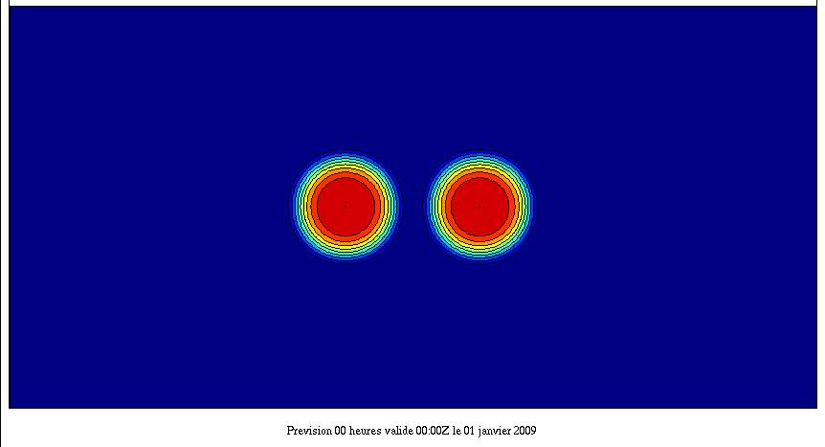
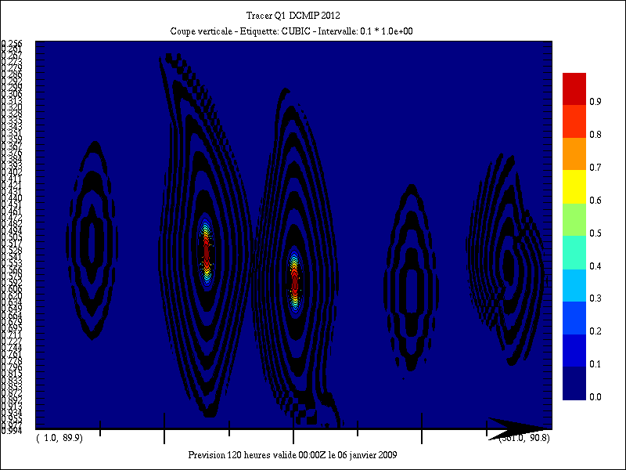
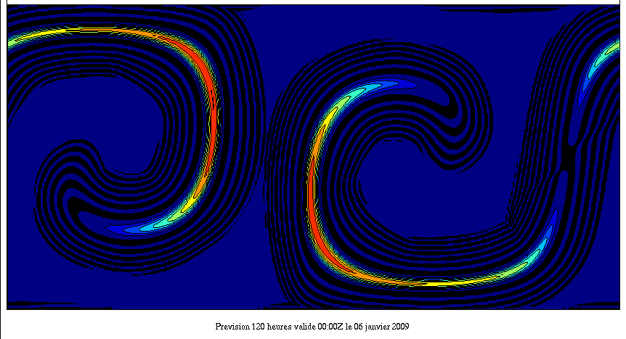
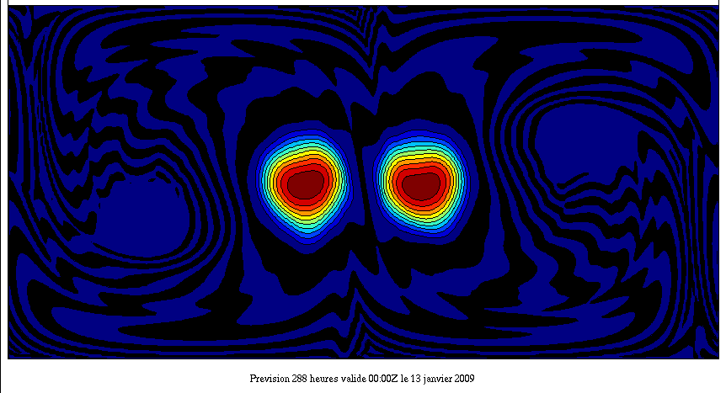
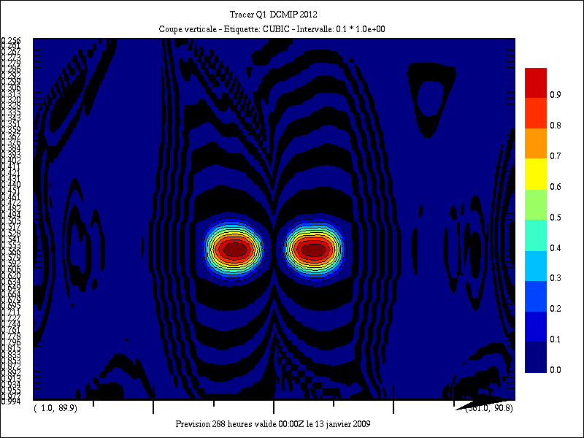
Advection 3D: DCMIP 2012: Tracer Q1
Resolution 360x180x60 DT=3600 s
Q1
Level 0.565829
Cubic
Q3
Vertical Slice at Equator
Divergent
reversal winds
t=0
t=5d
t=12d

Slide 23
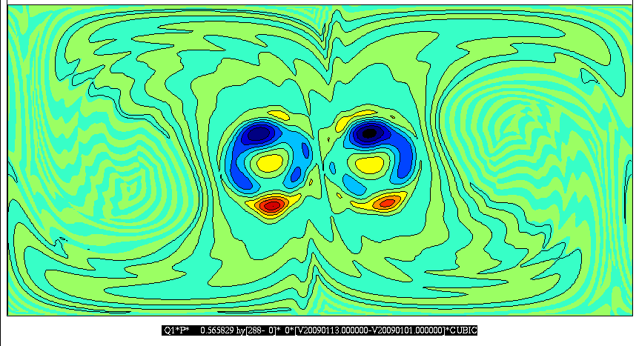
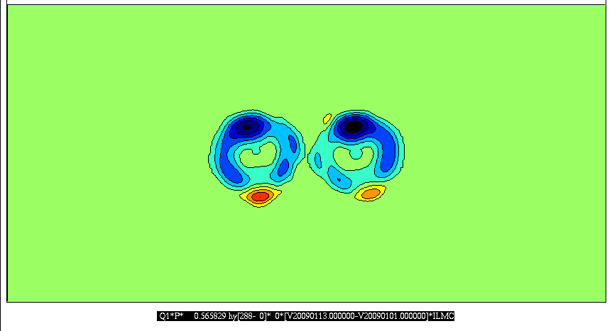
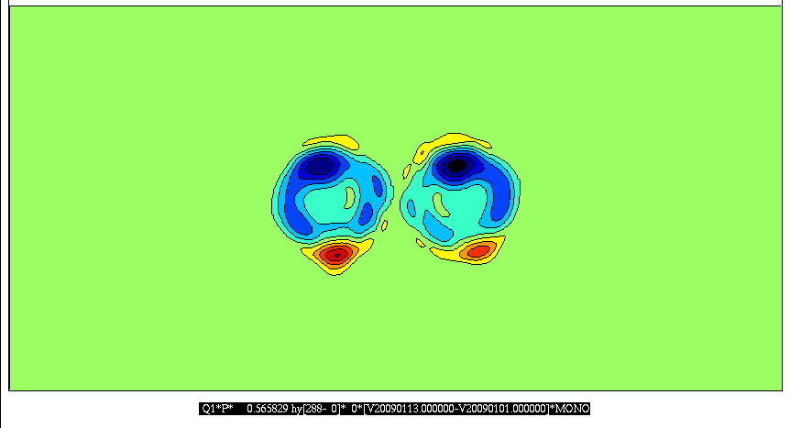
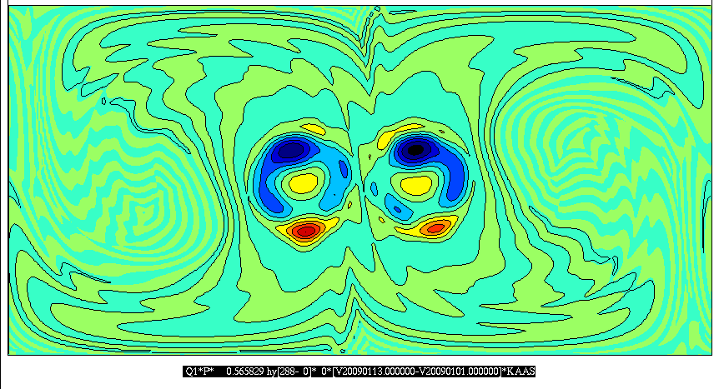
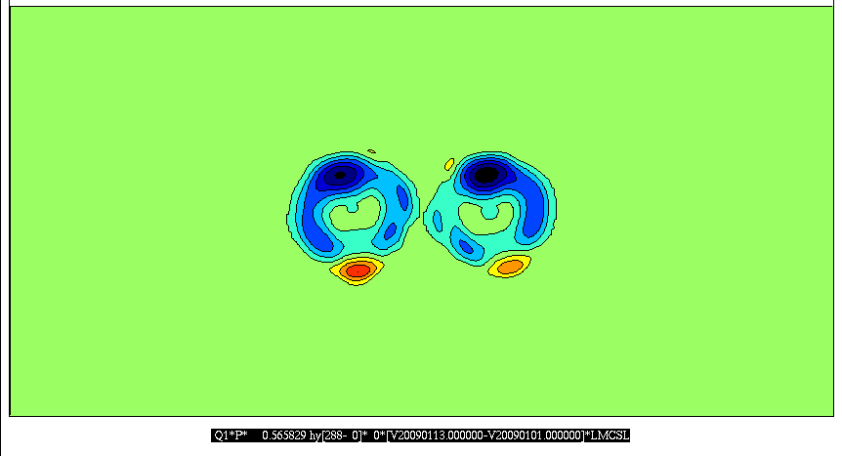
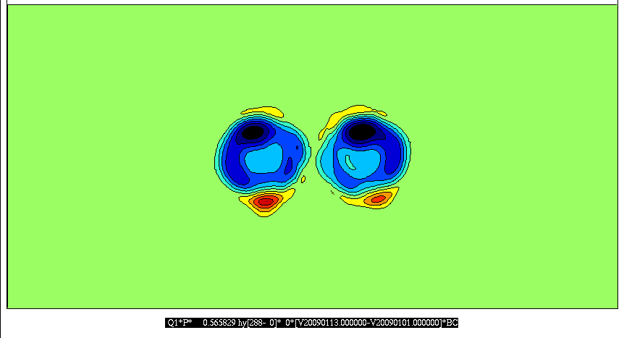
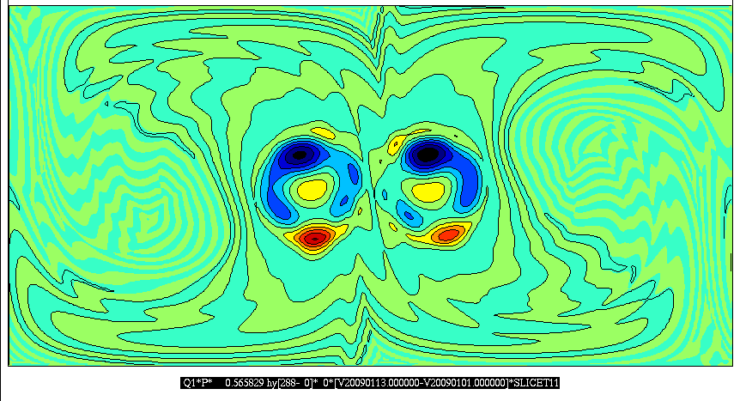
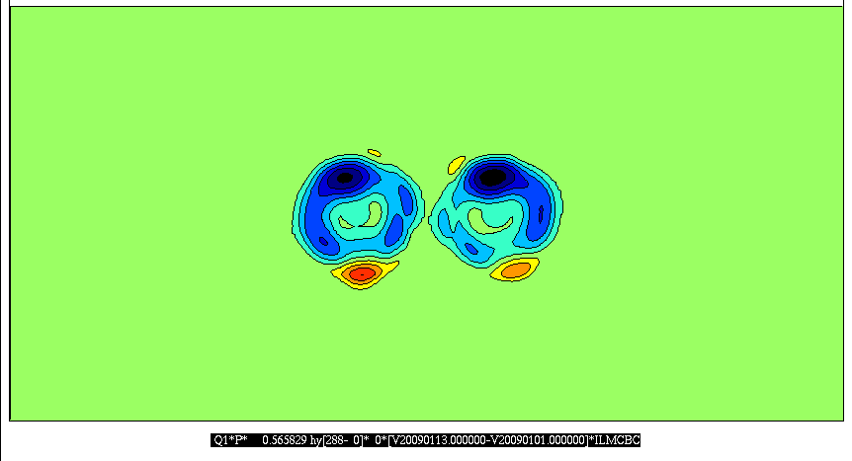
Advection 3D: Tracer Q1: Errors
t=12d
Level 0.565829
Cubic
Cubic + ILMC
Mono
Kaas
Kaas + ILMC
Mono BC
Slice
Slice + ILMC
ILMC BC

Slide 24
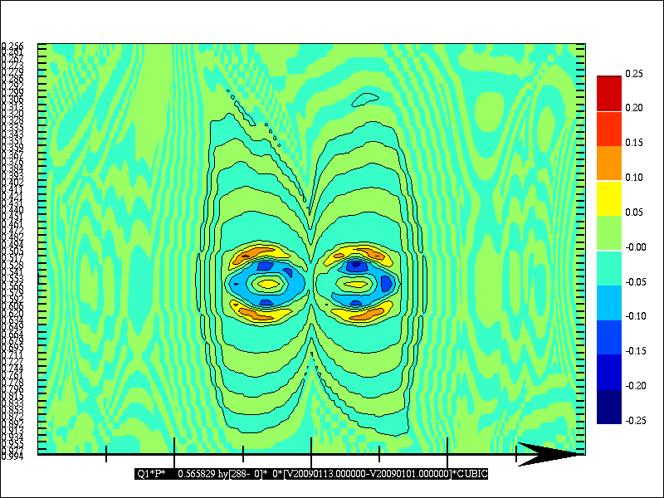
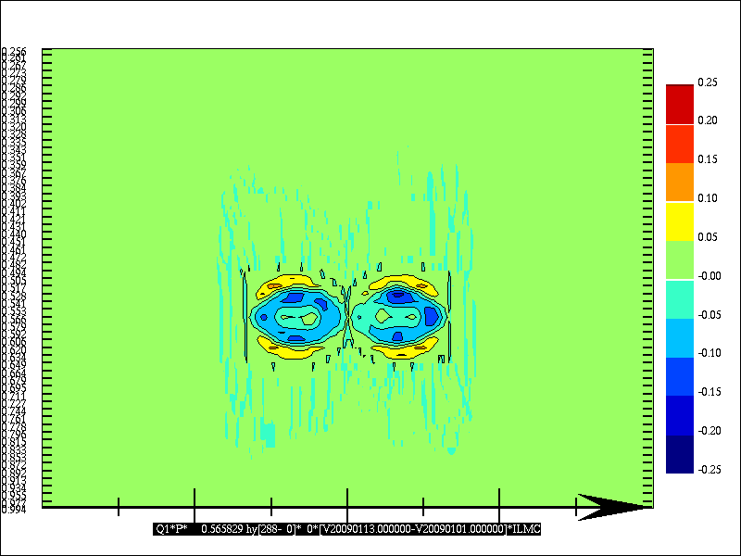
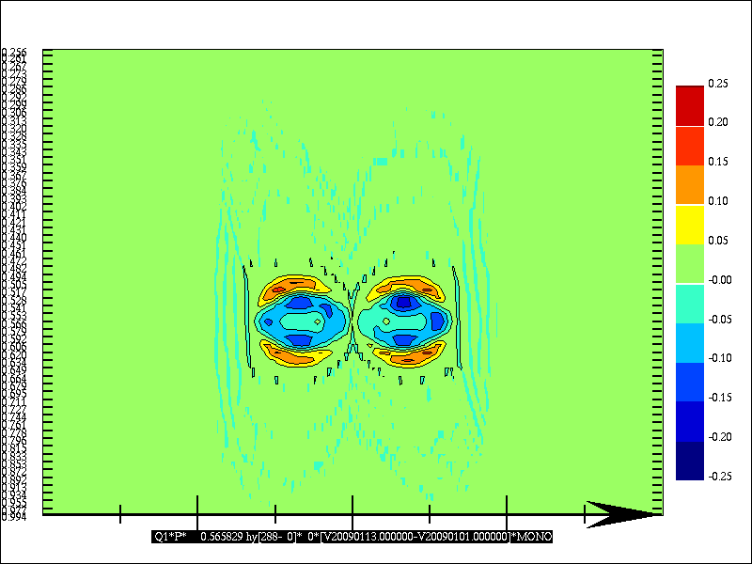
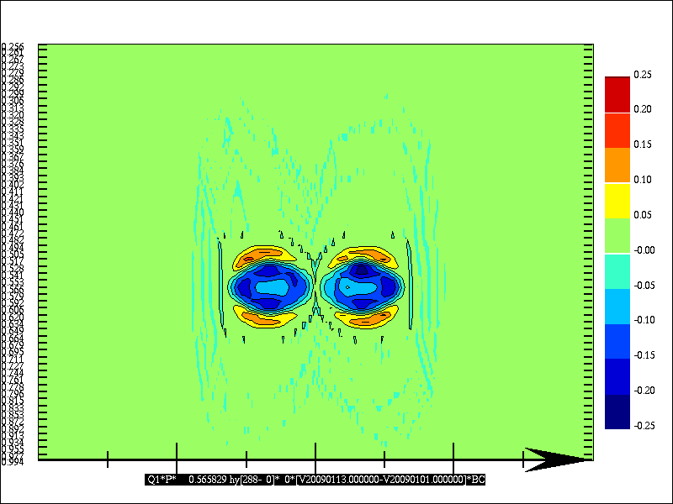
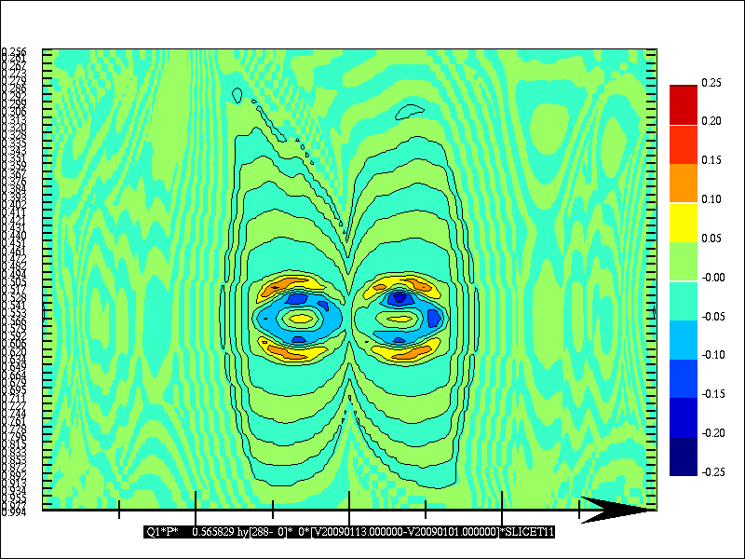
Advection 3D: Tracer Q1: Errors
t=12d
Vertical Slice at Equator
Cubic
Cubic + ILMC
Mono
Kaas
Kaas + ILMC
Mono BC
Slice
Slice + ILMC
ILMC BC

Slide 25
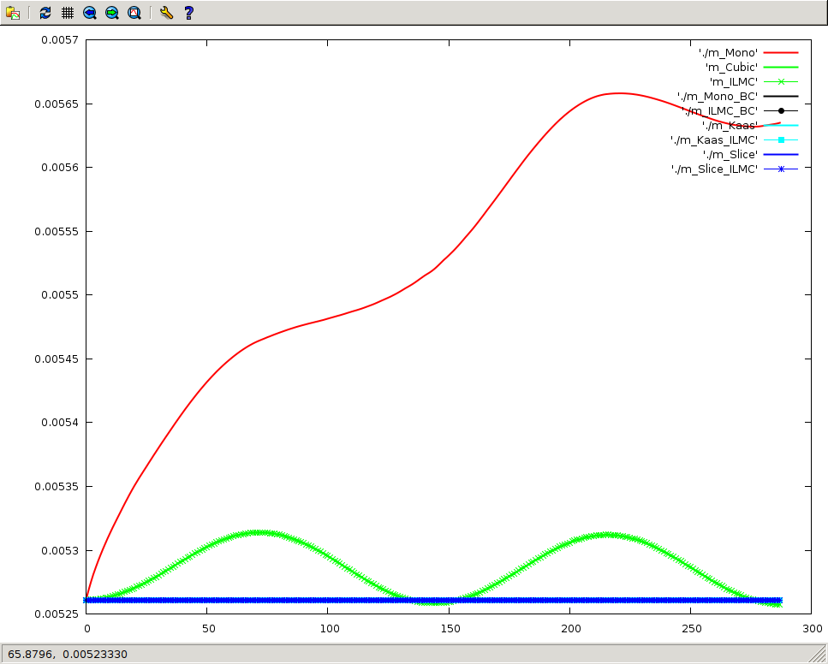
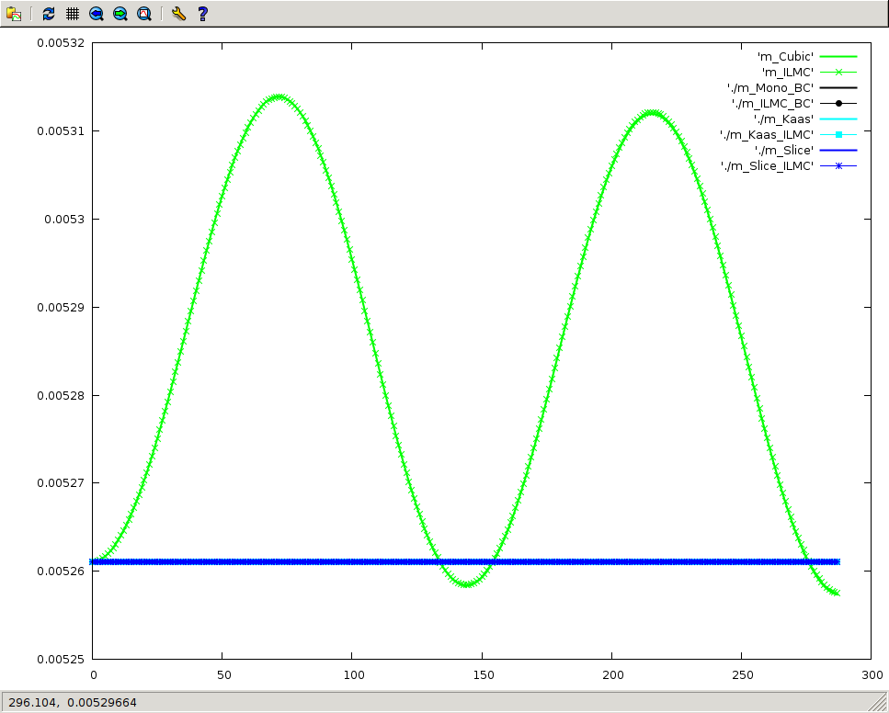
Advection 3D: Tracer Q1: Masses in time
Cubic and
Cubic+ILMC
Gain in mass with Mono
Cubic and
Cubic+ILMC
Blow up without Mono
The others
No change in mass with
The others

Slide 26
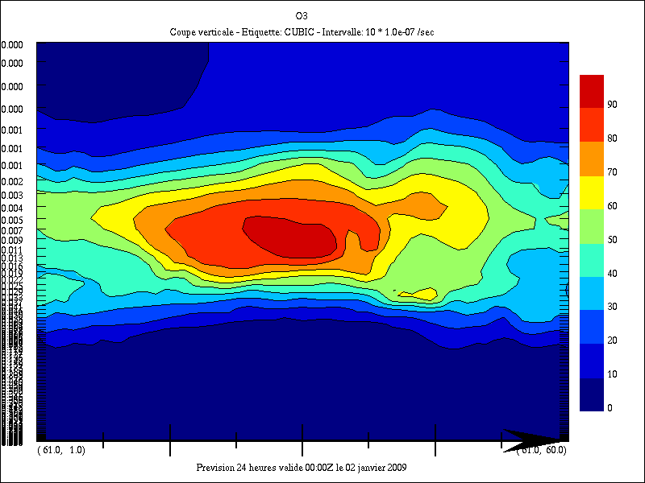
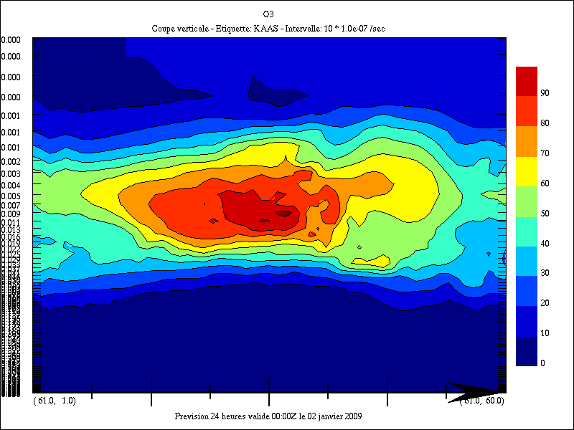
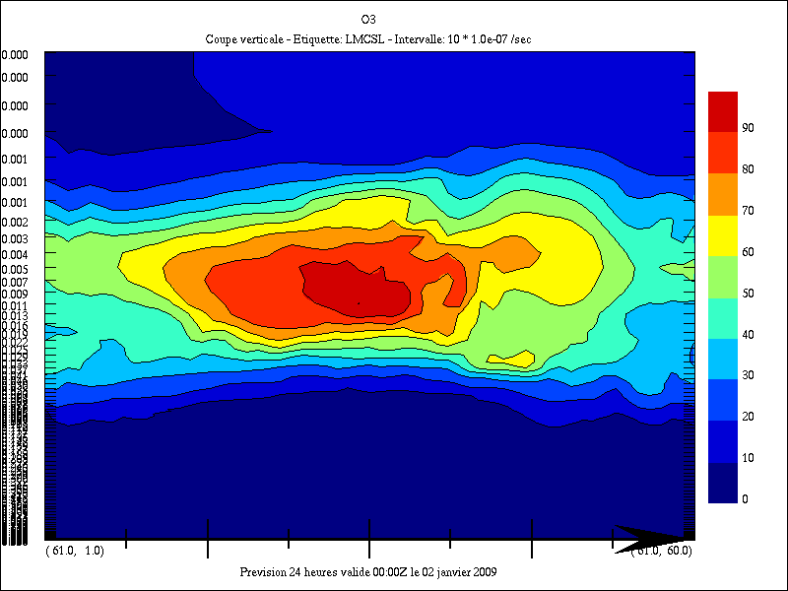
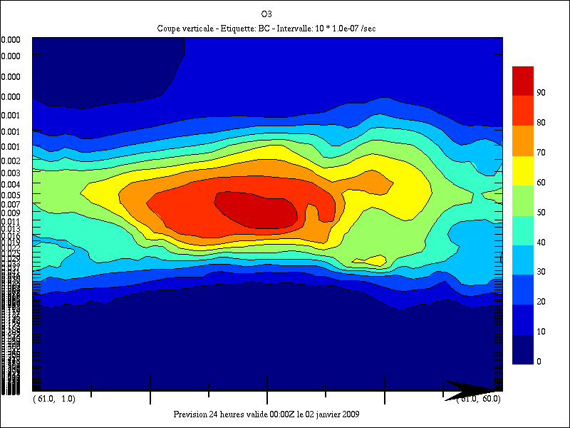
1 day Forecast with Physics (no Chemistry): Tracer O3:
Resolution 120x60x80 DT=1800 s
Cubic
Cubic + ILMC
Mono
Kaas
Kaas + ILMC
Mono BC
Slice
Slice + ILMC
ILMC BC
Vertical Slice South-North

Slide 27
1 day Forecast with Physics (no Chemistry): Tracer O3: Masses in time
Gain in mass
with Mono
Gain in mass with
Cubic and Cubic+ILMC
Gain in mass with
Slice and Slice + ILMC
No change in mass with
Mono BC and ILMC BC
Lost in mass with
Kaas and Kaas + ILMC
More Testcases with vertical velocity w/o mountains required to consolidate Kaas and Slice
Need to regularize the divergence that is implied by the departure points in Kaas and Slice

Slide 28
Yin-Yang Grid for global Forecast
YIN
YAN
Yin-Yang
A two-way nesting method between two-limited area models; Qaddouri and Lee QJRMS 2011

Slide 29
Semi-Lagrangian on Yin-Yang grid
1-Extend each panel (Yin, Yang) by a halo (size depends on CFL_max),
2-Interpolate from other panel to the halos the fields and winds from previous time-step,
3-Do Semi-Lagrangian as usual in each panel. Goto 2

Slide 31
zero minimal-overlap

Slide 32
computing mass in the overlap Zerroukat ( UKMetO)

Slide 33
Weight computation Zerroukat

Slide 34
Advection 2D: Mono Bermejo-Conde: Global versus Yin-Yang
Global
Masses in time
Yin-Yang
Yin-Yang
Global
Errors Q2
t=12d

Slide 35
Experiments
GEM 4.6.0 – rc6
Based on the GDPS config with Δt=30 min & psadj=on
Global Uniform (360x180)
Yin Yang (319x107) – minimum overlap – no blending
Linearized chemistry (O₃ , CH₄) – non interactive
Mass fixers : BC (ILMC monotonicity) – tracers only
4 runs:
1) GEM Lat-Lon (GU) – 11y
2) GEM Lat-Lon + Mass fixers (GUF) – 11y
3) GEM Yin Yang (GY) – 3y
4) GEM Yin Yang + Mass fixers (GYF) -3y
Same dynamics

Slide 36
GU

Slide 37
GU
GUF

Slide 38
(DU)
GUF - GU

Slide 39
Column Ozone (DU)
3 Year zonal mean time series

Slide 40
Total Ozone (DU)
GY
GYF

Slide 41
Column Ozone (DU)
GUF - GU
GYF - GY

Slide 42
GU
GY
GUF-GU
GYF-GY

Slide 43
O3 (ppbv) – July 2012
O3 (ppbv) - July 2012
GUF-GU
GYF-GY

Slide 44
Conclusions & next
Mass fixers can be used to diagnose the deficiency of numerical schemes:
S-L transport on the Yin-Yang grid system ensure better mass conservation for ozone. For methane, the impact is neutral.
Next:
Impact of Horizontal diffusion
Evaluation of ILMC in GEM-MACH-v2 (GEM4 based)
GEM-MACH-Global and mass fixers

Slide 45
REFERENCES
Bermejo R., and J.Conde, 2002: A conservative quasi-monotone semi-Lagrangian scheme, Mon.Wea.Rev., 130, 423-430.
Gravel S,. and A.Staniforth, 1994: A mass-conserving semi-Lagrangian scheme for the Shallow-Water equations, Mon.Wea.Rev., 122, 243-248
Kaas, E., 2008: A simple and efficient locally mass conserving semi-Lagrangian transport scheme, Tellus, 60A, 305-320.
Kent, J., P.A.Ullrich, and C.Jablonowski, 2013: Dynamical core model intercomparison project: Tracer transport test cases, Q.J.R.Meteorol.Soc., DOI: 10.1002/qj.2208
Laprise, R., and A.Plante, 1995: A class of semi-Lagrangian integrated-Mass (SLIM) numerical transport algorithms, Mon.Wea.Rev.,123,553-565
Lauritzen, P.H., and J.Thuburn, 2012: Evaluating advection/transport schemes using interrelated tracers, scatter plots and numerical mixing diagnostics, Q.J.R.Meteorol.Soc., 138, 665, 906–918
Mahidjiba, A., A.Qaddouri, J.Côté, 2008: Application of the semi-Lagrangian inherently conserving and efficient (SLICE) transport method to divergent flows on a C grid, Mon.Wea.Rev., 136, 4850-4866
Sorensen, B., E.Kaas, and U.S.Korsholm, 2013: A mass-conserving and multi-tracer efficient transport scheme in the online integrated Enviro-HIRLAM model, Geosci. Model Dev., 6, 1029-1042
Zerroukat, M., and T.Allen, 2012: A three-dimensional monotone and conservative semi-Lagrangian (SLICE-3D) for transport problems, Q.J.R.Meteorol.Soc., 138, 1640–1651
Zerroukat, M., 2006: SLICE-3D: A three-dimensional conservative semi-Lagrangian scheme for transport problems, SRNWP-NT, Zagreb (Presentation)

