Slide 1
Implementation of 4D-EnVar and other data assimilation improvements in the GDPS (and RDPS), version 4.0.0
Mark Buehner
Pre-CPOP seminar
April 11, 2014

Slide 2
Major Contributions from:
ARMA:
Stéphane Laroche
Louis Garand
Sylvain Heillette
Stephen MacPherson
Ervig Lapalme
Cecilien Charette
CMDA:
Josée Morneau
Pierre Koclas
Judy St James
Manon Lajoie
Réal Sarrazin
RPN:
Ron McTaggart-Cowan
Martin Charron
CMDS:
Yves Chartier
Vincent Vu
Reine Parent
Michel Van Eeckhout
… and many others!

Slide 3
Upgrade to deterministic systems
Changes are mostly to the data assimilation systems (GDPS/RDPS):
4D-EnVar replaces 4D-Var
Model and Analysis grids:
  Analysis increment: 50km instead of 100km grid spacing
  Unchanged for background and analysis
Satellite radiance observations:
  Improved satellite radiance bias correction scheme
  Additional AIRS/IASI channels assimilated
  Upgrade RTTOV8 to RTTOV10
  Modified obs error stddev for all radiance observations
Improved treatment of radiosonde (4D) and aircraft observations
Assimilation of ground-based GPS data
Use of new global sea ice concentration analysis
4D-IAU and recycling of physics variables (GDPS only)
Use of Maestro for R/D/O

Slide 4
Ensemble-Variational assimilation: EnVar
EnVar uses a variational assimilation approach in combination with the already available 4D ensemble covariances from the EnKF
By making use of the 4D ensembles, EnVar performs a 4D analysis without the need of the tangent-linear and adjoint of GEM
Consequently, it is more computationally efficient and easier to maintain/adapt than 4D-Var
Hybrid covariances are used in EnVar by averaging the ensemble covariances with the static NMC-method covariances
Future improvements to EnKF will benefit both ensemble and deterministic forecasts→ incentive to increase overall effort on EnKF development

Slide 5
EnVar formulation
In 4D-Var the 3D analysis increment is evolved in time using the TL/AD forecast model (here included in H_{4D}):
In EnVar the background-error covariances and analysed state are explicitly 4-dimensional, resulting in cost function:

Slide 6
EnVar: a replacement for 4D-Var
Overall, global EnVar analysis (~10 min) is ~6X faster than 4D-Var (~1 hr) on half as many cpus (320 vs 640), even though much higher resolution increments (50km vs 100km)
Identical configuration of EnVar used for both global and regional systems (unified deterministic analysis)
Started to share modular fortran code between EnVar and EnKF, unification effort continuing (obs related)
For practical and scientific reasons, decision made to replace 4D-Var with more efficient EnVar in GDPS/RDPS, if results from EnVar are at least as good as current 4D-Var

Slide 7
Current operational systems
2013-2017: Toward a Reorganization of the NWP Suites at Environment Canada
Global ensemble forecasts (GEPS)
Regional
ensemble forecasts (REPS)
Global
EnKF
Global deterministic
forecast (GDPS)
Regional deterministic
forecast (RDPS)
Global
4D-Var
Regional
4D-Var
global system
regional system

Slide 8
2014 implementation: Increasing role of global ensembles
2013-2017: Toward a Reorganization of the NWP Suites at Environment Canada
Global ensemble forecast (GEPS)
Regional
ensemble forecast (REPS)
Global
EnKF
Background error covariances
Global deterministic forecast (GDPS)
Regional
deterministic forecast (RDPS)
Global
EnVar
Regional
EnVar
global system
regional system

Slide 9
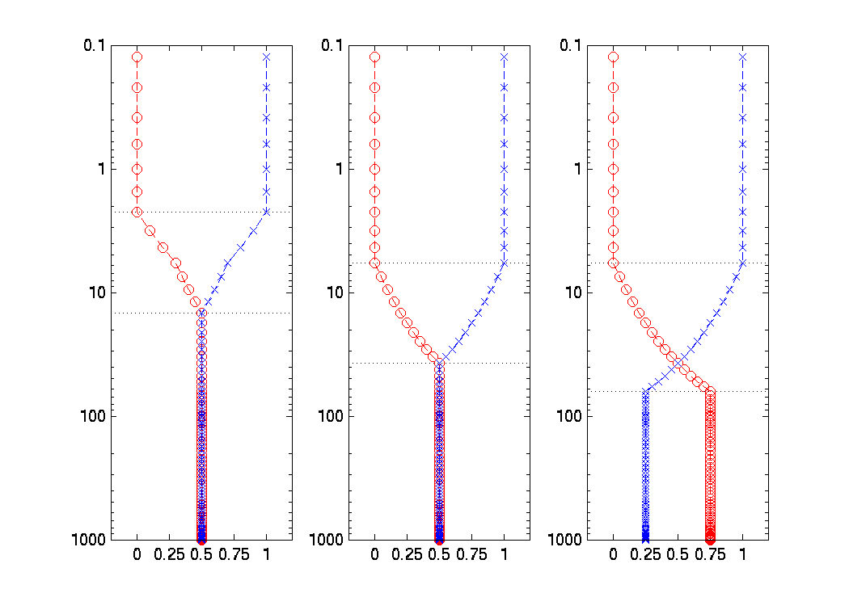
EnVar uses Hybrid Covariance Matrix
Model top of EnKF is lower than GDPS
Bens and Bnmc are averaged in troposphere ½ & ½, tapering to 100% Bnmc at and above 6hPa (EnKF model top at 2hPa)
Therefore, EnVar cannot be better than 3D-Var above ~10hPa !
Also, in some regions Bens has much smaller variances than Bnmc, so still dominated by Bnmc even though combined ½ + ½
pressure
Bens scale factor
Bnmc scale factor
scale factor

Slide 10
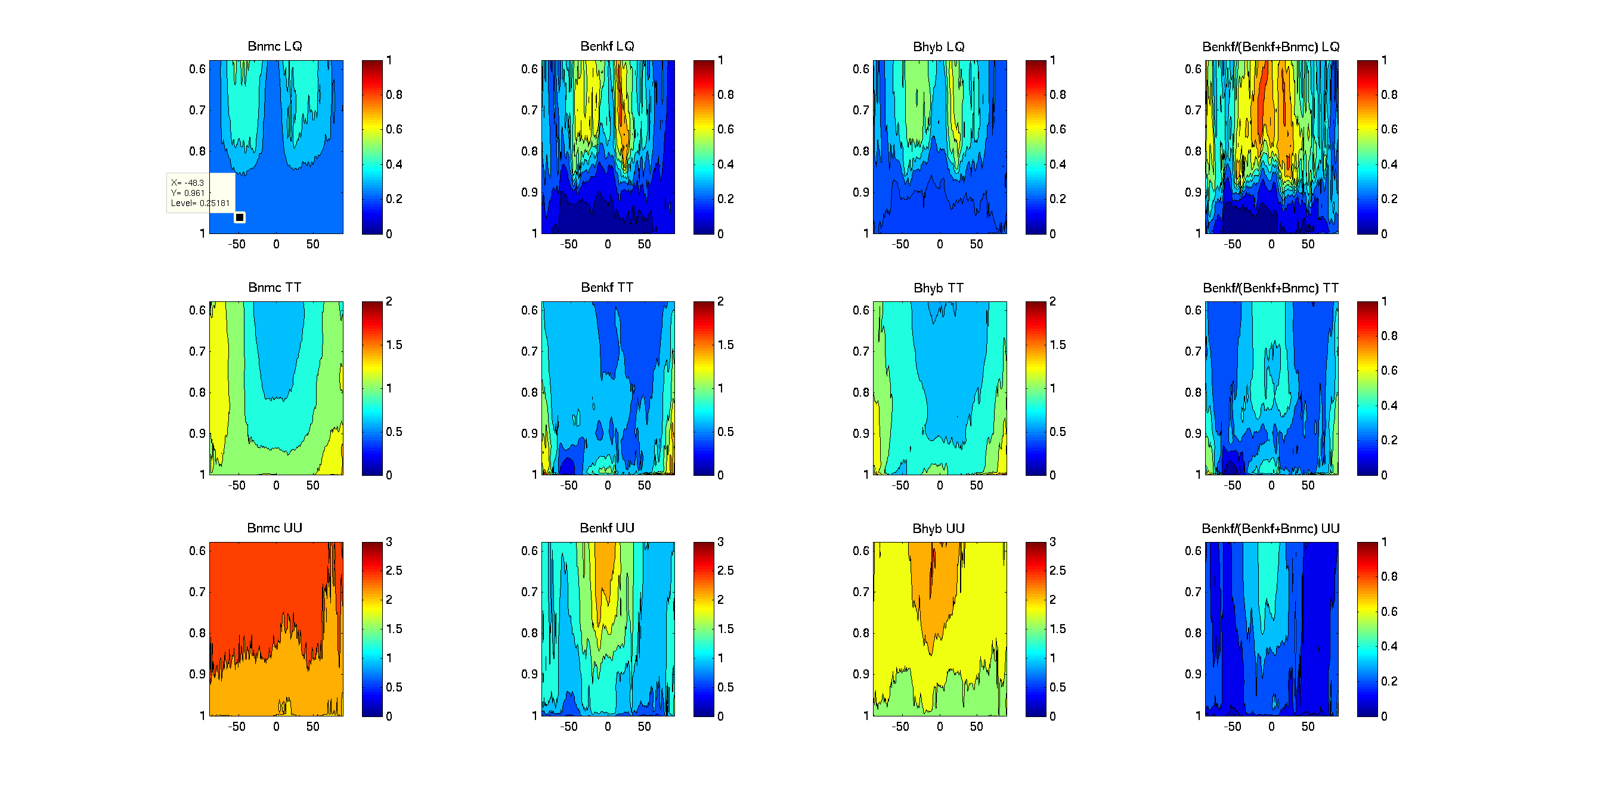
Bens vs. Bnmc
Ensemble spread much lower than Bnmc stddev in marine boundary layer
Background error stddev in marine boundary layer: Bens vs Bnmc
  LQ: 10% vs 25%
  TT: 0.2 vs 1.0
  UU: 0.5 vs 2.0

Slide 11
Dependencies between global systems
Current system (1-way dependence):
GEPS relies on GDPS to perform quality control (background check) for all observations and bias correction for satellite radiance observations
GDPS:
x_{b}
x_{b}, obs
x_{a}
x_{b}
Bgcheck+BC
4D-Var
GEM (9h fcst)
obs
GEPS:
x_{b}
x_{a}
x_{b}
EnKF
GEM (9h fcst)

Slide 12
Dependencies between global systems
Current system (1-way dependence):
With EnVar (2-way dependence):
2-way dependence (EnVar uses EnKF ensemble of background states) increases complexity of overall system → 2 systems have to be run simultaneously
GDPS:
x_{b}
x_{b}, obs
x_{a}
x_{b}
Bgcheck+BC
4D-Var
GEM (9h fcst)
obs
GEPS:
x_{b}
x_{a}
x_{b}
EnKF
GEM (9h fcst)
GDPS:
x_{b}
x_{b}, obs
x_{a}
x_{b}
Bgcheck+BC
EnVar
GEM (9h fcst)
x_{b}
obs
GEPS:
x_{b}
x_{a}
x_{b}
EnKF
GEM (9h fcst)

Slide 13
Results showing impact from only replacing 4D-Var (or 3D-Var) with EnVar: global forecasts
(Buehner et al., NPG 2013)

Slide 14
Forecast Results: EnVar vs. 4D-Var
Radiosonde verification scores – 6 weeks, Feb/Mar 2011
6h forecast
North Tropics South
bias
stddev
zonal wind temperature

Slide 15
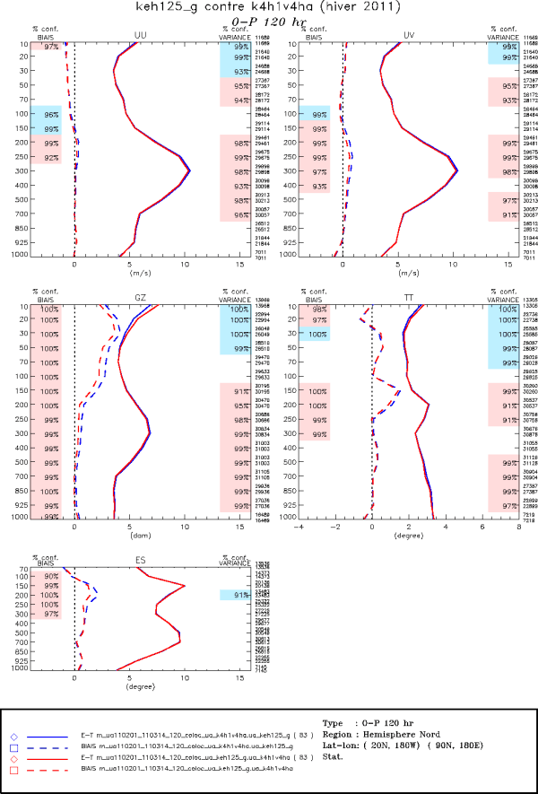
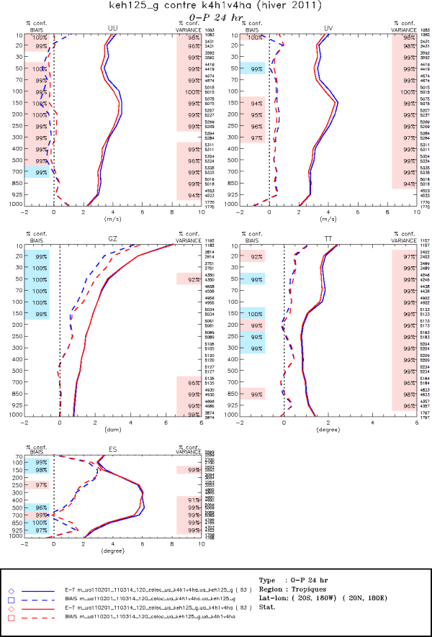
Forecast Results: EnVar vs. 4D-Var
Radiosonde verification scores – 6 weeks, Feb/Mar 2011
U
|U|
U
|U|
GZ
T
GZ
T
EnVar vs. 4D-Var
120h forecast
North extra-tropics
EnVar vs. 4D-Var
24h forecast
Tropics
T-T_{d}
T-T_{d}

Slide 16
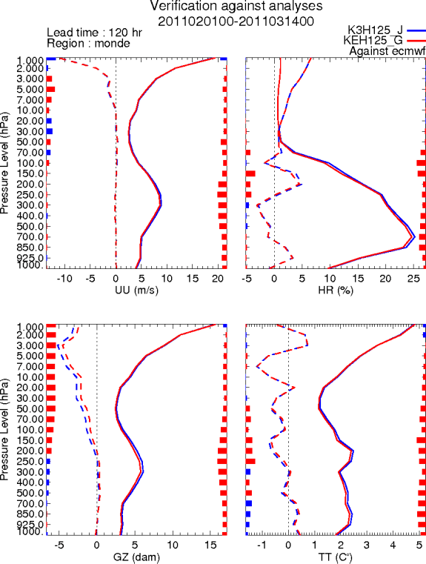
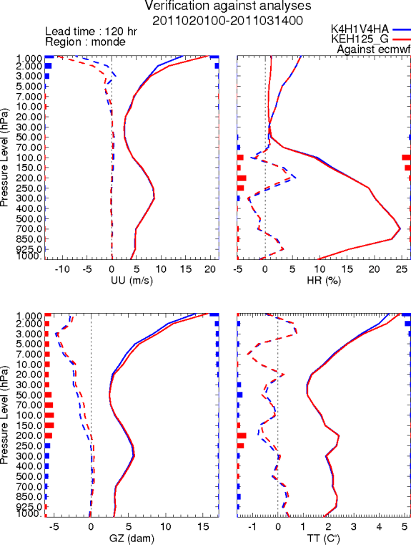
Forecast Results: EnVar vs. 3D-Var and 4D-Var
Verification against ERA-Interim analyses – 6 weeks, Feb/Mar 2011
120h forecast, global domain
EnVar vs. 3D-Var EnVar vs. 4D-Var
no EnKF
covariances
no EnKF
covariances
transition
zone
transition
zone
½ EnKF and
½ NMC
covariances
½ EnKF and
½ NMC
covariances
U
RH
U
RH
GZ
T
GZ
T

Slide 17
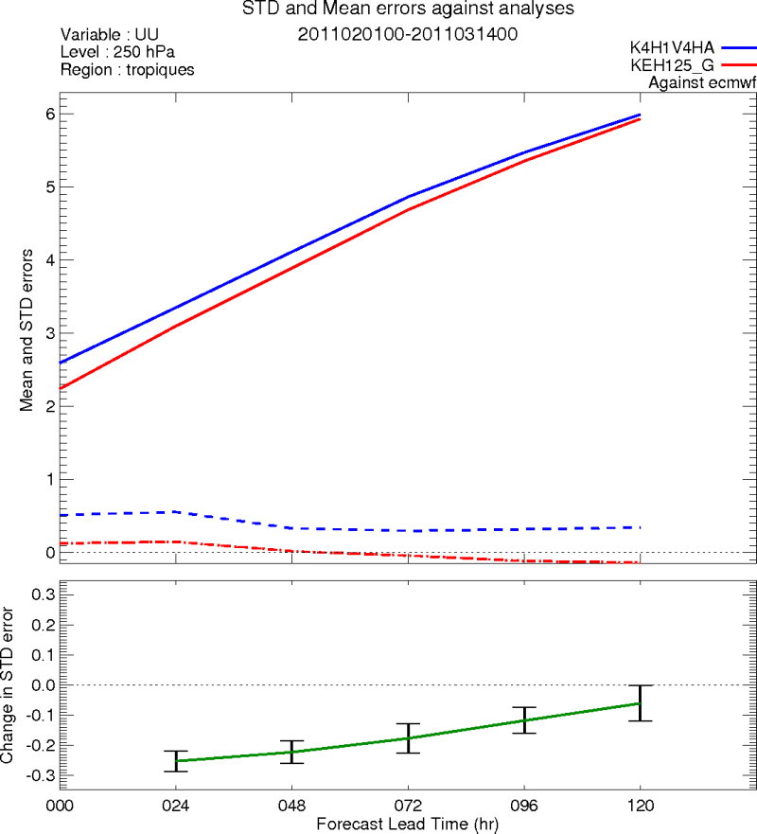
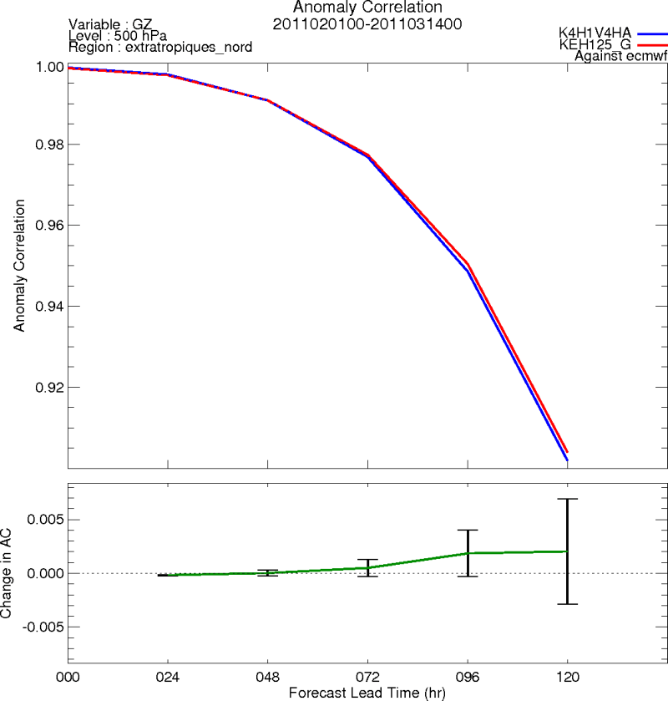
Forecast Results: EnVar vs. 4D-Var
Verification against ERA-Interim analyses – 6 weeks, Feb/Mar 2011
North extra-tropics
500hPa GZ correlation anomaly
Tropics
250hPa U-wind STDDEV
EnVar vs. 4D-Var
EnVar vs. 4D-Var

Slide 18
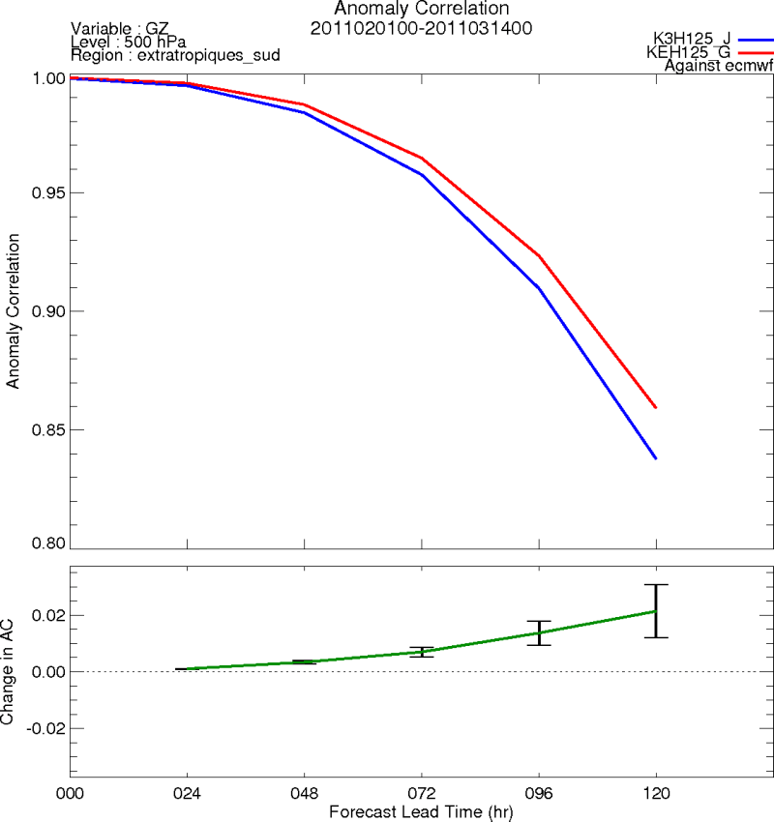
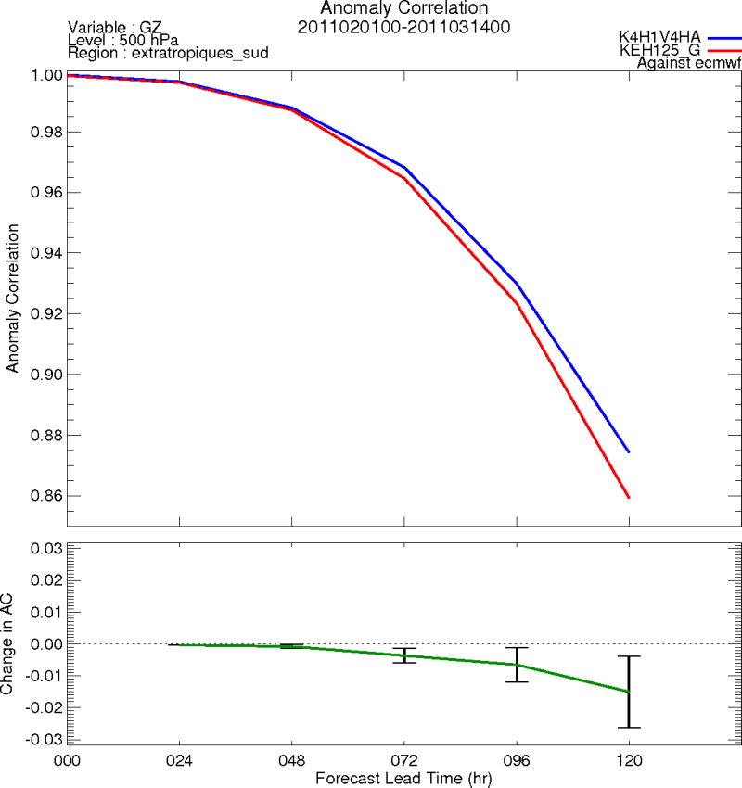
Forecast Results: EnVar vs. 3D-Var and 4D-Var
Verification against ERA-Interim analyses – 6 weeks, Feb/Mar 2011
South extra-tropics
500hPa GZ correlation anomaly
EnVar vs. 3D-Var EnVar vs. 4D-Var
This is the only significant degradation seen in troposphere vs. 4D-Var

Slide 19
Additional data assimilation improvements to GDPS (and RDPS)

Slide 20
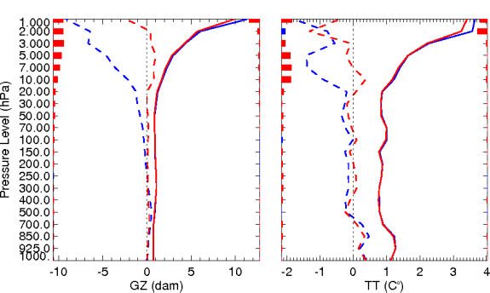
New satellite radiance bias correction approach
Current approach uses background state as reference state for bias correction, i.e. background state assumed unbiased
New approach: Perform an extra 3D-Var analysis that assimilates only: radiosonde, GPS-RO, aircraft, AMV, surface obs, scatterometer
This analysis is ONLY used as the reference state for computing the bias correction (instead of the background state)
Allows conventional data and GPS-RO (instead of the forecast model) to have the last word for establishing the reference state for bias correction
24h global forecast vs ERA-interim
New approach (uses 3D-Var analysis)
Old approach (uses background state)
GZ
T

Slide 21
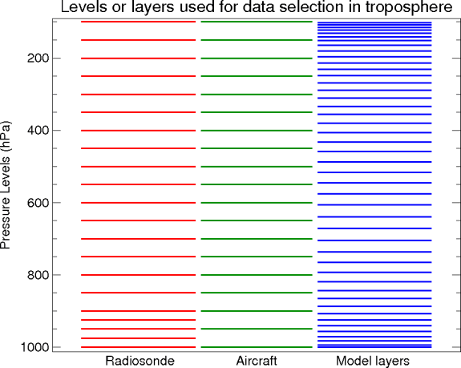
Upgrades to Processing and Assimilation of Radiosonde and Aircraft Data
(Laroche and Sarrazin, W&F, 2013)
Increased volume of data: selection of observations according to model levels.
Revised observation error statistics.
Horizontal drift of radiosonde balloon and acquisition time taken into account in both data assimilation and verification systems → 4D.
Bias correction scheme for aircraft temperature reports.
Bias correction scheme for radiosonde temperature and humidity under development.
Proposed
for both
Radiosonde &
Aircraft
Operational

Slide 22
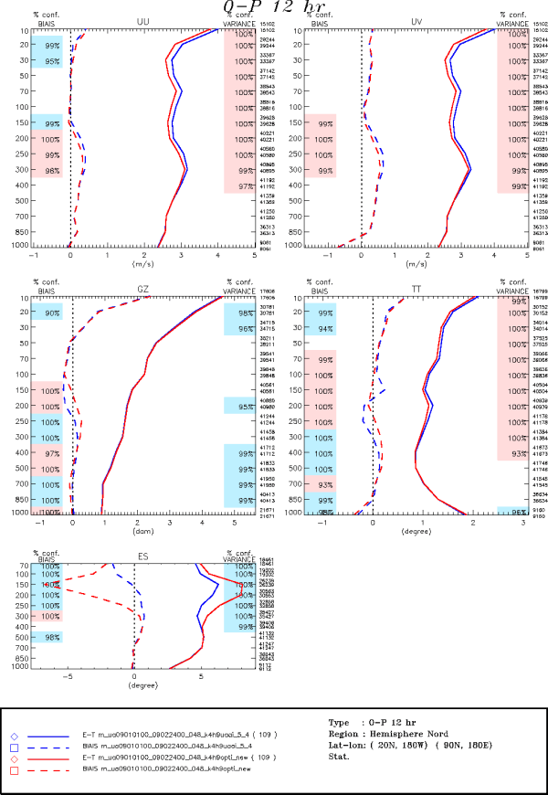
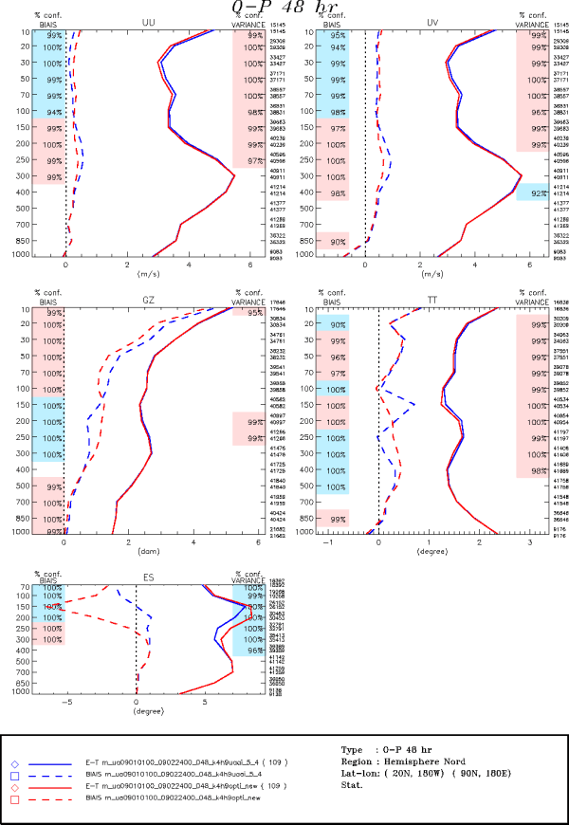
Verification Scores against Radiosondes for the GDPS over the Northern Hemisphere for January and February 2009
Upgrades to Processing and Assimilation of Radiosonde and Aircraft Data
General short-range forecast improvements above 500 hPa in both wind and temperature fields.
The temperature forecast biases are significantly improved due to the bias correction scheme for aircraft below 200 hPa and to the new rejection criteria for radiosonde humidity data above.
Wind module
Temperature
12h
48h

Slide 23
Revision of AIRS/IASI channel selection
cm-1 | Spectral bands | 2008 4DVar |  | 2011 4DVar |  | 2014 EnVar
 |  | AIRS | IASI | AIRS | IASI | AIRS | IASI
650-770 | T sounding (peak higher than 80mb) | 0 | 0 | 0 | 0 | 0 | 0
 | T sounding (80mb < peak < 150mb) | 0 | 0 | 0 | 0 | 28 | 30
 | T sounding (peak lower than 150mb) | 20 | 0 | 20 | 43 | 34 | 45
770-980 | Surface, low peaking T, RH sounding | 6 | 0 | 6 | 19 | 12 | 19
980-1070 | Ozone sounding | 0 | 0 | 0 | 0 | 0 | 0
1070-1310 | Surface and cloud properties | 4 | 0 | 4 | 0 | 8 | 6
1310-2035 | Water vapor & temperature sounding | 33 | 0 | 33 | 0 | 32 | 33
2035-2175 | CO column amount | 0 | 0 | 0 | 0 | 0 | 0
2175-2250 | Temperature sounding (N₂O band) | 9 | 0 | 9 | 0 | 13 | 9
2250-2420 | Temperature sounding (CO₂ Band) | 15 | 0 | 15 | 0 | 15 | 0
2420-2700 | Surface and cloud properties | 0 | 0 | 0 | 0 | 0 | 0
 | Total volume assimilated (Million/day) | 87 0.7 | 0 0 | 87 0.7 | 62 0.5 | 142 1.8 | 142 2.0

Slide 24
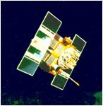
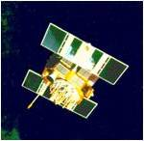

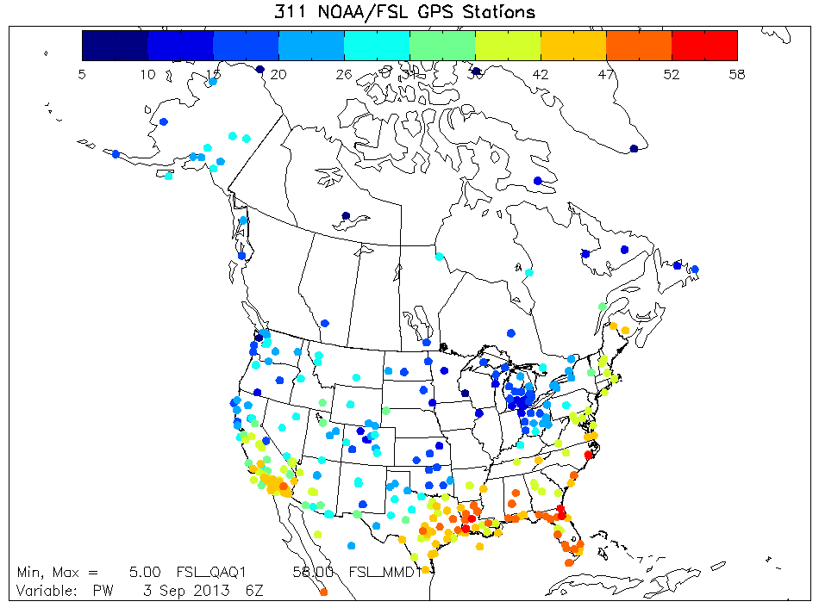
Assimilation of GB-GPS Data over North America
(Stephen Macpherson)
Data available every 30 minutes. Network uses mostly existing (NGS geodesy) GPS site infrastructure with some additional sites installed and maintained by NOAA. GPS MET from nearby SYNO/METAR at ~50% of sites.
Like NOAA wind profiler network, still a “demonstration” network although GPS PW data are assimilated operationally in NCEP regional models. FSL plans to transfer network to OPS.
More GPS sites in Canada could be added (with assistance from Environment Canada).
zenith
mapping function
delay due atmosphere N(z)
GPS Receiver

Slide 25
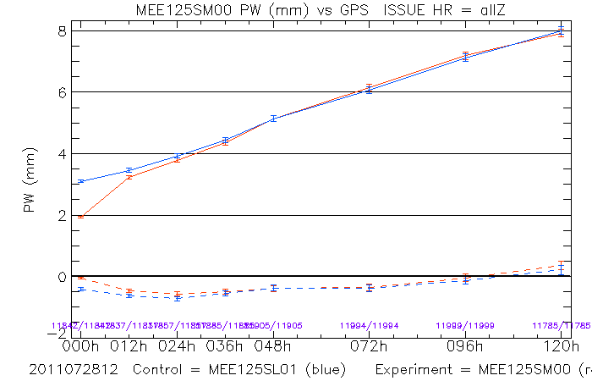
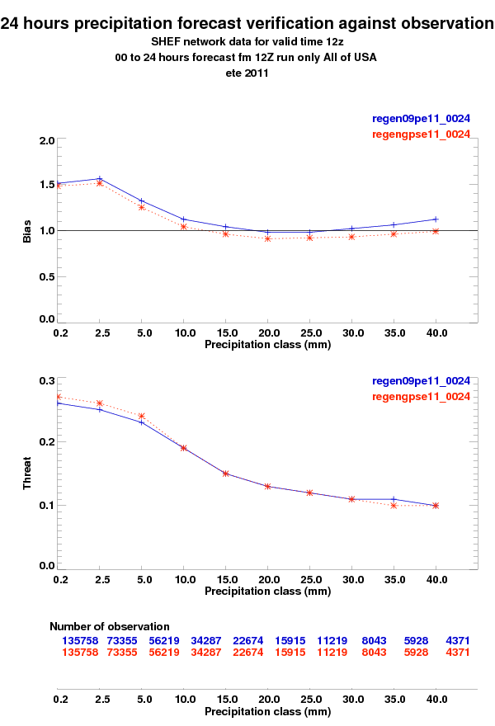
Assimilation of GB-GPS Data over North America
PW verification against GPS observations over North America for the GDPS (summer)
Positive impact on analysis and forecast HU (PW) when verified against GB-GPS observations, mainly in the short range (days 1-2).
GB-GPS data help reduce moist bias in EnVar HU analysis over some regions of USA and Mexico.
RDPS 24h PR accumulation forecast scores improved, mostly in classes < 20 mm and for 00-24h period; overall PR is reduced (due to reduced PW), which helps reduce the positive PR bias of the model.
Overall impact is less in winter but still evident in the warmer, more humid regions of North America.
Data from other GPS networks (E-GVAP) will be added in the future.
0h-24h precipitation bias and threat scores over the USA for the RDPS (summer)

Slide 26
Results showing total impact from all proposed changes
(GDPS 4.0.0 vs. GDPS 3.0.0)
Verification against radiosonde observations (1D or 4D)

Slide 27
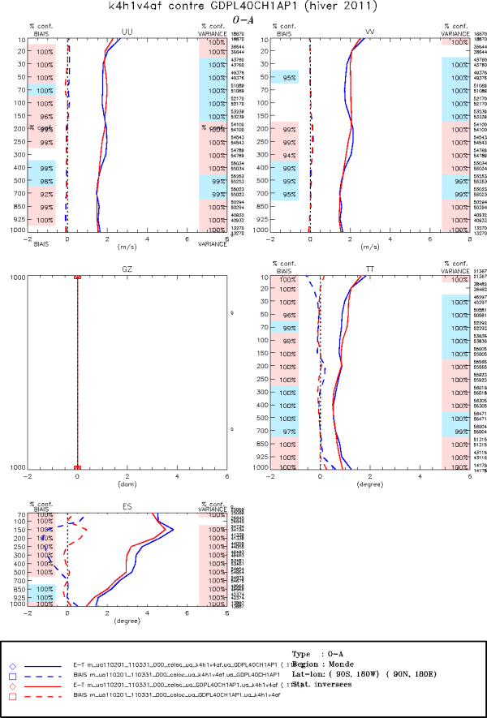
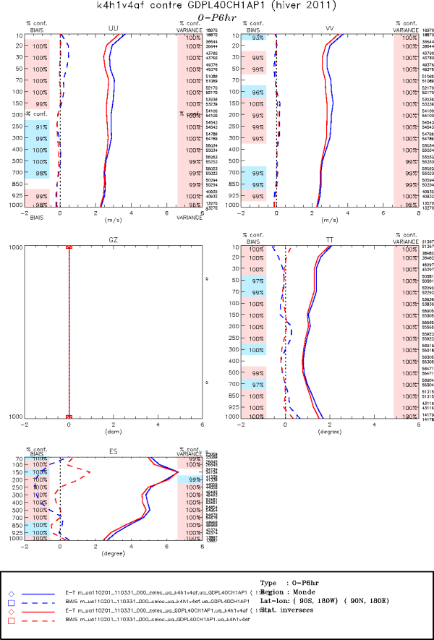
Forecast Results: GDPS 4.0.0 vs GDPS 3.0.0
Verification vs. (1D/4D) Radiosondes – Feb-March, 2011, World
Anl-Obs
P6h-Obs
U
V
U
V
T
T
T-T_{d}
T-T_{d}

Slide 28
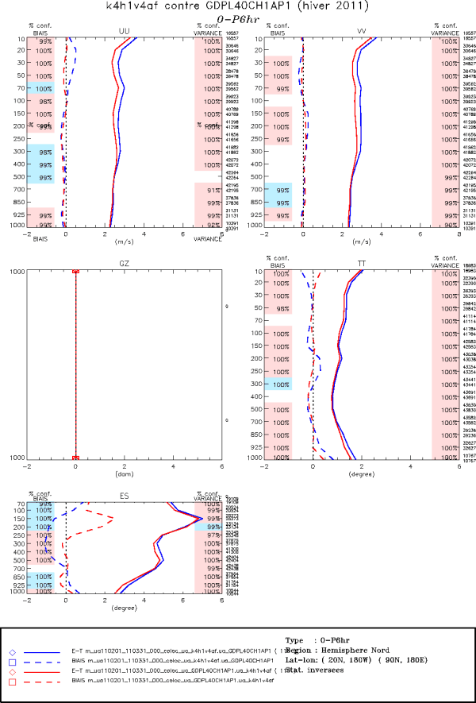
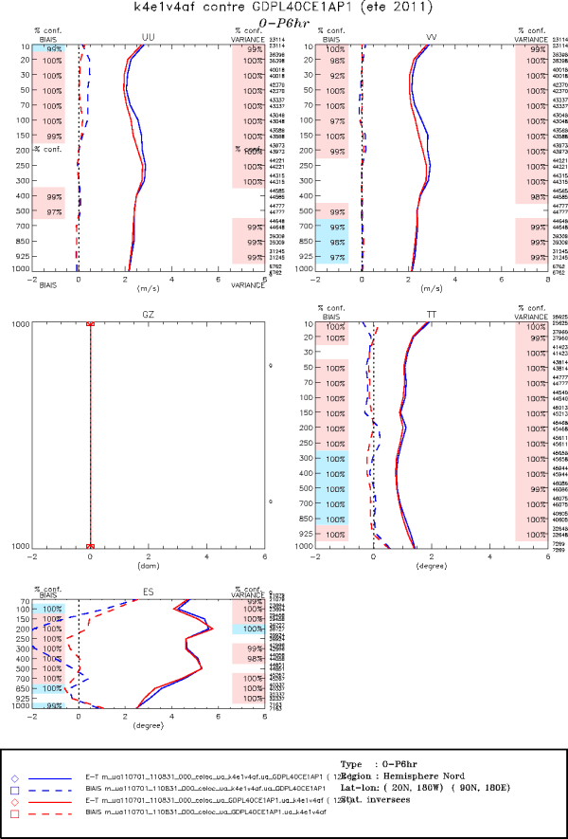
Forecast Results: GDPS 4.0.0 vs GDPS 3.0.0
Verification vs. (1D/4D) Radiosondes – P6h-Obs, Northern extra-tropics
Feb-March, 2011
July-August, 2011
U
V
U
V
T
T
T-T_{d}
T-T_{d}

Slide 29
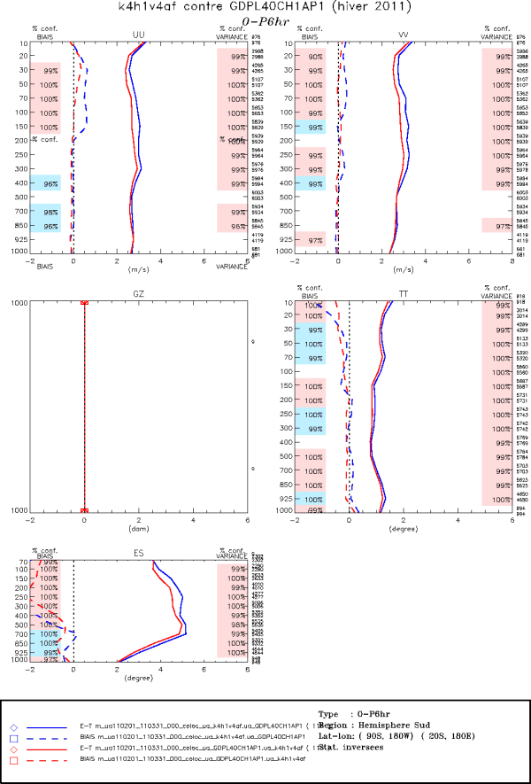
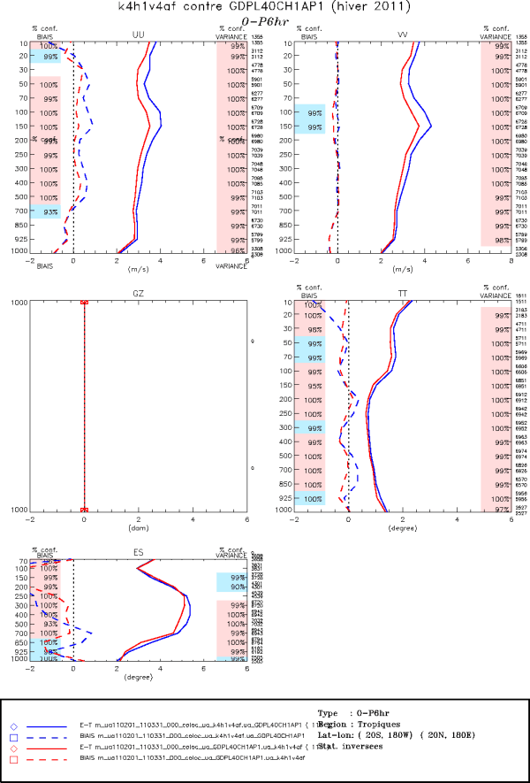
Forecast Results: GDPS 4.0.0 vs GDPS 3.0.0
Verification vs. (1D/4D) Radiosondes – P6h-Obs, Feb-March, 2011
Southern extra-tropics
Tropics
U
V
U
V
T
T
T-T_{d}
T-T_{d}

Slide 30
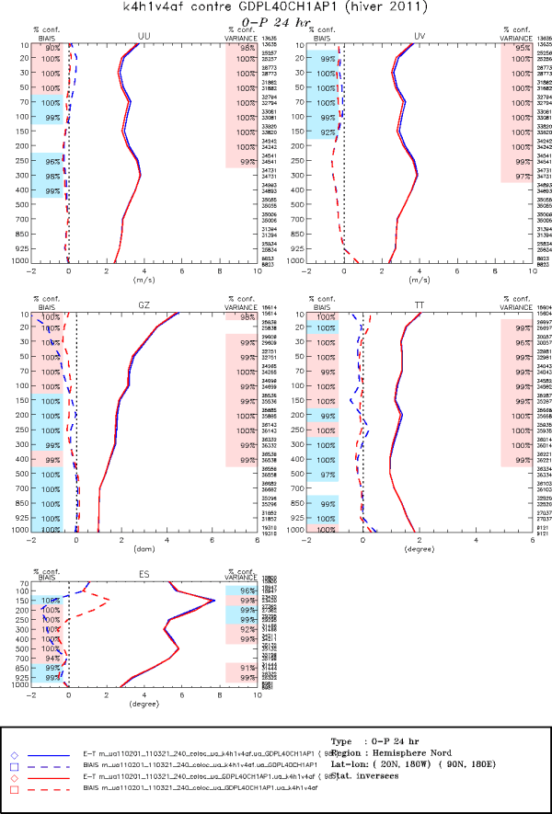
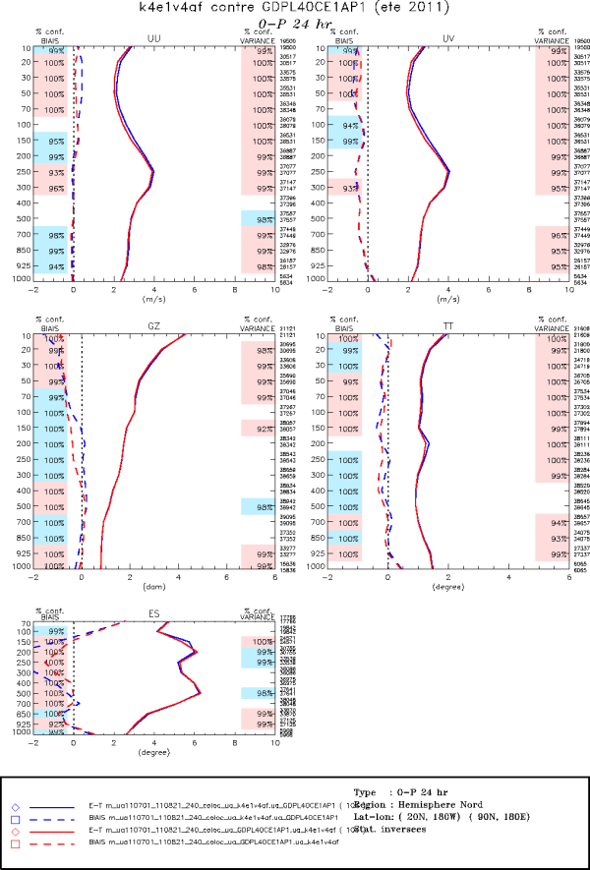
Forecast Results: GDPS 4.0.0 vs GDPS 3.0.0
Verification vs. (1D) Radiosondes – 24h, Northern extra-tropics
Feb-March, 2011
July-August, 2011
U
|U|
U
|U|
GZ
T
GZ
T
T-T_{d}
T-T_{d}

Slide 31
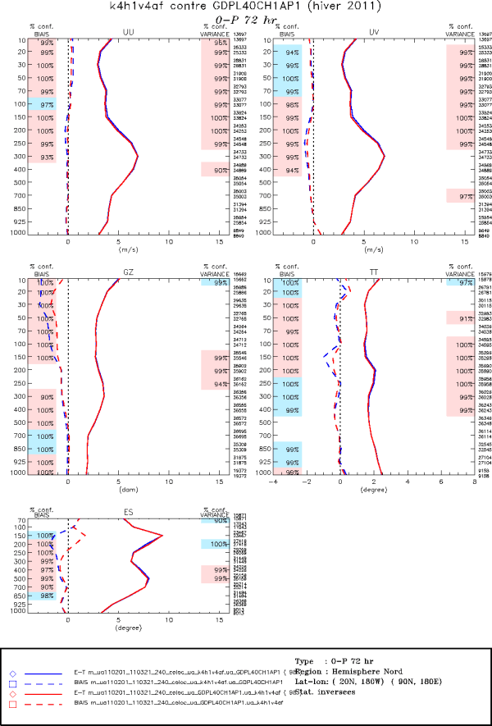
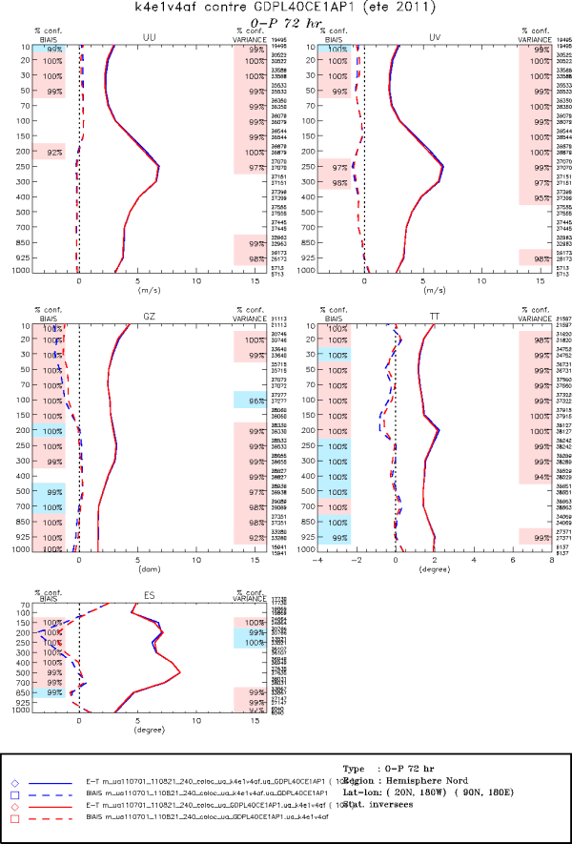
Forecast Results: GDPS 4.0.0 vs GDPS 3.0.0
Verification vs. (1D) Radiosondes – 72h, Northern extra-tropics
Feb-March, 2011
July-August, 2011
U
|U|
U
|U|
GZ
T
GZ
T
T-T_{d}
T-T_{d}

Slide 32
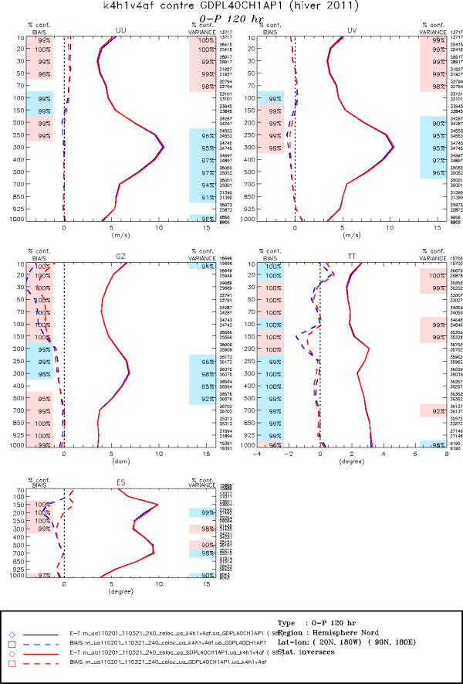
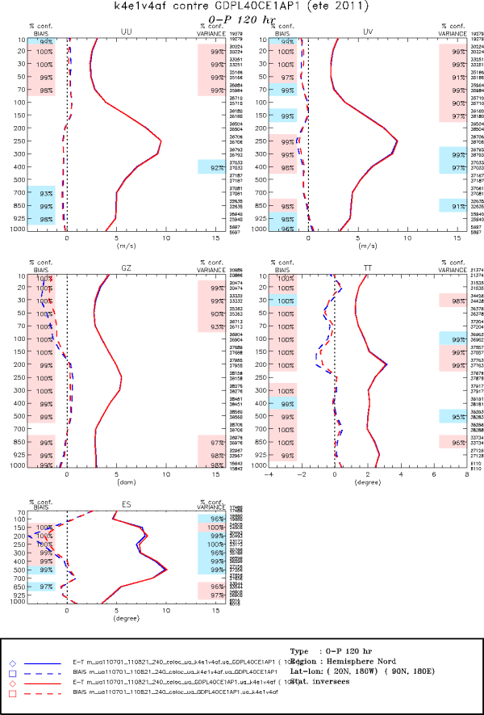
Forecast Results: GDPS 4.0.0 vs GDPS 3.0.0
Verification vs. (1D) Radiosondes – 120h, Northern extra-tropics
Feb-March, 2011
July-August, 2011
U
|U|
U
|U|
GZ
T
GZ
T
Slight negative impact for winds/GZ 250hPa-500hPa, but…
T-T_{d}
T-T_{d}

Slide 33
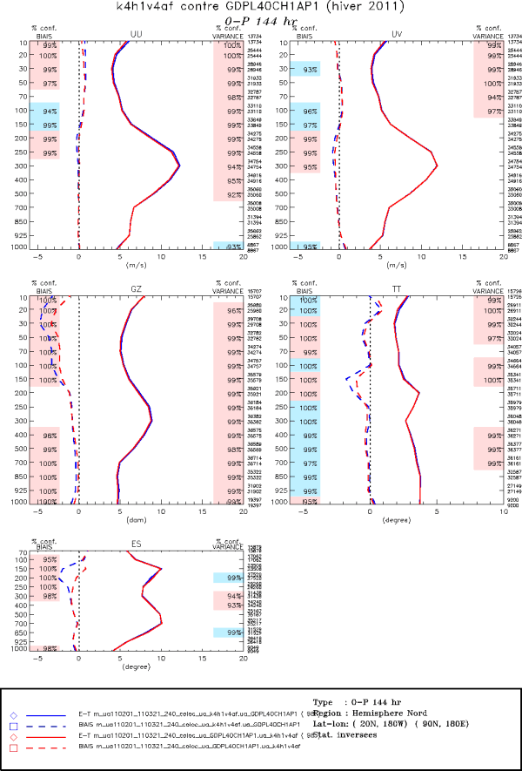
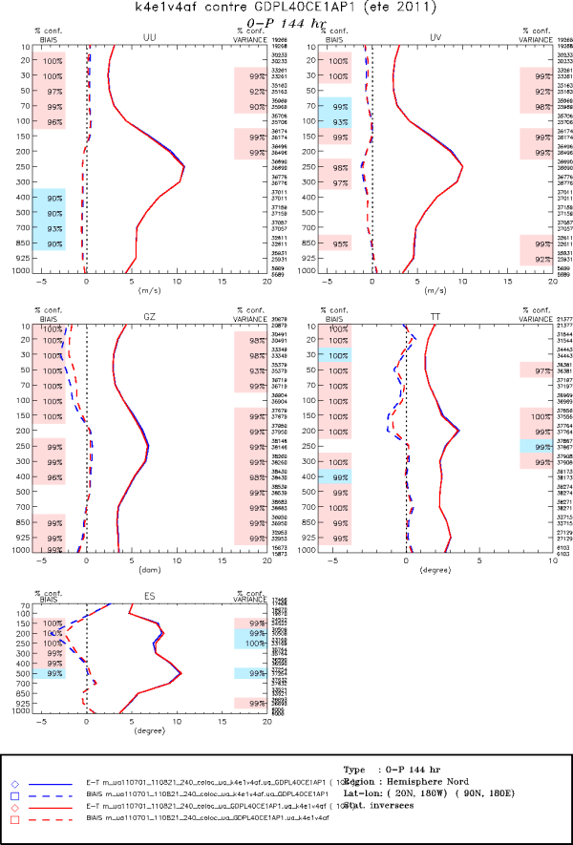
Forecast Results: GDPS 4.0.0 vs GDPS 3.0.0
Verification vs. (1D) Radiosondes – 144h, Northern extra-tropics
Feb-March, 2011
July-August, 2011
U
|U|
U
|U|
GZ
T
GZ
T
Becomes positive or neutral for day 6!
T-T_{d}
T-T_{d}

Slide 34
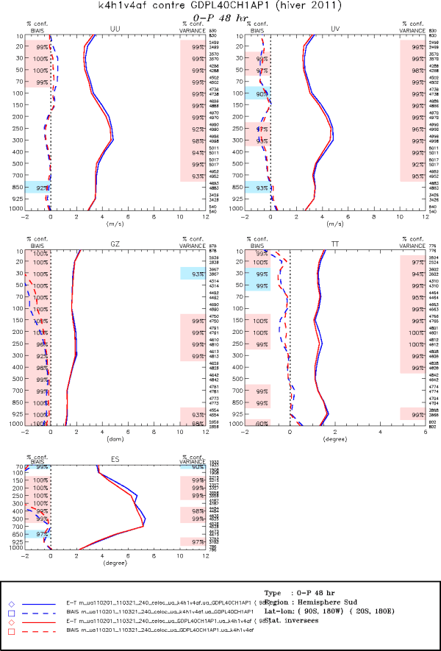
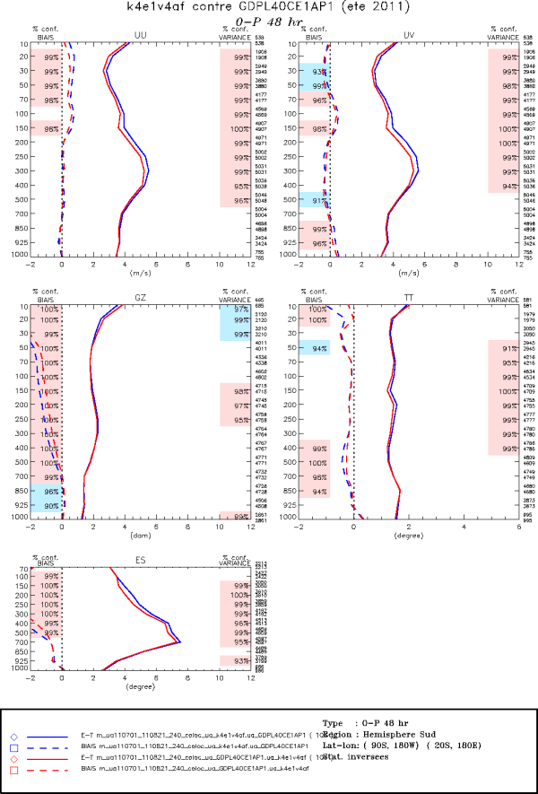
Forecast Results: GDPS 4.0.0 vs GDPS 3.0.0
Verification vs. (1D) Radiosondes – 48h, Southern extra-tropics
Feb-March, 2011
July-August, 2011
U
|U|
U
|U|
GZ
T
GZ
T
T-T_{d}
T-T_{d}

Slide 35
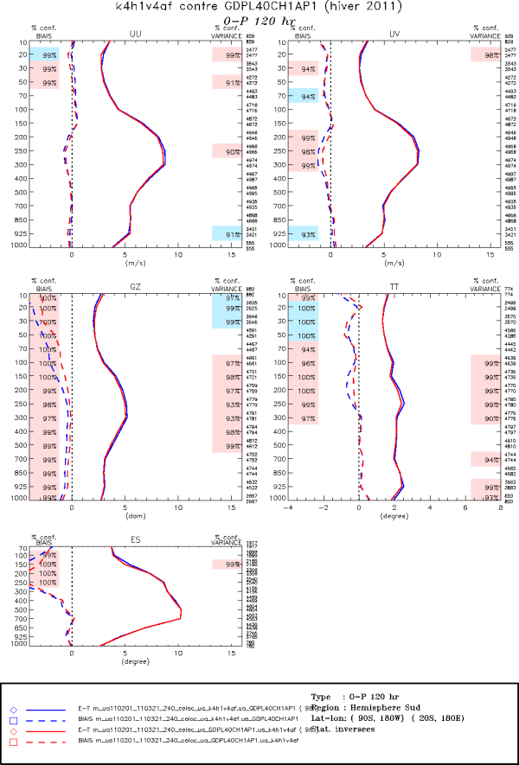
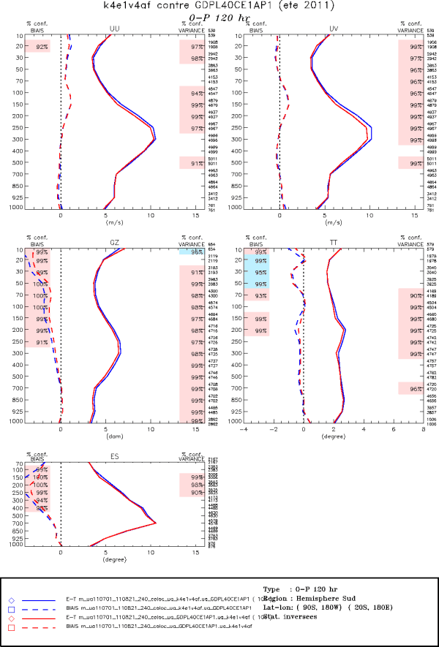
Forecast Results: GDPS 4.0.0 vs GDPS 3.0.0
Verification vs. (1D) Radiosondes – 120h, Southern extra-tropics
Feb-March, 2011
July-August, 2011
U
|U|
U
|U|
GZ
T
GZ
T
T-T_{d}
T-T_{d}

Slide 36
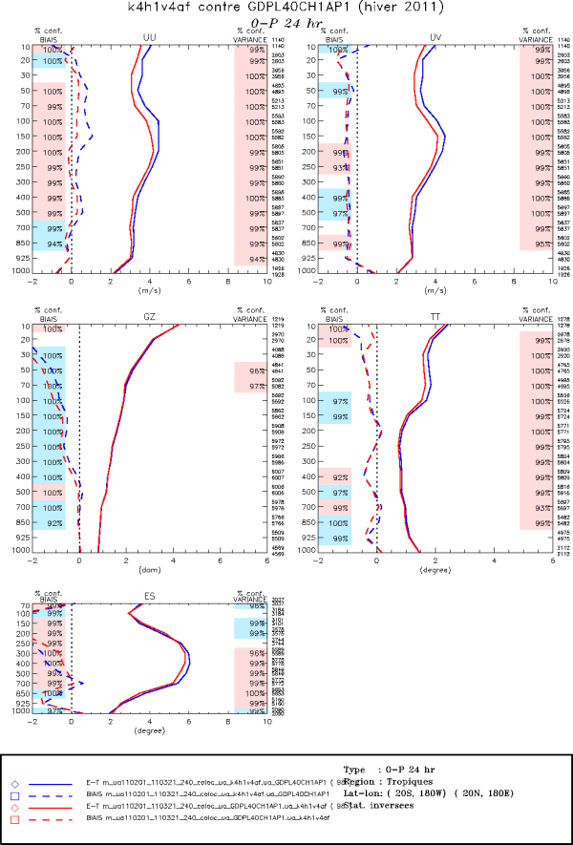
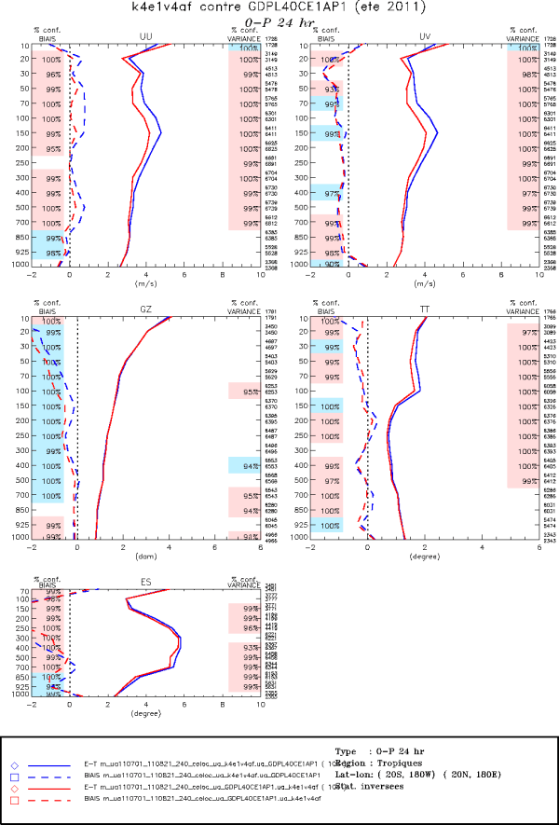
Forecast Results: GDPS 4.0.0 vs GDPS 3.0.0
Verification vs. (1D) Radiosondes – 24h, Tropics
Feb-March, 2011
July-August, 2011
U
|U|
U
|U|
GZ
T
GZ
T
T-T_{d}
T-T_{d}

Slide 37
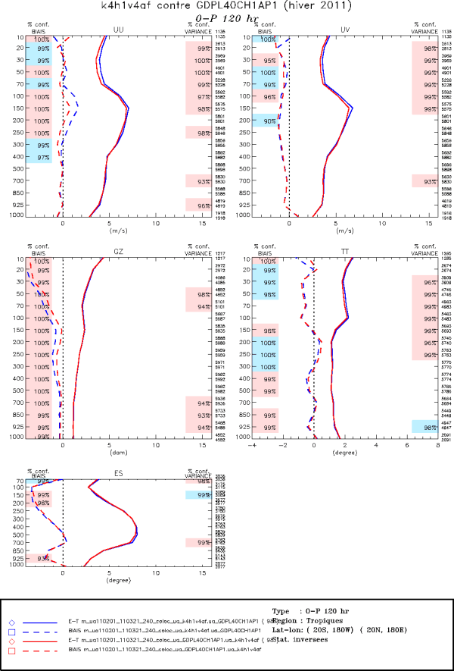
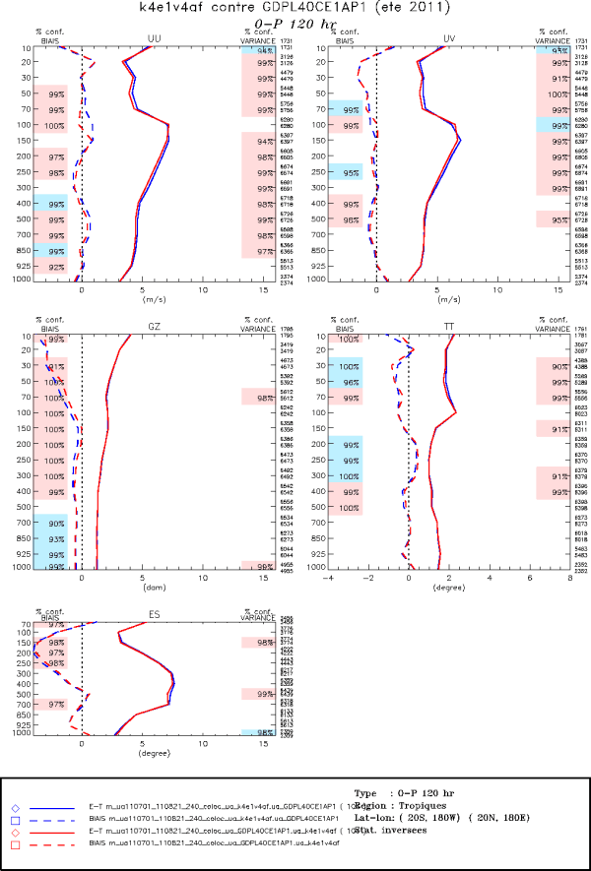
Forecast Results: GDPS 4.0.0 vs GDPS 3.0.0
Verification vs. (1D) Radiosondes – 120h, Tropics
Feb-March, 2011
July-August, 2011
U
|U|
U
|U|
GZ
T
GZ
T
T-T_{d}
T-T_{d}

Slide 38
Results showing total impact from all proposed changes
(GDPS 4.0.0 vs. GDPS 3.0.0)
Verification against own analyses
Not reliable for short-term forecast verification (≤ 48h) due to significant change to analyses

Slide 39
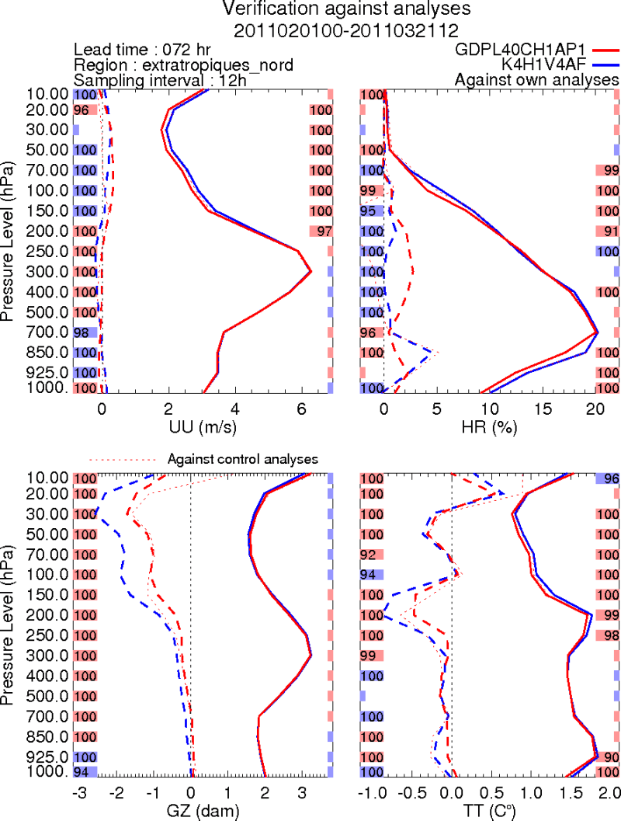
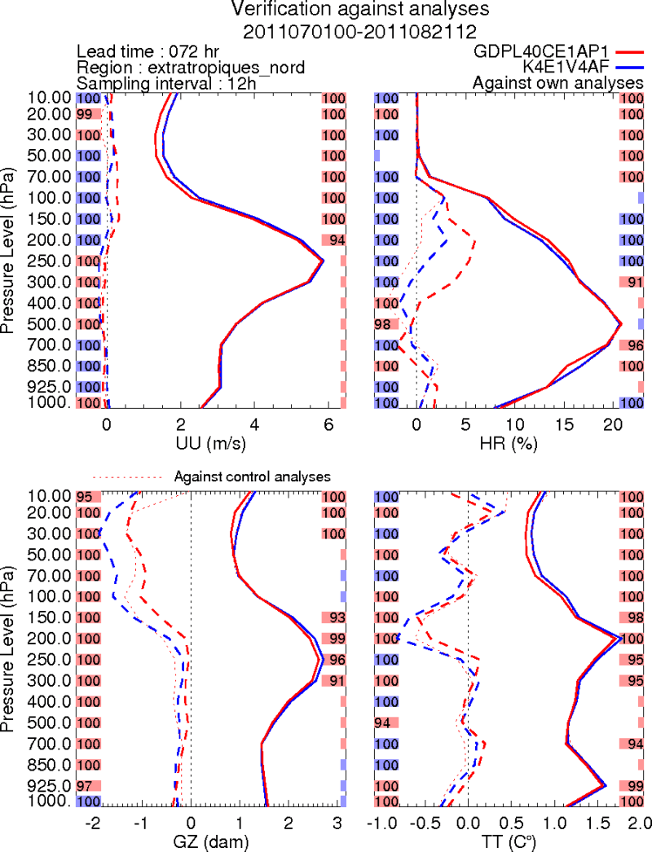
Forecast Results: GDPS 4.0.0 vs GDPS 3.0.0
Verification vs. OWN analyses – 72h, Northern extra-tropics
Feb-March, 2011
July-August, 2011
U
RH
U
RH
GZ
T
GZ
T

Slide 40
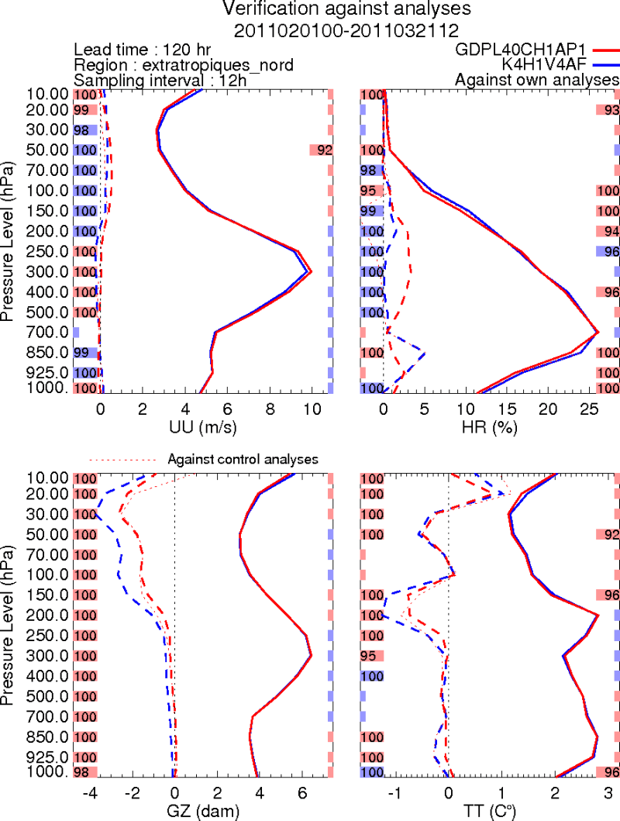
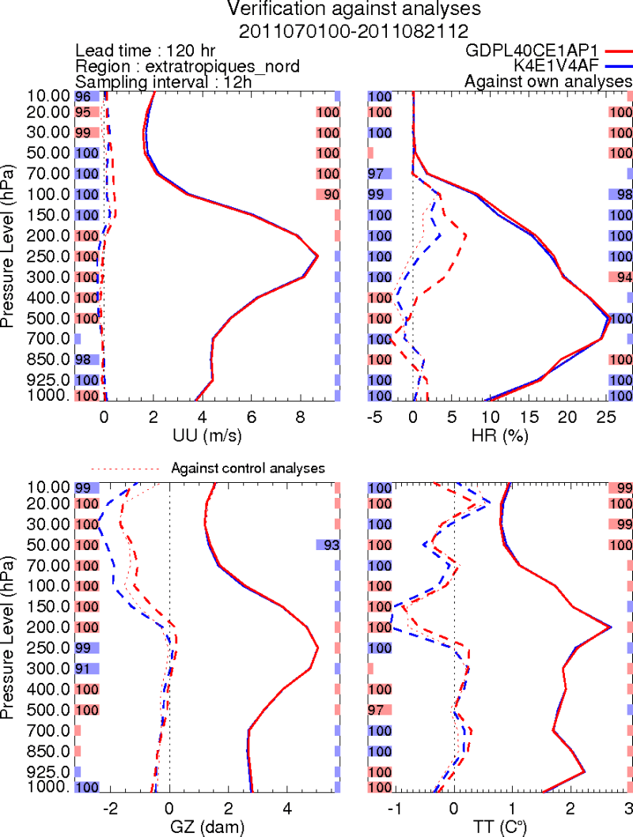
Forecast Results: GDPS 4.0.0 vs GDPS 3.0.0
Verification vs. OWN analyses – 120h, Northern extra-tropics
Feb-March, 2011
July-August, 2011
RH
U
RH
U
GZ
GZ
T
T

Slide 41
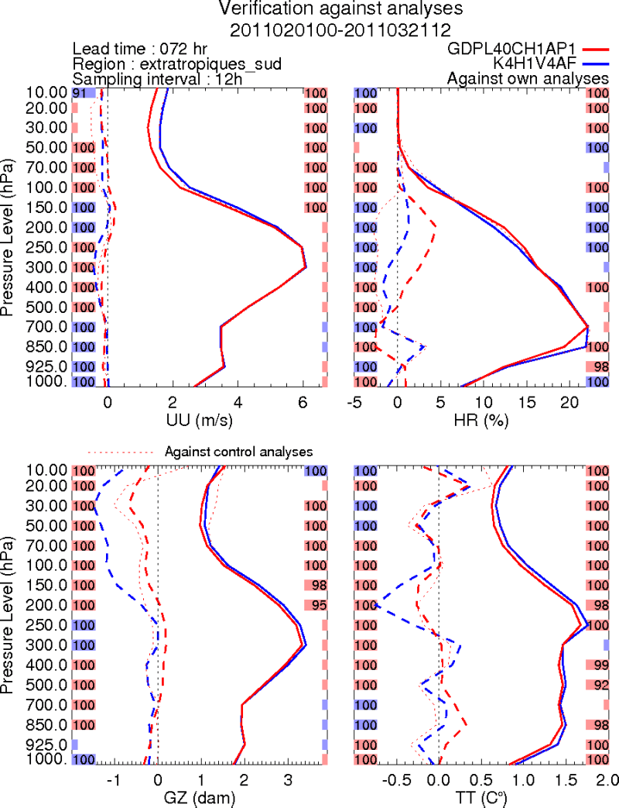
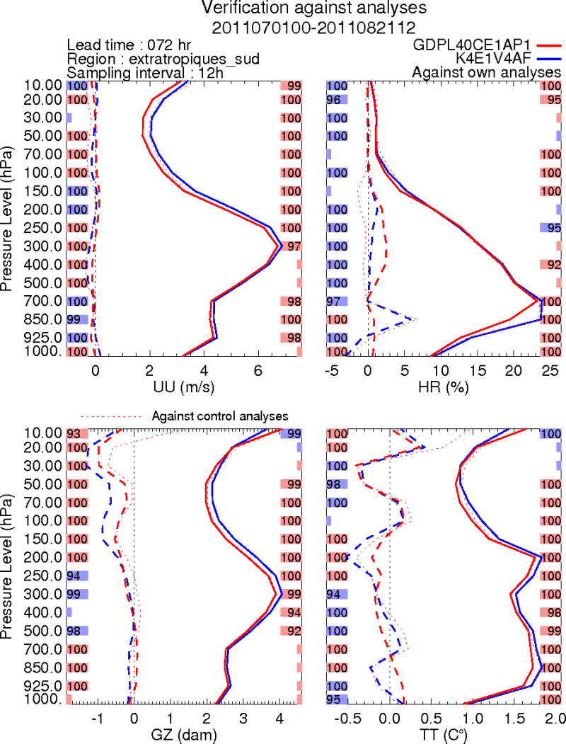
Forecast Results: GDPS 4.0.0 vs GDPS 3.0.0
Verification vs. OWN analyses – 72h, Southern extra-tropics
Feb-March, 2011
July-August, 2011
U
RH
U
RH
GZ
T
GZ
T

Slide 42
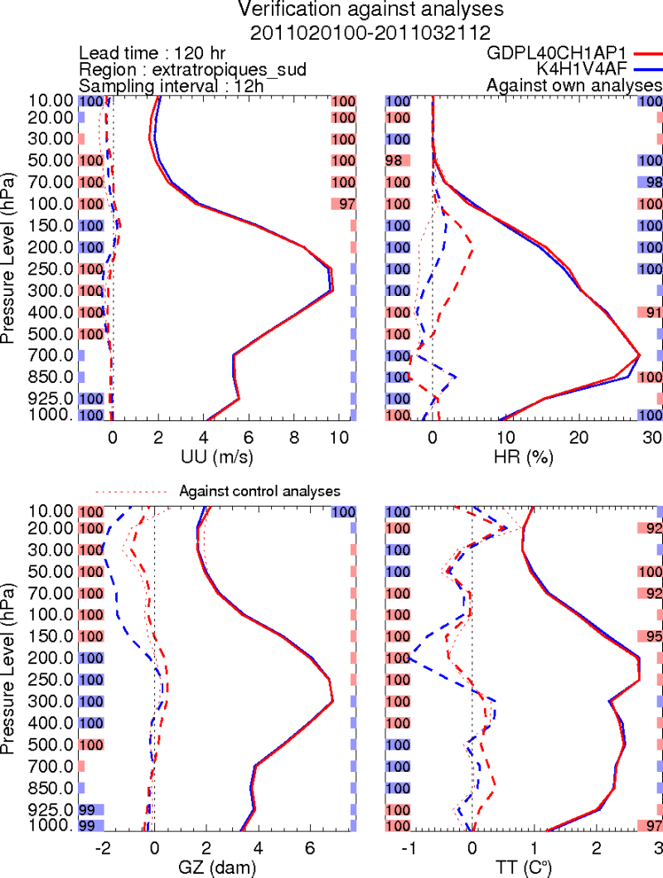
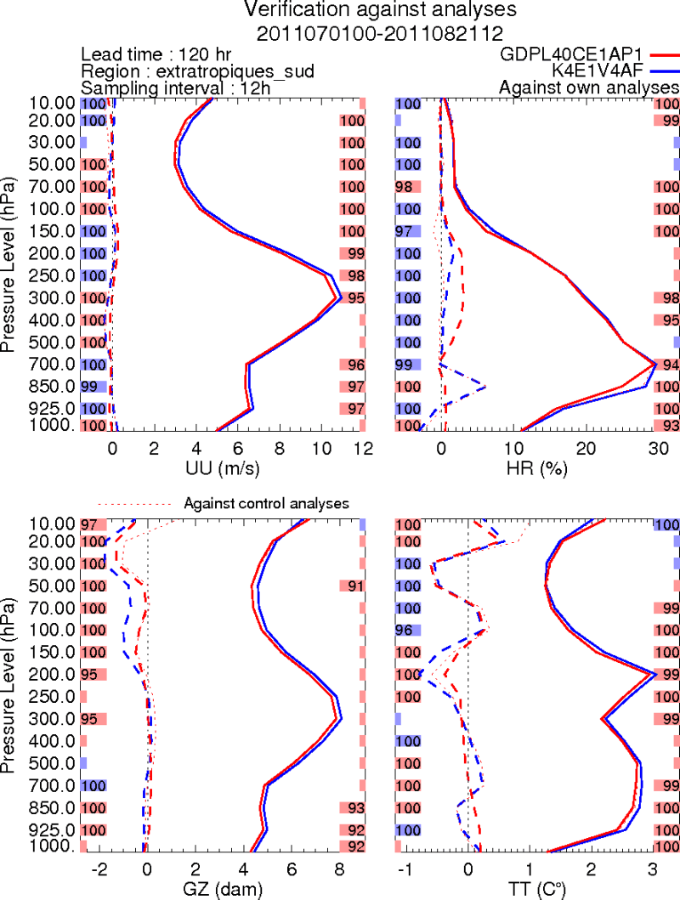
Forecast Results: GDPS 4.0.0 vs GDPS 3.0.0
Verification vs. OWN analyses – 120h, Southern extra-tropics
Feb-March, 2011
July-August, 2011
U
RH
U
RH
GZ
T
GZ
T

Slide 43
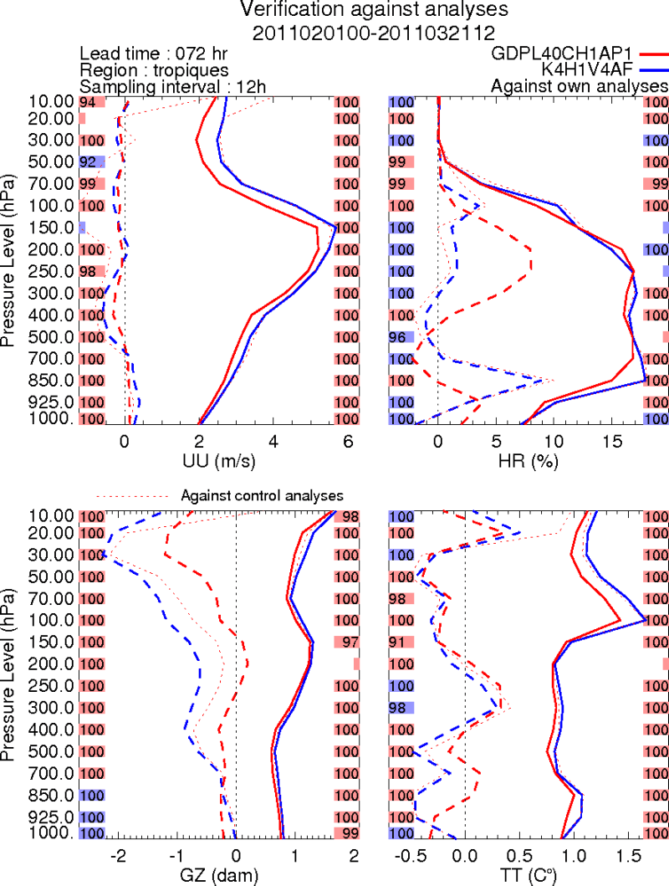

Forecast Results: GDPS 4.0.0 vs GDPS 3.0.0
Verification vs. OWN analyses – 72h, Tropics
Feb-March, 2011
July-August, 2011
U
RH
U
RH
GZ
T
GZ
T

Slide 44


Forecast Results: GDPS 4.0.0 vs GDPS 3.0.0
Verification vs. OWN analyses – 120h, Tropics
Feb-March, 2011
July-August, 2011
U
RH
U
RH
GZ
T
GZ
T

Slide 45


Forecast Results: GDPS 4.0.0 vs GDPS 3.0.0
Verification vs. OWN analyses – 72h, North America
Feb-March, 2011
July-August, 2011
U
RH
U
RH
GZ
T
GZ
T

Slide 46


Forecast Results: GDPS 4.0.0 vs GDPS 3.0.0
Verification vs. OWN analyses – 120h, North America
Feb-March, 2011
July-August, 2011
U
RH
U
RH
GZ
T
GZ
T

Slide 47


Forecast Results: GDPS 4.0.0 vs GDPS 3.0.0
Verification vs. OWN analyses – GZ 500hPa, Northern extra-tropics
Feb-March, 2011
July-August, 2011

Slide 48


Forecast Results: GDPS 4.0.0 vs GDPS 3.0.0
Verification vs. OWN analyses – GZ 500hPa Southern extra-tropics
Feb-March, 2011
July-August, 2011

Slide 49
Results showing total impact from all proposed changes
(GDPS 4.0.0 vs. GDPS 3.0.0)
Verification against ERA-interim reanalyses
Just at 24h lead-time, analyses used for verification are independent of both systems

Slide 50


Forecast Results: GDPS 4.0.0 vs GDPS 3.0.0
Verification vs. ERA-Interim analyses – 24h, Northern extra-tropics
Feb-March, 2011
July-August, 2011
U
RH
U
RH
GZ
T
GZ
T

Slide 51


Forecast Results: GDPS 4.0.0 vs GDPS 3.0.0
Verification vs. ERA-Interim analyses – 24h, Southern extra-tropics
Feb-March, 2011
July-August, 2011
U
RH
U
RH
GZ
T
GZ
T

Slide 52


Forecast Results: GDPS 4.0.0 vs GDPS 3.0.0
Verification vs. ERA-Interim analyses – 24h, Tropics
Feb-March, 2011
July-August, 2011
U
RH
U
RH
GZ
T
GZ
T

Slide 53


Forecast Results: GDPS 4.0.0 vs GDPS 3.0.0
Verification vs. ERA-Interim analyses – 24h, North America
Feb-March, 2011
July-August, 2011
U
RH
U
RH
GZ
T
GZ
T

Slide 54
Results showing total impact from all proposed changes
(GDPS 4.0.0 vs. GDPS 3.0.0)
Verification against surface observations

Slide 55




Forecast Results: GDPS 4.0.0 vs GDPS 3.0.0
Verification vs. Surface obs: Temperature stddev
Feb-March, 2011
July-August, 2011
5.5
3.5
0Z
3.0
2.0
Note: scales are different for each plot!
More positive for winter than summer
Note: scales are different for each plot!
5.5
3.5
12Z
2.5
2.0

Slide 56




Forecast Results: GDPS 4.0.0 vs GDPS 3.0.0
Verification vs. Surface obs: Temperature bias
Feb-March, 2011
July-August, 2011
0.0
0.2
Decreased initial bias due to cycling clouds
0Z
-1.5
-0.8
Note: scales are different for each plot!
More positive for winter than summer
Note: scales are different for each plot!
0.4
0.2
12Z
-0.6
-0.8

Slide 57




Forecast Results: GDPS 4.0.0 vs GDPS 3.0.0
Verification vs. Surface obs: Dewpoint stddev
Feb-March, 2011
July-August, 2011
5.5
3.5
0Z
2.5
2.0
Note: scales are different for each plot!
Note: scales are different for each plot!
6.0
3.5
12Z
3.0
2.0

Slide 58




Forecast Results: GDPS 4.0.0 vs GDPS 3.0.0
Verification vs. Surface obs: Dewpoint bias
Feb-March, 2011
July-August, 2011
1.0
0.2
Decreased initial bias due to cycling clouds
0Z
-1.0
-0.8
Note: scales are different for each plot!
Note: scales are different for each plot!
1.5
0.4
12Z
0.0
-0.8

Slide 59
Results showing total impact from all proposed changes
(GDPS 4.0.0 vs. GDPS 3.0.0)
Verification against precipitation observations

Slide 60



Forecast Results: GDPS 4.0.0 vs GDPS 3.0.0
Verification vs. Synop obs: Precipitation, Feb-March, 2011
0h-24h accumulation
RH, Northern Extra-tropics
GDPS 3.0.0 – ERA-interim
Increased precip bias day 1
GDPS 4.0.0 – ERA-interim
Less spin-up of humidity in new system

Slide 61


Forecast Results: GDPS 4.0.0 vs GDPS 3.0.0
Verification vs. Synop obs: Precipitation, Feb-March, 2011
48h-72h accumulation
96h-120h accumulation
Increased precip bias day 3

Slide 62



Forecast Results: GDPS 4.0.0 vs GDPS 3.0.0
Verification vs. Synop obs: Precipitation, July-August, 2011
24h-48h accumulation
RH, Northern Extra-tropics
GDPS 3.0.0 – ERA-interim
Increased precip bias day 2
GDPS 4.0.0 – ERA-interim

Slide 63


Forecast Results: GDPS 4.0.0 vs GDPS 3.0.0
Verification vs. Synop obs: Precipitation, July-August, 2011
48h-72h accumulation
96h-120h accumulation

Slide 64


Forecast Results: GDPS 4.0.0 vs GDPS 3.0.0
Verification vs. SHEF obs: Precipitation, Feb-March, 2011
48h-72h accumulation
96h-120h accumulation

Slide 65


Forecast Results: GDPS 4.0.0 vs GDPS 3.0.0
Verification vs. SHEF obs: Precipitation, July-August, 2011
48h-72h accumulation
96h-120h accumulation

Slide 66
Conclusions
GDPS 4.0.0 vs GDPS 3.0.0:
  Proposed vs. existing system → overall improvement to forecasts
  Relative improvements larger at short lead times than at day 5
  Largest day 1 improvements are in the tropics
  Only negative impact is at day 5, northern extra-tropics, but positive for day 6 (also 3 and 4)!
  Improved surface scores, especially temperature during winter → snow density fix
  Increased precipitation bias at short lead times, likely due to increased 850hPa humidity (but less spin up of humidity)
  Above ~20hPa, scores from EnVar alone similar to 3D-Var, worse than 4D-Var (benefit from raising EnKF model top to 0.1hPa?)
  Compensated by assimilation of 4D radiosonde obs that gives improvements up to 10hPa
  Computational saving (vs 4D-Var) allows more rapid increase in analysis resolution and volume of assimilated observations
  Increased focus on improving the EnKF will benefit both deterministic and ensemble prediction systems

Slide 67
Extra slides follow

Slide 68
4D error covariances
Temporal covariance evolution
EnVar (4D B matrix):
256 NLM integrations provide 4D background-error covariances
4D-Var:
TL/AD inner loop integrations,
2 outer loop iterations,
then 3h NLM forecast
-3h
0h
+3h
“analysis time”

Slide 69
Future: Global and regional ensembles…
2013-2017: Toward a Reorganization of the NWP Suites at Environment Canada
Regional ensemble forecasts (REPS)
Regional
EnKF
boundary conditions
Global ensemble forecasts (GEPS)
Background error covariances
Global
EnKF
Regional deterministic forecast (RDPS)
Regional
EnVar
Background error covariances
Global deterministic forecast (GDPS)
High-resolution deterministic
forecast (2.5km) (HRDPS)
Global
EnVar
High-res EnVar
global system
regional system

Slide 70


Forecast Results: GDPS 4.0.0 vs GDPS 3.0.0
Verification vs. ERA-Interim analyses – 72h, Northern extra-tropics
Feb-March, 2011
July-August, 2011
U
RH
U
RH
GZ
T
GZ
T

Slide 71


Forecast Results: GDPS 4.0.0 vs GDPS 3.0.0
Verification vs. ERA-Interim analyses – 120h, Northern extra-tropics
Feb-March, 2011
July-August, 2011
U
RH
U
RH
GZ
T
GZ
T

Slide 72


Forecast Results: GDPS 4.0.0 vs GDPS 3.0.0
Verification vs. ERA-Interim analyses – 120h, Southern extra-tropics
Feb-March, 2011
July-August, 2011
U
RH
U
RH
GZ
T
GZ
T

Slide 73


Forecast Results: GDPS 4.0.0 vs GDPS 3.0.0
Verification vs. ERA-Interim analyses – 120h, Tropics
Feb-March, 2011
July-August, 2011
U
RH
U
RH
GZ
T
GZ
T

Slide 74


Forecast Results: GDPS 4.0.0 vs GDPS 3.0.0
Verification vs. ERA-Interim analyses – 72h, North America
Feb-March, 2011
July-August, 2011
U
RH
U
RH
GZ
T
GZ
T

Slide 75


Forecast Results: GDPS 4.0.0 vs GDPS 3.0.0
Verification vs. ERA-Interim analyses – 120h, North America
Feb-March, 2011
July-August, 2011
U
RH
U
RH
GZ
T
GZ
T

Slide 76
Experimental results:
4D-EnVar vs. 3D-EnVar
3D version of EnVar also tested:
only uses EnKF flow-dependent ensembles valid at the centre of the 6h assimilation window, instead of every 60 minutes throughout the window
(both still use ½ & ½ hybrid covariances in the troposphere)
3D-EnVar compared with 4D-EnVar

Slide 77


Forecast Results: 4D-EnVar vs. 3D-EnVar
Verification against ERA-Interim analyses – 4 weeks, Feb 2011
North extra-tropics
500hPa GZ correlation anomaly
South extra-tropics
500hPa GZ correlation anomaly

