Slide 1
The Polar Communications and Weather Mission (PCW)
A new Mandate for Environment Canada
G. Szejwach and L. Garand
March 25, 2011

Slide 2
Contents
PCW Mission Objectives
Status and Major Milestones
EC’s Mandate within the PCW Mission
Overall Ground Segment Concept
Functions associated with the Application Ground Segment Facilities
Baseline List of Products
Data Volumes
Creating the new PWC Data Processing Center
Manpower Resources Estimates
Suggestions and Recommendations
Conclusion
Notes:
2

Slide 3
PCW Mission Objectives
24/7 communications in Canadian Arctic in support of:
- DND operations
- air and marine traffic
- communities
24/7 high spatial resolution meteorological
data above 50º N in support of:
  Numerical Weather Prediction (short to medium range)
  Environmental monitoring, emergency response
  Climate monitoring
Space and Weather Monitoring
Notes:
3

Slide 4
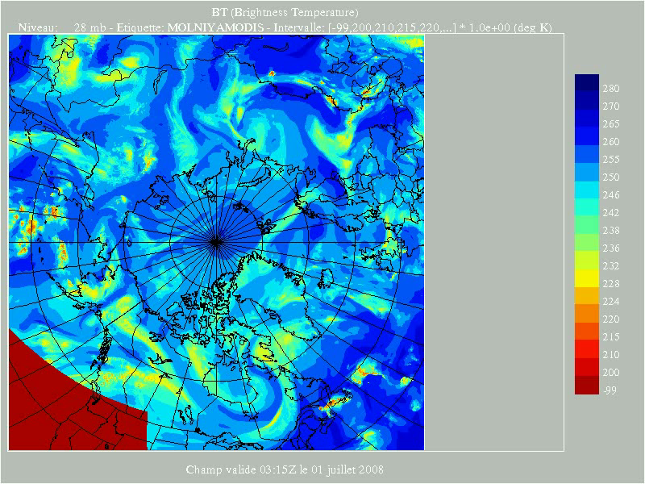
24-h animation, 2 satellites

Slide 5
Status and Major Milestones
Approved and Funded
Phase 0 completed: September 2008
Phase A contract awarded: July 2009
Phase A Major Milestones
  Technology Readiness Assessment Review: October 2009
  Critical Technologies Development procurement: February 2009
  Mission Requirements Review: February 25, 2010
  Preliminary System Requirements Review: June 2010
  Phase A closure: March 31, 2011
  Approval and Funding Still Required
Phase B contract award: late 2011, start mid 2012
PPP approach likely
Launch of Satellite 1: Q1 2017
Launch of Satellite 2: Q2 2017
PCW is top priority program at CSA
Notes:
5

Slide 6
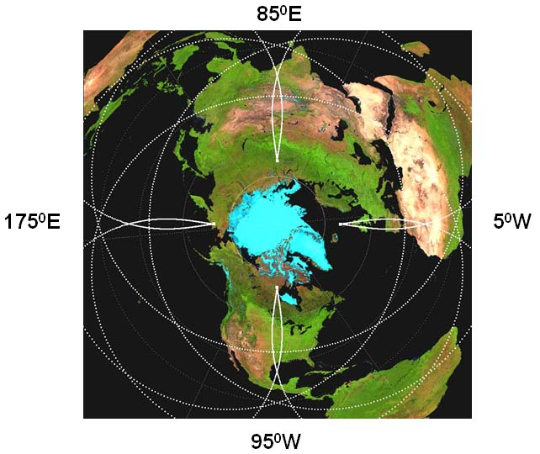
Baseline12-h orbit concept
Apogee: 39,500 km
Perigee: 600 km
2 sats in one plane leading to 4 apogees
separated by 90 deg
Ref: Trishchenko and Garand, Jtech, 2011

Slide 7
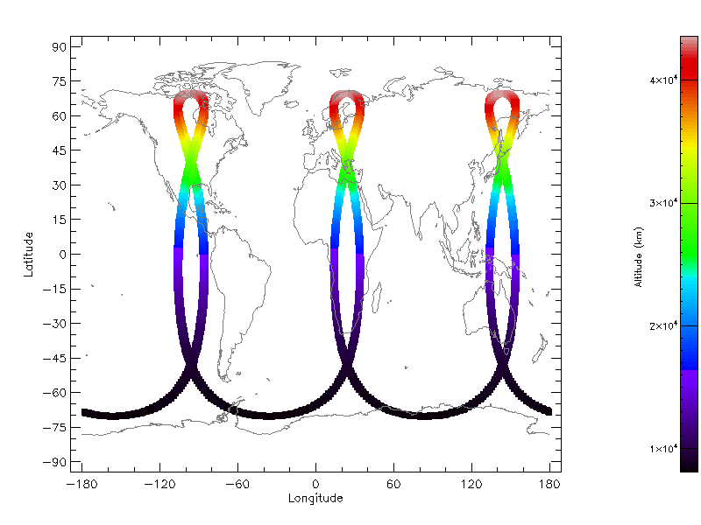
Revised orbital concept: 16-h orbit
Apogee: ~43,500 km
Perigee: ~8,100 km
Main advantage:
Much less subject
to damage from
protons than 12-h
orbit
Suggested apogees:
95⁰W; 25⁰E, 145⁰E
Three APogee (TAP) orbit

Slide 8
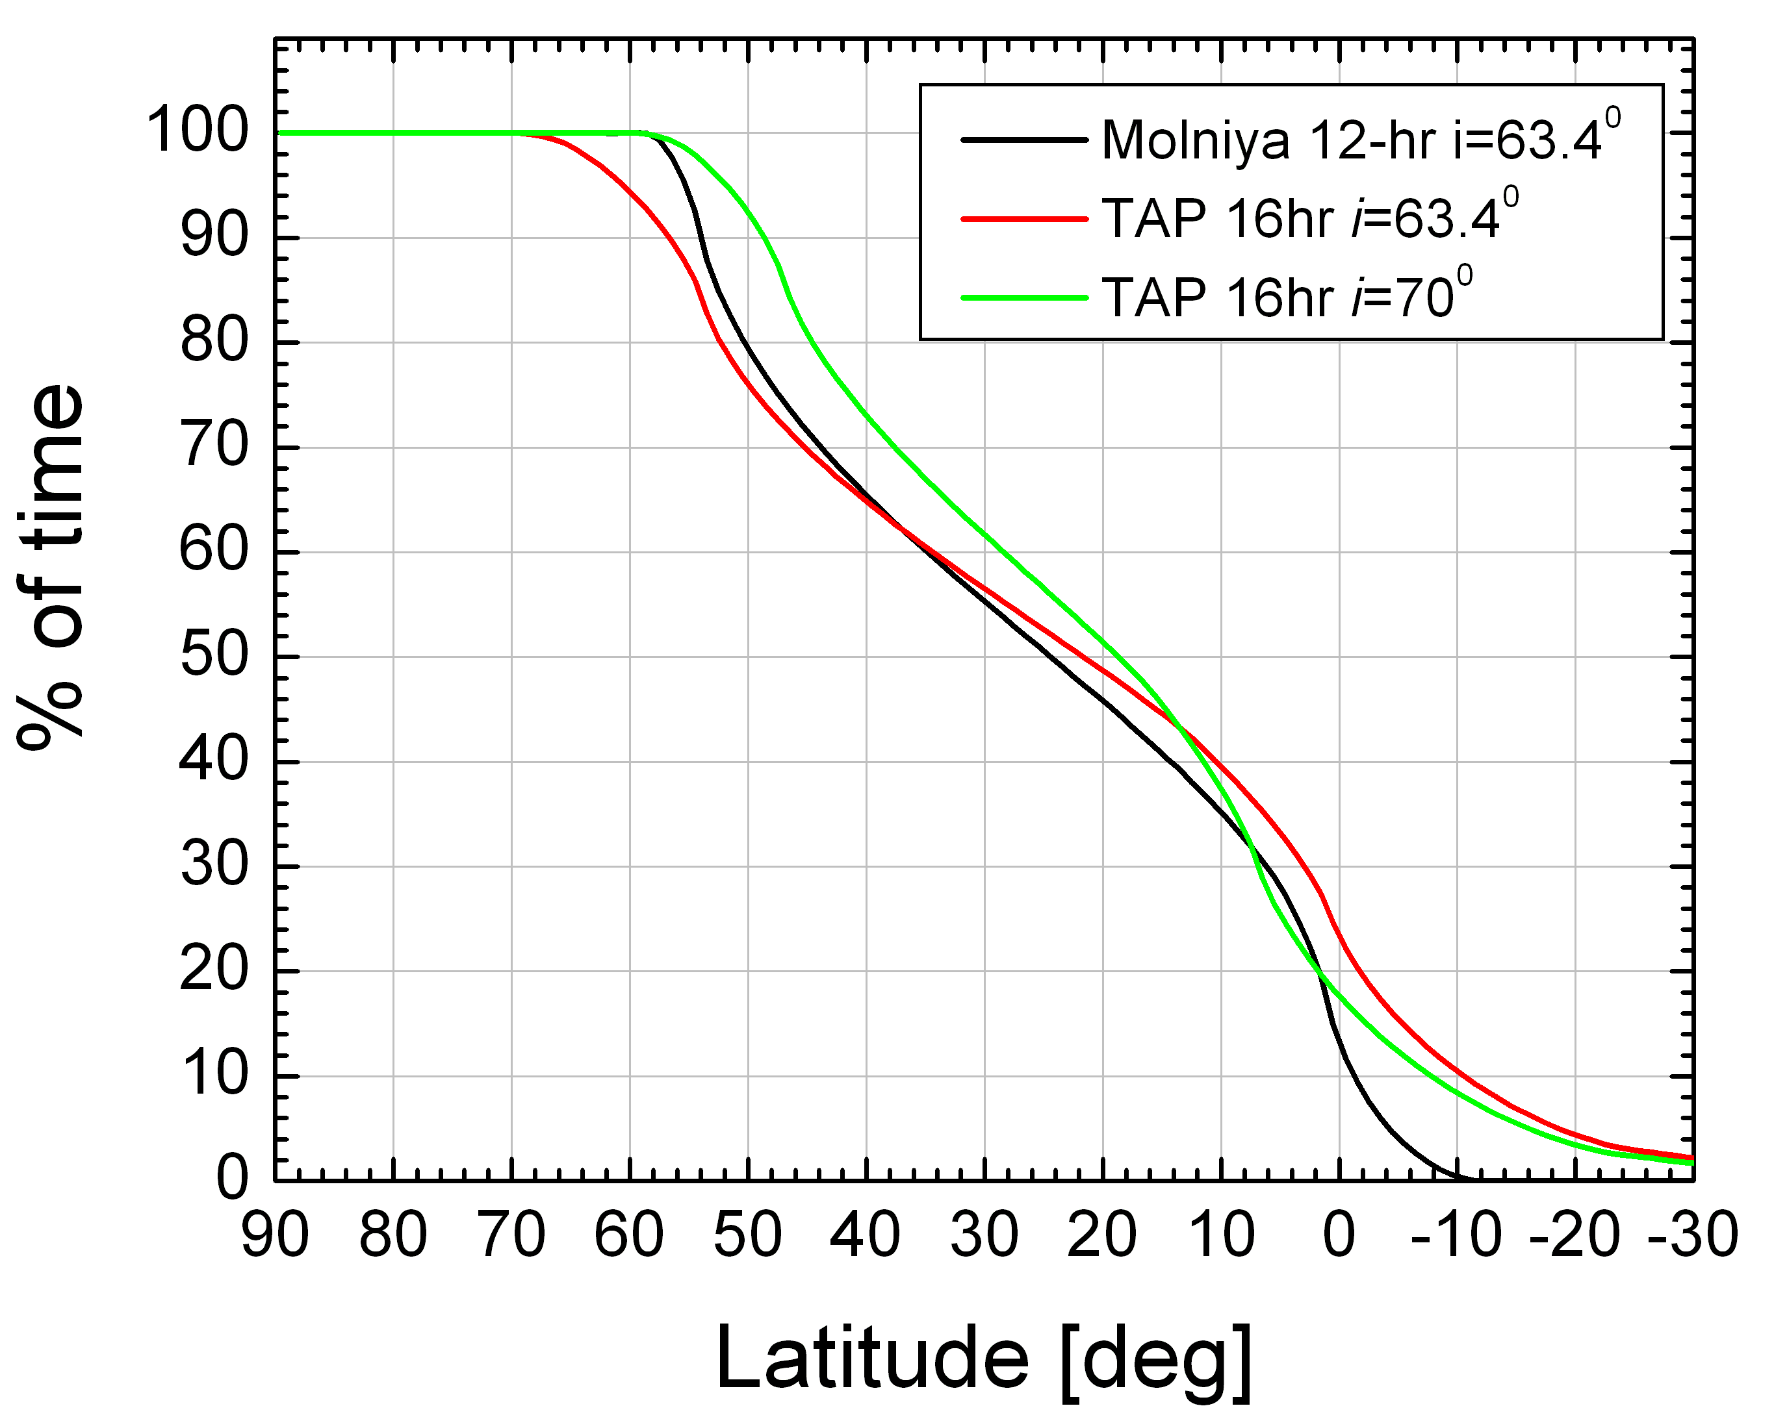
Zonal mean coverage: 12-hr vs 16-hr orbit
Better coverage with higher
orbit inclination, but may
Require more fuel for
maintenance
From: Trischenko et al, 2011 (JTech)

Slide 9
PCW Imager Specifications
Band No. | subgroup | Wavelength (microns) | Heritage | Priority | GSD (km) Goal Max | Main applications
1 | VNIR | 0.45-0.49 | ABI, FDHSI | 1 | 0.5 1.5 | Surface, clouds, aerosols
2 |  | 0.59-0.69 | ABI, FDHSI | 1 | 0.5 1.5 | Wind, clouds, ice mapping
3 |  | 0.704-0.714 | MERIS-09 | 2 | 0.5 1.5 | Water quality, chlorophyll
4 |  | 0.85-0.89 | ABI, FDHSI | 1 | 0.5 1.5 | Wind, aerosols, vegetation
5 | SWIR | 1.04 – 1.06 | SGLI SW1 | 2 | 1.0 3.0 | Snow grain and clouds
6 |  | 1.37-1.39 | ABI, FDHSI | 2 | 1.0 3.0 | Cirrus detection
7 |  | 1.58-1.64 | ABI, FDHSI | 1 | 0.5 1.5 | Snow-cloud distinction, ice cover
8 |  | 2.22-2.28 | ABI, FDHSI | 1 | 1.0 3.0 | Aerosol, smoke, cloud phase
9 | MWIR | 3.80-4.00 | ABI, FDHSI | 1 | 2.0 3.0 | Fog, fires, ice/cloud separation, wind, cld.phase
10 |  | 5.77-6.60 | ABI, FDHSI | 1 | 2.0 3.0 | Wind, high level humidity
11 |  | 6.75-7.15 | ABI, MTSAT | 2 | 2.0 3.0 | Wind, mid level humidity
12 |  | 7.24-7.44 | ABI, FDHSI | 1 | 2.0 3.0 | Wind, low level humidity,SO₂
13 | LWIR | 8.30-8.70 | ABI, FDHSI | 1 | 2.0 3.0 | Total water, cloud phase
14 |  | 9.42-9.80 | ABI, FDHSI | 2 | 2.0 3.0 | Total ozone
15 |  | 10.1-10.6 | ABI, FDHSI | 2 | 2.0 3.0 | Cloud, surface, cirrus
16 |  | 10.8-11.6 | ABI, HIRS | 1 | 2.0 3.0 | Cloud, SST, ash
17 |  | 11.8-12.8 | ABI, FDHSI | 1 | 2.0 3.0 | Ash, SST
18 | LIRCO2 | 13.0-13.6 | ABI, FDHSI | 1 | 2.0 3.0 | Cloud height
19 |  | 13.5-13.8 | MODIS,HIRS | 2 | 2.0 6.0 | Cloud height, low level temperature
20 |  | 13.8-14.1 | MODIS,HIRS | 2 | 2.0 6.0 | Cloud height, mid level temperature
21 |  | 14.1-14.4 | MODIS,HIRS | 2 | 2.0 6.0 | Cloud height, high level temperature

Slide 10
Science Team activities
Orbital analysis
Radiance simulations (RRTOV, CRTM)
Import U. Wisconsin AMV software
OSSE on PCW AMV impact
Support proposals of additional atmospheric payloads (UV-VIS-NIR, FTS)
Definition of future PCW Data Processing Center

Slide 11
EC’s Mandate within the PCW mission
PCW has a mandate similar to that of NOAA, Eumetsat or GMA
Primary user of the meteorological mission
Responsible for:
  Operational processing
  Product generation
  Archiving & retrieval
  Data distribution/dissemination: national & international
Notes:
11

Slide 12
OVERALL
GROUND SEGMENT CONCEPT

Slide 13
Overall Ground Segment Concept
Initial industrial concept
Constellation in High
Eccentricity
Orbit
Data pre-processing
(Level 0 to Level 1c)
Meteorological Products Generation
(Level 1 to Level 2)

Slide 14
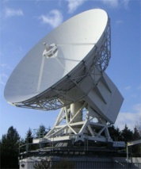

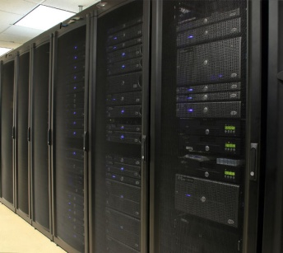
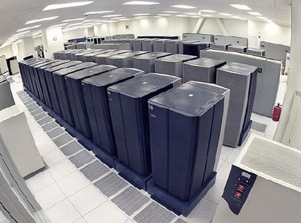
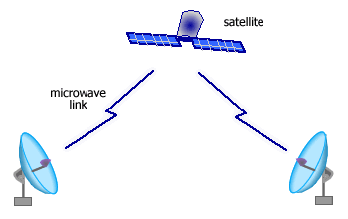
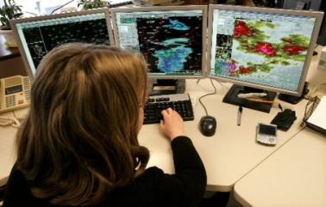
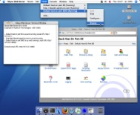
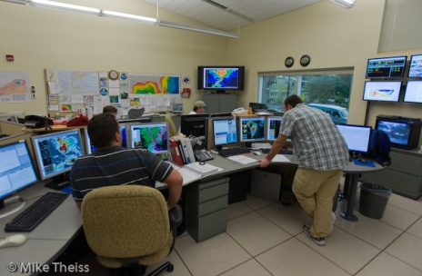
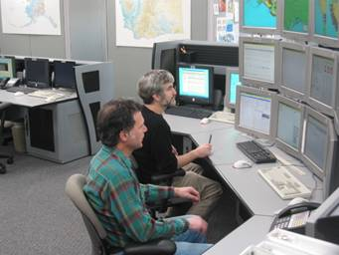
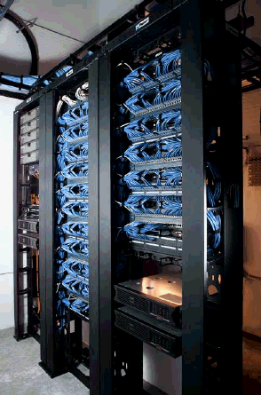
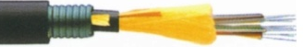
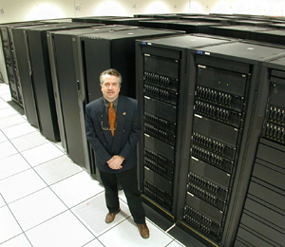

PCW Meteorological Data Flow
Ground Station
Raw data
Products Archival & Retrieval Facility (PARF)
Archive Products
Met Primary Data
Processing Facility (PDPF)
Raw data
Archive Users
Processed
images
WWW & FTP
Other Users
Processed images
Meteorological products
Subset of
Products
Met. Applications
Processing Facility (MAPF)
Products Acquisition & Distribution Facility (PADF)
Near-real time
Products
Foreign National Weather Services
Meteorological products

Slide 15
PCW Meteorological Data Flow
Ground Station
PCW Application Data Center
Raw data
Products Archival & Retrieval Facility (PARF)
Archive Products
Met Primary Data
Processing Facility (PDPF)
Raw data
Archive Users
Processed
images
WWW & FTP
Other Users
Processed images
Meteorological products
Subset of
Products
Met. Applications
Processing Facility (MAPF)
Products Acquisition & Distribution Facility (PADF)
Near-real time
Products
Foreign National Weather Services
Meteorological products

Slide 16
PCW DATA CENTER
FACILITIES

Slide 17
Functions associated with Data Pre-processing
Primary Data Processing Facility (PDPF)
Nominally developed by CSA, operated by EC
Generate geometrically rectified and radiometrically corrected images from the level 0 (raw) data which enter the PDPF from the Primary Ground Station. This involves the following actions:
  Data acceptance and Preparation
  Level 0 Data pre-processing
  Navigation extraction
  Level 0 data resampling
  Radiometric calibration processing
  Geometric Calibration processing
  Radiometric quality assessment
  Geometric quality assessment

Slide 18
PDPF Functional Architecture and Interfaces
Primary Ground Station
(PGS)
Met. Primary Data
Processing Facility (PDPF)
0
Level 0 Checking
Pre-Processing
Level 0 to 1c Processing
Navigation Extraction
Level 0 data resampling
Geometric Calibration
Radiometric Calibration
Space Weather and Other
L1
Other Products Generators
Meteorological Data Radiometric and Geometric
Quality Assessment
Calibration
Meteorological Applications Processing Facility
(MAPF)
Products
Archive and Retrieval Facility
(PARF)
Image Quality
0
1c
Transfer Image Data
1b
1c
Products
Acquisition and Distribution Facility
(PADF)
1b
1c

Slide 19
Functions associated with Product Generation Meteorological Application Product Facility (MAPF)
  Meteorological Product generation is performed within the Meteorological Application Product Facility (MAPF) from Level 1 image data supplied by the Primary Data Processing Facility (PDPF).
  After quality control, encoded products are delivered to users and to the Product Archive and Retrieval Facility (PARF) for online and offline retrieval. MAPF functions include:
  Reception of processed image data and associated auxiliary data from the Meteorological Primary Data Processing Facility (PDPF). These include all Level 1 data
  Data checking and acceptance

Slide 20
Functions associated with Product Generation Meteorological Application Product Facility (MAPF)
MAPF functions (cont.)
  Meteorological product (and other as required) generation (Level 2 and above)
  Calibration monitoring
  Product verification
  Analysis and reporting
  Visualisation and analysis
  Monitoring and control
  Distribution of products to the Product Acquisition and Dissemination Facility (PADF)

Slide 21
MAPF Functional Architecture and Interfaces
Met. Primary Data
Processing Facility (PDPF)
1b
1c
Meteorological Applications Processing Facility
(MAPF)
Data Checking
Acceptance
Data Integrity
External
Data
Product Generation
Science Team
(R&D)
Image Quality
Algorithms
Calibration
Calibration Monitoring
Cal/Val
Product
Verification Validation
& Reporting
Product Quality
U
S
E
R
S
Products
Acquisition and Distribution Facility
(PADF)
Product Availability
Products
Archive and Retrieval Facility
(PARF)
1c
2,3
Products
Transfer
2,3
EC Forecast
Office
Forecast
Analysis

Slide 22
Functions associated with Product Distribution Product Acquisition and Distribution Facility (PADF)
The PADF performs the acquisition and the distribution of PCW image data and meteorological products generated by EC or by other entities (TBD).
The data streams coming into the PADF will include:
  Processed Image data from the Meteorological Primary Data Processing Facility (PDPF)
  Meteorological products from the MAPF
  Archive Products from the PARF and/or other entities (TBD)
  Service messages (e.g. service or test messages)
  Others (for future extension)

Slide 23

PADF Functional Architecture and Interfaces
Users
Archive Data Users
Registered Users
Operational (Weather) Services
WWW
Products Acquisition and Distribution Facility (PADF)
User Support
PCW Web Site
Data Hub
Near Real Time Dissemination (Land lines or Telecast)
Public at Large Products
Subset of L 1c,2,3 Products
Subset of L1c, 2,3 Products
Scheduling
Near Real Time Products
1b,c
2,3
1c
2,3
Products
Archive and Retrieval Facility
(PARF)
Meteorological Applications Processing Facility
(MAPF)

Slide 24
Functions associated with Archiving & Retrieval Products Archive & Retrieval Facility(PARF)
The Users Requirement Document (URD) [Ref.1] defines the archiving requirements as follows:
  PCW meteorological data must be archived. Details are to be developed, but the following are current requirements: Level 0, 1c and 2 data is required to be archived indefinitely, along with the accompanying metadata including satellite information. Level 1b data must be stored for 5 years after acquisition.
The data archiving system should be able to generate any Level 1b data files on demand, starting from Level 0 data and corresponding metadata.

Slide 25
Functions associated with Archiving & Retrieval Products Archive & Retrieval Facility(PARF)
The Product Archive and Retrieval Facility (PARF) should provide the following functions:
  Acquisition & archiving of images data up to Level 1c
  Acquisition and archiving of Level 2 and above products elaborated by the MAPF
  Acquisition and archiving of Level 2 and above products elaborated by other entities (TBD)
  Generation and maintenance of catalogues covering the archived data sets
  Provision of on-line catalogue query and product retrieval

Slide 26
Functions associated with Archiving & Retrieval Products Archive & Retrieval Facility(PARF)
  Provision to the end users of a comprehensive set of services allowing access to the archived data sets and related information
  Provision of an information service giving access to PCW or PARF specific operations-related data
  Provision of an interface to the other facilities in the Ground Segment for generating/updating information of relevance to the end users covering operational aspects
  Distribution of products to the Product Acquisition and Dissemination Facility (PADF) (TBC)

Slide 27
PARF Functional Architecture and Interfaces
Primary Data Processing Facility
(PDPF)
Meteorological Applications Processing Facility
(MAPF)
0,1b,c
2,3
Products Archive & Retrieval Facility
(PARF)
Acquisition
Archive Repository
Formatting & Delivery
Products
Acquisition and Distribution Facility
(PADF)
Catalogue
User Services
PARF
USERS

Slide 28
PARF Functional Architecture and Interfaces
Other Government Agencies (mixed option)
Other Products Providers
Primary Data Processing Facility
(PDPF)
Meteorological Applications Processing Facility
(MAPF)
Products
0,1b,c
2,3
Local Repository
Products Archive & Retrieval Facility
(PARF)
Formatting & Delivery
2,3
Acquisition
Catalogue
Archive Repository
Formatting & Delivery
Products
Acquisition and Distribution Facility
(PADF)
User Services
User Services
Catalogue
PARF
USERS
Direct Users

Slide 29
Calibration, Validation, and Reprocessing
CEOS WORKING GROUP on Cal/Val:
  Calibration: The process of quantitatively defining the system responses to known, controlled signal inputs.
  Validation: The process of assessing, by independent means, the quality of the data products derived from the system outputs.
GSICS (Global Space-based Inter-Calibration System)
  The PCW application ground segment should be designed to adhere to GSICS conventions on Cal/Val
  Small impact on archive and reprocessing facilities
Notes:
Functions associated with Calibration and Validation
within PDPF:
Perform routine modification of calibration coefficients (using on-board measurements)
Monitor and update the calibration values used to generate Level 1c images
Forward the calibration constants values to the Meteorological Product Application Facility (MAPF)
Within MAPF:
Assess the quality of the calibration coefficients using meteorological data
Propose recommendations to the PDPF in preparation for next image
Perform routine validation through inter-comparison as part of GSICS activities
Analyze historical calibration data to find out if a problem exists
Perform reprocessing of past products, as required, using the Reprocessing Facility

Slide 30
Functions associated with Calibration and Validation
Within PDPF:
  Perform routine modification of calibration coefficients (using on-board measurements)
  Monitor and update the calibration values used to generate Level 1c images
  Forward the calibration constants values to the Meteorological Product Application Facility (MAPF)

Slide 31
Functions associated with Calibration and Validation
Within MAPF:
  Assess the quality of the calibration coefficients using meteorological data
  Propose recommendations to the PDPF in preparation for next image
  Perform routine validation through inter-comparison as part of GSICS activities
  Analyze historical calibration data to find out if a problem exists
  Perform reprocessing of past products, as required, using the Reprocessing Facility

Slide 32
PCW Application Ground Segment Functional Architecture: Reprocessing Facility
Products Archive and Retrieval Facility
(PARF)
Meteorological Applications
Processing Facility (MAPF)
Levels 2 & above Products Repository
2,3
Levels 2 & above Processing
Level 0
Repository
GSICS Products &
Calibration
Repository
Level 1
Repository
L0
L1
2,3
Reprocessing Facility (RF)
Level 0 to 1
Processing
L1
Levels 2 & above Processing
Off-Line
USERS

Slide 33
Functions associated with Mission Monitoring, Reporting, & User Support
Mission monitoring and reporting (within MAPF):
  Product quality assessment
  Provision of statistics on product delivery, timeliness, availability
  Preparation of reports for users and management
User support (within PARF and PADF):
  Answer to queries
  Interface with users for PARF and other products
  Elaboration and distribution of information material (written form or web-based)

Slide 34
BASELINE LIST OF PRODUCTS

Slide 35
Baseline List of PCW Products (1)
PRODUCT | Repeat Cycle | Latency | COMMENT
Level 1c imagery | 15 min | 15 min | Calibrated, mapped to standard grid (15 min refresh)
Level 2 imagery | 15 min | 30 min | Composite of 2 satellites
AMV: Atmospheric Motion Vectors | 1 hour | 1 hour | Latency is w.r.t. oldest image of triplets/duos used for tracking
Cloud mask | 15 min | 30 min | Important for direct assimilation of radiances
Cloud height, amount, emissivity, temperature | 15 min | 30 min | Important for AMV
Volcanic ash height (optical depth) | 15 min | 30 min | When active. Done at Dorval volcanic ash advisory center. Could develop a SO2 product as well.
Fog and surface visibility | 15 min | 30 min
Forest fires. Hot spots | 3 hours | 1 hour | Product elaborated either, or both at CCRS and CFC
Baseline List of Products from PCW Imager (as of 16 September 2010)
Imagery and Priority 1 Products
Note: Near real time products are derived from Level 1c

Slide 36
Baseline List of PCW Products (2)
PRODUCT | Repeat Cycle | Latency | COMMENT
Ice motion vector | TBD | TBD | To be defined (e.g. Canadian Ice Service)
Snow/ice mapping (cover and depth) | 6 hours | 6 hours | Derived from 15 min. Resolution 2 km. May include snow grain size.
SST: sea surface temperature | 1 hour | 2 hours | Resolution 4 km
LST: land surface temperature | 1 hour | 2 hours | Resolution 4 km
Surface albedo | 6 hours | 6 hours | Resolution 10 km. Could be done at CCRS
Aerosol optical depth | 3 hours | 6 hours | Resolution 10 km
Atmospheric stability index | 1 hour | 1 hour | Resolution 10 km
Aircraft icing threat | 1 hour | 15 min | Resolution 10 km
Total ozone | 1 hour | 1 hour | Resolution 10 km
Note: Level 2 products are retrievals made from Level 1c. Level 3 products defined at a coarser resolution. Surface parameters are only available in clear air (mask =0) or when the sun angle allows. In areas devoid of observations, the pixels are either left blank or replaced by a previously obtained value.
Baseline List of Products from PCW Imager (as of 16 September 2010)
Priority 2 - Level 2/3 generated by EC

Slide 37
Baseline List of PCW Products (3)
PRODUCT | Repeat Cycle | Latency | COMMENT
Vegetation Index | 1 day | 1 day | Resolution 1 km
FPAR | 1 day | 1 day | Fraction of Absorbed Photosynthetically Active Radiation. Resolution 1 km
LAI: Leaf Area Index | 1 day | 1 day | Resolution 2 km
Radiative fluxes | 1 hour | 1 day | Resolution 10 km (SW, LW, PAR at surface and TOA)
Land surface emissivity | 1 day | 1 day | 4km consistent with LST product
Archive Products: Levels 0, 1c and 2 are archived forever at CMC, and Level 1b for 5 years. In addition rotating archive of Level 0 at ground receiving station.
Baseline List of Products from PCW Imager (as of 16 September 2010)
Priority 2 - Level 3 climate essential variables products and archive
Products can be elaborated by EC or Other Government Department

Slide 38
DATA VOLUMES

Slide 39
Near Real Time Data Volumes
Level 0 data received by the Primary Data Processing Facility (PDPF)
Level 1 data received, and Level 2,3 data transmitted, by the Meteorological Application Processing Facility (MAPF)
Level 1,2,3 data distributed by the Product Acquisition and Distribution Facility (PADF)

Slide 40
Other Products Data Volumes
Archive and Retrieval (PARF)
  Level 0,1,2,3 data received by the Archive & Retrieval Facility (PARF)
  Level 1,2,3 data processed by the PARF to Users
  Level 0,1,2,3 data processed by the PARF for GSCIS (Cal/Val) and reprocessing purposes
FTP/WEB Site for registered Users
WWW Site for Public Users

Slide 41
Preliminary Data Volumes Estimates
Level 2,3 Products |  |  |  | Measures | Vol Scene | Vol Day | Yearly
 |  |  |  | per day | Mbytes | MBytes | Gbytes
Wind Low( >700 hPa) |  |  |  | 2.43E+06 | 0.22 | 5.17 | 2
Wind Mid (400-700 hPa) |  |  |  | 2.43E+06 | 0.22 | 5.17 | 2
Wind Upper <400 hPa) |  |  |  | 2.43E+06 | 0.22 | 5.17 | 2
Cloud mask |  |  |  | 3.50E+08 | 2.33 | 223.40 | 82
Cloud height |  |  |  | 3.50E+08 | 7.76 | 744.68 | 272
Cloud amount |  |  |  | 3.50E+08 | 7.76 | 744.68 | 272
Cloud emissivity |  |  |  | 3.50E+08 | 7.76 | 744.68 | 272
Cloud top temperature |  |  |  | 3.50E+08 | 7.76 | 744.68 | 272
Integrated Humidity |  |  |  | 1.40E+07 | 0.31 | 29.79 | 11
Volcanic ash height |  |  |  | 3.50E+08 | 7.76 | 744.68 | 272
Volcanic ash optical depth |  |  |  | 3.50E+08 | 7.76 | 744.68 | 272
Fog |  |  |  | 2.19E+09 | 48.48 | 4654.26 | 1699
Surface visibility |  |  |  | 2.19E+09 | 48.48 | 4654.26 | 1699
Fire hot spots |  |  |  | 1.83E+08 | 48.48 | 387.86 | 142
Ice motion vector |  |  |  | 2.19E+07 | 1.94 | 46.54 | 17
Snow/ice cover |  |  |  | 9.13E+07 | 48.48 | 193.93 | 71
Snow/ice depth |  |  |  | 9.13E+07 | 48.48 | 193.93 | 71
SST: sea surface temp. |  |  |  | 2.19E+07 | 1.94 | 46.54 | 17
LST: land surface temp. |  |  |  | 3.50E+08 | 7.76 | 744.68 | 272
Surface albedo |  |  |  | 9.13E+07 | 48.48 | 193.93 | 71
Total Aerosol optical depth |  |  |  | 9.73E+06 | 0.86 | 20.69 | 8
Atmospheric stability index |  |  |  | 8.76E+07 | 1.94 | 186.17 | 68
Aircraft icing threat |  |  |  | 2.19E+07 | 1.94 | 46.54 | 17
Total ozone |  |  |  | 1.40E+07 | 0.31 | 29.79 | 11
Vegetation Index |  |  |  | 9.13E+07 | 193.93 | 193.93 | 71
FPAR |  |  |  | 9.13E+07 | 193.93 | 193.93 | 71
LAI: Leaf Area Index |  |  |  | 2.28E+07 | 48.48 | 48.48 | 18
Radiative fluxes |  |  |  | 2.19E+07 | 1.94 | 46.54 | 17
Land surface emissivity |  |  |  | 2.28E+07 | 12.12 | 48.48 | 18
Preliminary Data Volumes: Imagery
Product | Daily (GigaBytes) | Yearly (TeraBytes)
Level 0 | 499 | 182
Level 1b | 794 | 290
Level 1c | 148 | 54
Level 2 | 70 | 26
Level 3 | 17 | 6
Preliminary Data Volumes: Imagery MDA Estimates
Product | Daily (GigaBytes) | Yearly (TeraBytes)
Level 0 | 612 | 224
Level 1b | 1102 | 403
Level 1c | 735 | 269
Sounder
Product | Daily (GigaBytes) | Yearly (TeraBytes)
All Channels | 1686 | 616
Used by EC | 63 | 23

Slide 42
Preliminary Data Volumes Estimates
 | INPUT VALUES: Imagery
 | Imagery Level 0 to Level 1c |  |  |  |  | Enter values below |  |  |  | 99 = Place holder
 | Spatial Resolution of a given Channel (km) |  |  |  |  | 0.5 | 1 | 1.5 | 2 | 99 | 99
 | Number of channels with resolution X: Level 0 |  |  |  |  | 1 | 6 |  | 13 | 0 | 0
 | Number of channels with resolution X: Level 1b |  |  |  |  | 1 | 6 | 0 | 13 | 0 | 0
 | Number of channels with resolution X: Level 1c |  |  |  |  | 0 | 0 | 7 | 13 | 0 | 0
 | Number of bytes per pixel |  |  |  |  | 10 | 10 | 10 | 10 | 10 | 10
 | Number of full Images per day (2 Satellites) |  |  |  |  | 132 | 132 | 132 | 132 | 132 | 132
 | Side of Full Image (Square of Side X): Enter X (km) |  |  |  |  | 13,000
 | Formatting & other Overhead Level 0 (in %) |  |  |  |  | 35%
 | Data Overhead Level 1b (in %) |  |  |  |  | 80%
 | Data Overhead Level 1c (in %) |  |  |  |  | 20%
 | Ratio of Level 1c Scene over full disk (in %) |  |  |  |  | 54%
 | Imagery Level 2 |  |  |  |  | Enter values below
 | Number of bits per pixel Level 2 |  |  |  |  | 10
 | Data Overhead Level 2 (in %) |  |  |  |  | 100% |  |  |  |  |  | 99 = Place holder
 | Spatial Resolution X of a given Product Level 2 |  |  |  |  | 0.5 | 1 | 1.5 | 2 | 5 | 10 | 99 | 99 | 99 | 99
 | Ratio of Level 2 scene size S over full Image (in %) |  |  |  |  | 60% | 60% | 60% | 60% | 60% | 60% | 60% | 60% | 60% | 60%
 | Level 2 Imagery Repeat Cycle (min) for given product |  |  |  |  | 15 | 15 | 15 | 15 | 15 | 15 | 15 | 15 | 15 | 15
 | INPUT VALUES: Sounding Instrument
 | FTS |  |  |  |  | Enter values below
 | Spatial Resolution of a Measure |  |  |  |  | 10
 | Number of Downlinked Channels |  |  |  |  | 8000
 | Number of Bits per Measure |  |  |  |  | 10
 | Size of Scene (km2) |  |  |  |  | 9.E+07
 | Overhead per Scene (%) |  |  |  |  | 40%
 | Number of Scenes per Orbit |  |  |  |  | 33
 | Number of Orbits per Day (2 satellites) |  |  |  |  | 4
 | Number of Channels used by EC |  |  |  |  | 300

Slide 43
Preliminary Data Volumes Estimates
 | Level 2, 3 Products
 | Enter values | R.C (min) | Res(km) | Bits | Overhead
 | Wind Low( >700 hPa) | 60 | 30 | 10 | 70%
 | Wind Mid (400-700 hPa) | 60 | 30 | 10 | 70%
 | Wind Upper <400 hPa) | 60 | 30 | 10 | 70%
 | Cloud mask | 15 | 5 | 3 | 70%
 | Cloud height | 15 | 5 | 10 | 70%
 | Cloud amount | 15 | 5 | 10 | 70%
 | Cloud emissivity | 15 | 5 | 10 | 70%
 | Cloud top temperature | 15 | 5 | 10 | 70%
 | Integrated Humidity | 15 | 25 | 10 | 70%
 | Volcanic ash height | 15 | 5 | 10 | 70%
 | Volcanic ash optical depth | 15 | 5 | 10 | 70%
 | Fog | 15 | 2 | 10 | 70%
 | Surface visibility | 15 | 2 | 10 | 70%
 | Fire hot spots | 180 | 2 | 10 | 70%
 | Ice motion vector | 60 | 10 | 10 | 70%
 | Snow/ice cover | 360 | 2 | 10 | 70%
 | Snow/ice depth | 360 | 2 | 10 | 70%
 | SST: sea surface temp. | 60 | 10 | 10 | 70%
 | LST: land surface temp. | 15 | 5 | 10 | 70%
 | Surface albedo | 360 | 2 | 10 | 70%
 | Total Aerosol optical depth | 60 | 15 | 10 | 70%
 | Atmospheric stability index | 15 | 10 | 10 | 70%
 | Aircraft icing threat | 60 | 10 | 10 | 70%
 | Total ozone | 15 | 25 | 10 | 70%
 | Vegetation Index | 1440 | 1 | 10 | 70%
 | FPAR | 1440 | 1 | 10 | 70%
 | LAI: Leaf Area Index | 1440 | 2 | 10 | 70%
 | Radiative fluxes | 60 | 10 | 10 | 70%
 | Land surface emissivity | 360 | 4 | 10 | 70%
 | R.C = Repeat Cycle
 | Res = Spatial Resolution

Slide 44
CREATING THE PCW DATA PROCESSING CENTER

Slide 45
PCW Data Processing Center Functional Architecture
The following slides present first concepts of the PCW Data Processing Center overall functional architecture for two cases:
  A Baseline, with only meteorological products elaborated by EC
  An option including products generated by other entities (Government Department, Universities etc…)
Other options were studied but are not presented here

Slide 46
PCW Data Processing Center Functional Architecture (EC products only)
Users
Archive Data Users
Registered Users
Subset Products
Near Real Time Users
PCW Data
Processing
Center
Archive Product
WWW
(PARF)
User Services
(PADF)
Non-Near Real Time Data Delivery
(RF)
PCW Web Site
Near Real Time
Dissemination
Level 0, 1,2,3
Repository
Level 0 to 1
Level 2,3
L2,3
R&D
(MAPF)
Ground Station
L1
Level 1 to 2,3 Processing
L₀
(PDPF)
L₁
L0
Level 0 to 1
Processing
L₂ and L₃
General
products

Slide 47
PCW Data Processing Center Functional Architecture (Other Providers- Balanced)
Users
Archive Data Users
Registered Users
Subset Products
Near Real Time Users
Archive Product
WWW
(PARF)
User Services
(RF)
(PADF)
Level 0, 1,2,3
Repository
Non-Near Real Time Data Delivery
PCW Web Site
Near Real Time
Dissemination
Level 0 to 1
Level 2,3
R&D
Direct Users
L2,3
(MAPF)
Ground Station
L1
Level 1 to 2,3 Processing
Other Products Providers
(PDPF)
L0
Level 0 to 1
Processing
Products
Generation
Local
Archive

Slide 48
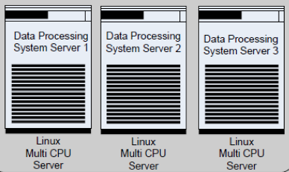
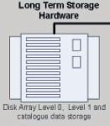



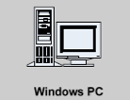

Building the PCW Data Processing Center:
System Architecture
PDPF Processing
MAPF Processing
Reprocessing
PADF Dissemination
PARF Archive Storage and Servers
PDPF Operators
MAPFF Operators
PADF Operators
PARF Order Servers
Image Quality Assessment
MAPF Products Quality Assessment
PARF Processors
Analysis & Corrections
Calibration
Reprocessing
Ftp/Proxy Servers
WWW Servers

Slide 49
PCW DATA PROCESSING CENTER
MANPOWER RESOURCES ESTIMATE

Slide 50
PCW Data Processing Center
Manpower Resources Estimates
Operational Staffing Needs
  Data Processing and Product Generation
  Archiving, Retrieval and User Services
  Product Distribution and Dissemination
  Maintenance, Engineering and Infrastructure
Research and Development Staffing Needs
  Algorithm Improvement
  Product Validation
  New Products Implementation

Slide 51
PCW Data Processing Center
Manpower Resources (Summary)
PCW
Data Center
Total Staff:78
Operations
Management
1
R&D Science
9
Admin
Support
4
PDPF
19
MAPF
11
PARF
7
PADF
14
ME&I
13

Slide 52
PCW Data Processing Center
Manpower Resources
Primary Data
Processing Facility
PDPF
Manager
1
Met. Application
Processing Facility
MAPF
Met. Products
Generation
Manager
1
Total:19
Total:11
Shift
14
Calibration
Experts
2
Image
Processing
Experts
2
Operational
Meteorologists
4
Remote Sensing
Experts
2
Cal/Val
Experts
2
Met.Products
S/W Engineers
2
Product Archive &
Retrieval Facility
PARF
Product Acquisition &
Dissemination Facility
PADF
Products
Dissemination
Manager
1
Archives &
User Service
Manager
1
Total:7
Total:14
Data Services
& Archive
Operators
3
User Services
& Help Desk
Operators
2
Web & S/W
Development
1
Training
0
Data Processing
Engineers
2
Dissemination
Engineers
2
Shift
Operators
7
User Helpdesk
2

Slide 53
PCW Data Processing Center
Manpower Resources (2)
Science Team
R&D
Management
& Support
MAN
Team Leader
1
Total:5
Total:9
Manager
1
Meteorological
Scientists
4
Rem.Sensing
Scientists
2
Validation
Scientist
1
Algorithm Dev.
Scientist
1
Admin
Support
4
Maintenance Engineering
& Infrastructure Support
ME&I
Maintenance
& Engineering
Manager
1
Total:13
Computer
Systems
3
Comms &
Dissemin.
2
Config. Mngt
& Control
2
System
Infrastructure
2
Data Proc
& Access
3

Slide 54
Staffing Optimization
Interfaces
Primary Data Processing Facility
(PDPF)
Shift
Meteorological Applications Processing Facility
(MAPF)
Product Archive & Retrieval Facility
(PARF)
Reprocessing Facility
(RF)
User Support
Product Acquisition & Distribution Facility
(PADF)
R&D
Maintenance & Engineering
Management and Admin. Support

Slide 55
EUMETSAT Ground Segment Staffing:
For Comparison
Operations
240-69-171
Division
Tot-Staff-Contr
Control Centre
110-22-88
Maintenance
& Engineering
77-17-60
Met Ops
30-18-12
Archive &
User Services
21-10-11
Prog.Dev.
112-92-20
GEO
16-16-0
LEO
29-25-4
Met
27-21-6
Prog.Prep.SAF
11-9-2
Sys.Eng Sup.
27-19-8

Slide 56
SUGGESTIONS AND RECOMMENDATIONS

Slide 57
Key Decisions by Management
Respective roles and responsibilities between partners on PCW Programme development, implementation and operations
Location of Ground Segment facilities
Procurement strategy
Recruitment strategy
(Approval and funding of the PCW Programme)

Slide 58
Suggestions and Recommendations
General
Aim: Elaborate strategies that will minimize risks, efforts, duplication, and costs during the different phases of the Programme
Recommendations:
  Develop in house expertise to ensure that EC can best fulfill its mandate
  Seek and use existing, proven methodologies and end-to-end products developed by NOAA or others
  Develop awareness and involve existing EC, University scientists in the project
  Fund polar and remote sensing research

Slide 59
Suggestions and Recommendations
Space Segment
Support CSA and ensure proper participation in relevant studies and in the decision process:
  Preparation of documentation
  Participate in industrial reviews, trade-off studies
  Interface (Space/Ground Segments)
  Meteorological sensor development and calibration
  Additional sensors (e.g. choice, impact on Ground Segment)
  Acquisition and dissemination schemes
  Data Formats (adherence to GSICS conventions)

Slide 60
Suggestions and Recommendations
Ground Segment
Perform a study to asses, and decide on, options for the location of the various elements of the Ground Segment
  Co-locate all facilities (except the Primary Ground Station)?
  Co-locate at EC-Dorval?
  Co-locate at CSA?
  Co-locate at another site (government or not)?
  Do not co-locate some of the facilities?

Slide 61
Suggestions and Recommendations
Ground Segment
Establish a joint (CSA-EC) Ground Segment team to ensure:
  Efficient interfaces between Level 1 image products developed and delivered by CSA
  Development and implementation of cost efficient and technically sound archiving and dissemination strategies
  A “smooth” transition between development and operational phases

Slide 62
Suggestions and Recommendations
Ground Segment (cont.)
  Assess in-house vs. industrial development and implementation of some elements of the ground segment facilities
Collaborate with providers of other PCW products, (Government Departments, Universities) and agree on product generation, archiving and distribution
  “Space Weather” products
  Science package (e.g. FTS)

Slide 63
Suggestions and Recommendations
Data Processing, Calibration/Validation
Product software packages strategy
  Collaborate with NOAA, EUMETSAT and assess the feasibility to re-use existing software packages developed for GOES-R, MTG, METOP
  Request industry to develop “portable” software packages, independent of hardware choices
  Develop and implement the reprocessing facility and use it for testing and validation purposes
  Participate in CGMS and GSICS meetings to benefit from “know-how” and effort sharing

Slide 64
Suggestions and Recommendations
Recruitment (short term)
Establish a team of full time EC staff plus consultancy support to:
  Develop, study, and recommend strategies on programmatic matters (overall planning, procurement and implementation of the ground segment, recruitment)
  Continue discussions with NOAA and other partners on product generation
  Prepare documentation for Phase-B studies
  Liaise with CGMS and GSICS participants

Slide 65
Suggestions and Recommendations
Recruitment and Training (longer term)
  Involve existing EC staff in the project
  Recruit and train post-docs who will participate in the development phases and would be natural candidates for new positions for Phase-E (operations)
  Assess the use of contractors for routine operational tasks whenever possible

Slide 66
Conclusion
This presentation introduced:
  The PCW mission objectives, its current status and major milestones
  A preliminary Ground Segment concept, based on the functions associated with the application facilities
  The current baseline list of products and corresponding data volumes
  Estimates of manpower resources necessary to run the applications ground segment
  A series of suggestions and recommendations

Slide 67
Conclusion: Key Recommendation
EC is facing a new and exciting challenge
EC should allocate enough internal resources to:
  Support EC high level management, in the decision process, through pertinent studies
  Collaborate with:
    CSA on Program development and implementation
    International partners on products software packages and calibration (e.g. NOAA, GSICS)
    Other Canadian Government Departments and Universities on science instrument products

