Slide 1
Mapping Surface NO₂ and PM_{2.5} from Satellite Observations
Randall Martin, Dalhousie University
with contributions from
Aaron van Donkelaar, Dalhousie U
Lok Lamsal, Dalhousie U → NASA Goddard
Colin Lee, U Toronto → Dalhousie U
Environment Canada, Downsview
16 Jan 2011

Slide 2
Major Nadir-viewing Space-based Measurements of Air Quality (Not Exhaustive)
Solar Backscatter & Thermal Infrared
Sensor | GOES Imager | MOPITT | MISR | MODIS | AIRS | SCIA-MACHY | TES | OMI | PARA-SOL | CALIOP | GOME-2 | IASI | VIIRS
Platform (launch) | GOES (varied) | Terra Aqua (1999) ( 2002) |  |  |  | Envisat (2002) | Aura (2004) |  | PARA-SOL (2004) | Calipso (2006) | MetOp (2006) |  | NPP (2011)
Equator Crossing | n/a | 10:30 1:30 |  |  |  | 10:00 | 1:45 |  | 1:30 | 1:30 | 9:30 |  | 1:30
Typical Res (km) | 4x4 | 22x22 | 18x18 | 10x10 | 14 x14 | 60x30 | 8x5 | >24x13 | 18x16 | 40x40 | 80x40 | 12 x12 | 6x6
Global Obs | n/a | 3.5 | 7 | 2 | 1 | 6 | n/a | 1 | 1 | n/a | 1 | 0.5 | 1
Aerosol | X |  | X | X |  | X |  | X | X | X | X |  | X
NO₂ |  |  |  |  |  | X |  | X |  |  | X
HCHO |  |  |  |  |  | X |  | X |  |  | X
CO |  | XX |  |  | X | X | X |  |  |  |  | X
Ozone |  |  |  |  |  | X | X | X |  |  | X | X
SO₂ |  |  |  |  | X | X |  | X |  |  | X
NH₃ |  |  |  |  |  |  | X |  |  |  |  | X

Slide 3

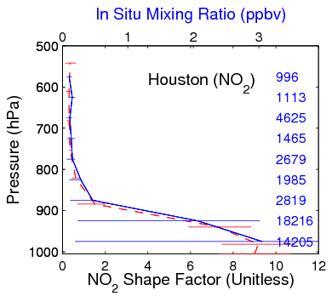
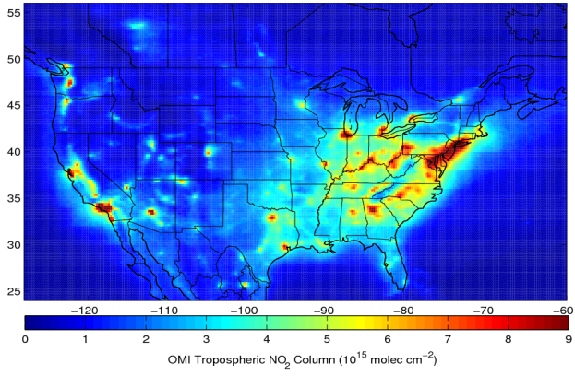
General Approach to Estimate Surface NO₂ Concentration
Method: Solar backscatter
NO2 Column
Model Profile
λ₁
λ₂
In Situ
Model
Scattering by
Earth surface
and atmosphere
Idealized
NO₂
absorption
spectrum
S → Surface Concentration
Ω → Tropospheric column
λ₁
λ₂

Slide 4
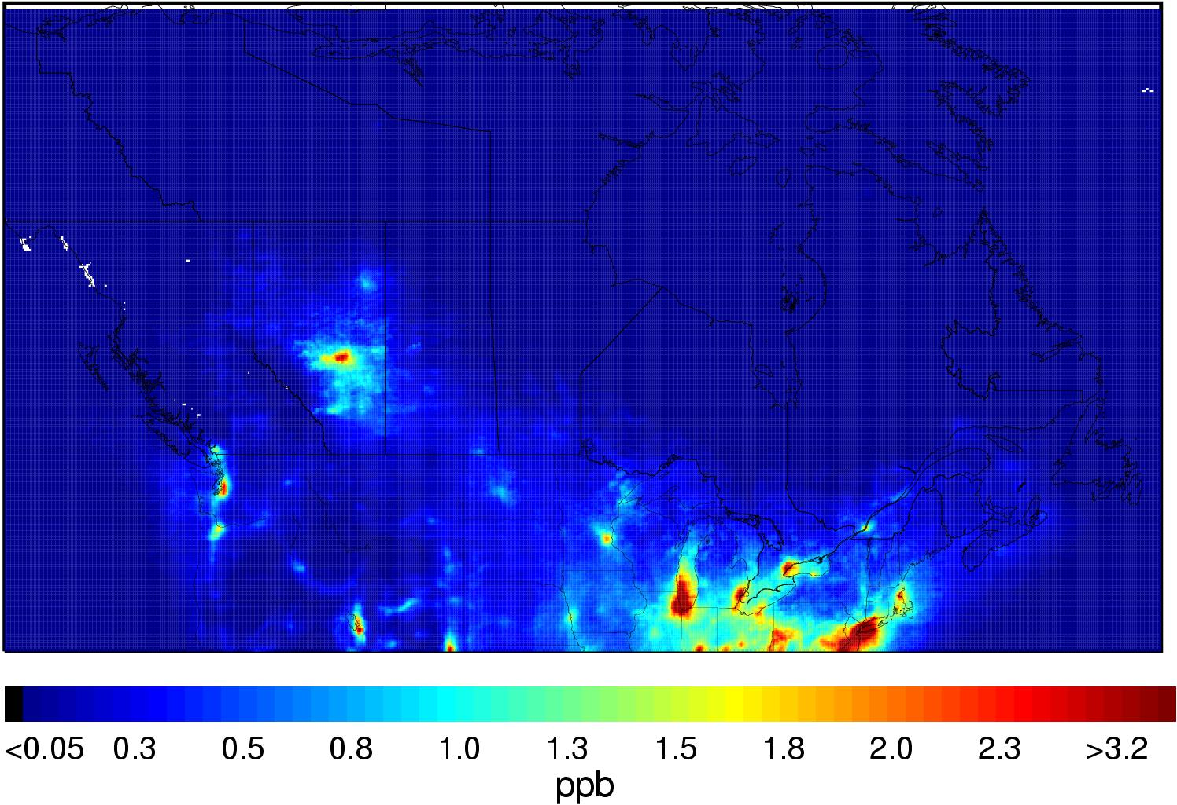
Afternoon Ground-Level NO₂ Inferred From OMI for 2005-2007
NO₂ [ppbv]
Lok Lamsal

Slide 5
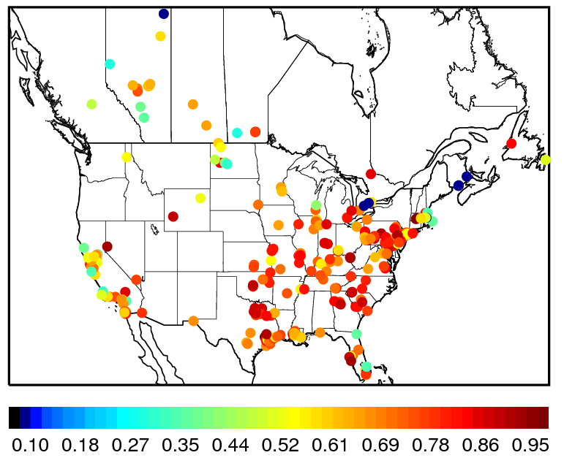
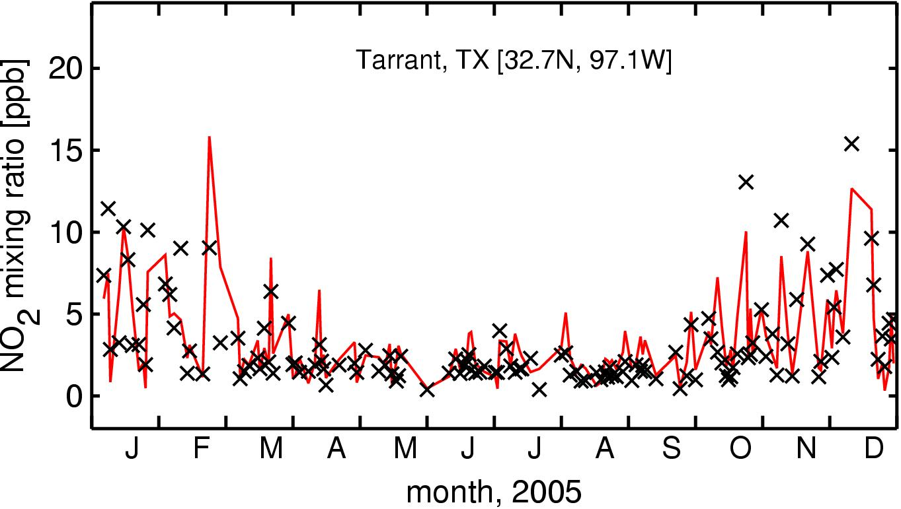
Ground-Level NO₂ Inferred From OMI for 2005
Works in Near-Real-Time!
Values Estimated Using Monthly NO₂ Profiles for Different Year (2006)
Temporal Correlation with In Situ Over 2005
×In situ
—— OMI
Insignificant change in results if profiles are daily coincident values from 2005
Lok Lamsal

Slide 6
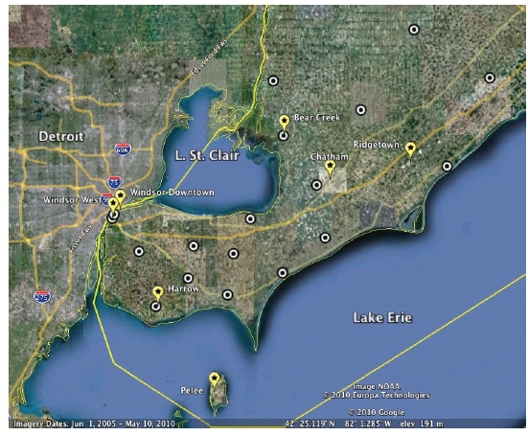
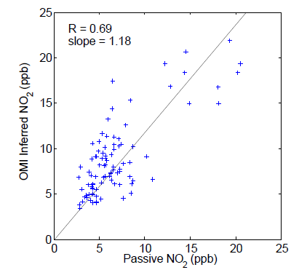
Infer Ground-level NO₂ Between Monitors Using Empirical Column-to-Surface Ratio from In Situ Monitors
Automatically Corrects for Bias in Satellite Column
Passive Sites
Permanent Sites
Lee et al., ACP, 2011

Slide 7
Combine both information sources (Model and In Situ)
Explore with PM_{2.5} inferred from MODIS & MISR AOD

Slide 8
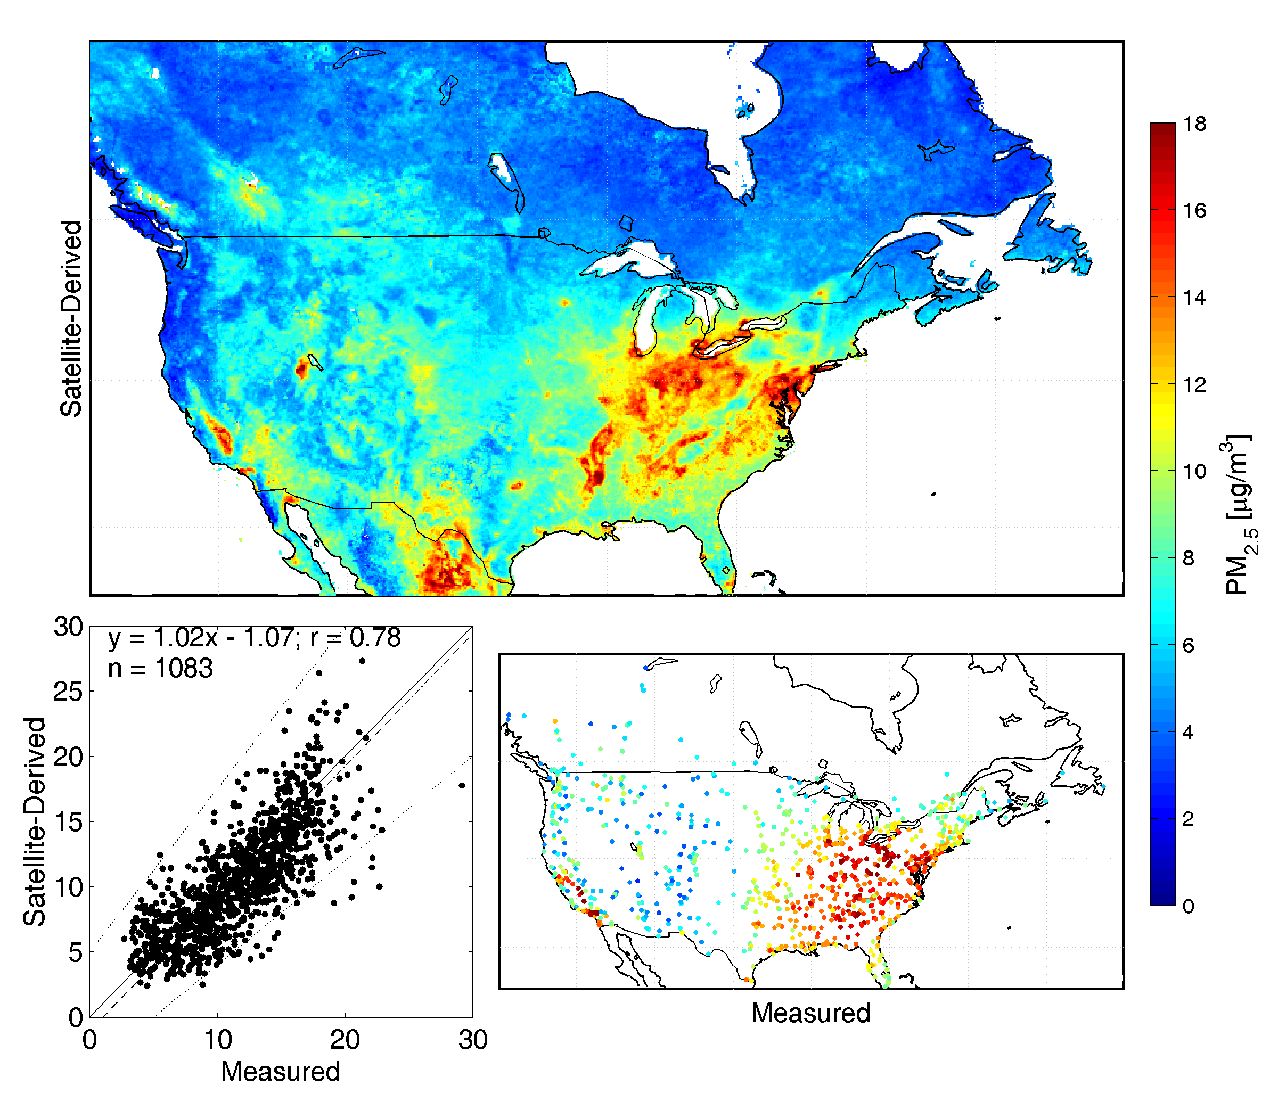
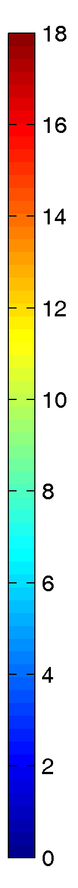
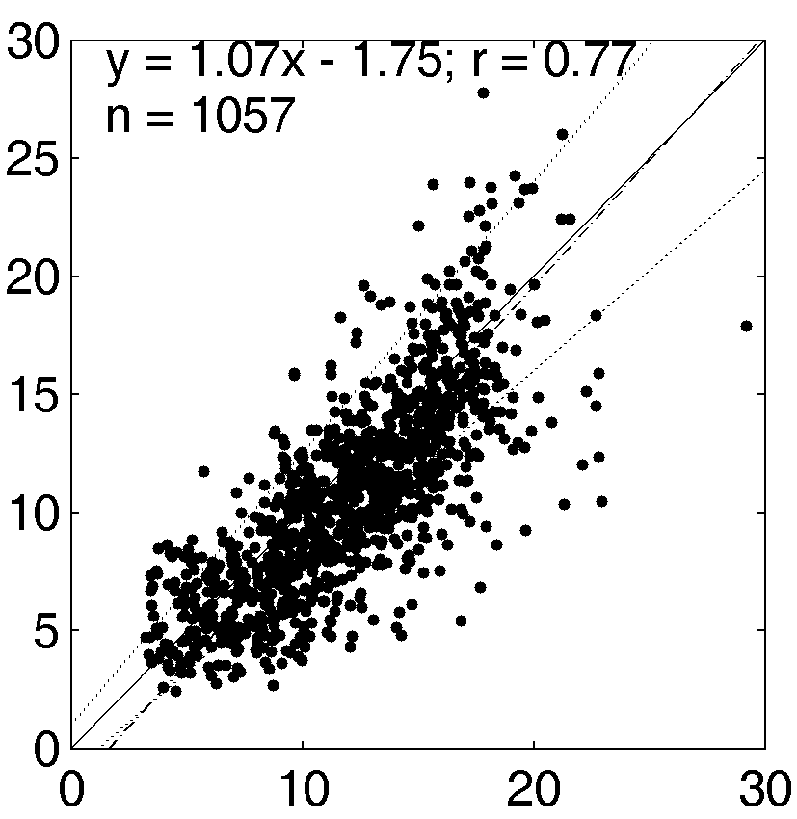
RAW Has Significant Agreement with Long-Term (2001-2006) In situ Measurements
 | r
MODIS AOD | 0.39
MISR AOD | 0.39
Combined AOD | 0.61
Combined PM_{2.5} | 0.77
Annual Mean PM_{2.5} [μg/m³] (2001-2006)
Satellite
Derived
Satellite-Derived [μg/m3]
In-situ
In-situ PM_{2.5} [μg/m³]
van Donkelaar et al., EHP, 2010

Slide 9
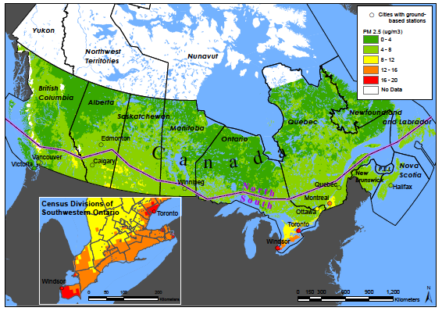
Significant Association of Long-Term PM_{2.5} Exposure with Cardiovascular Mortality
Crouse et al., EHP, submitted

Slide 10
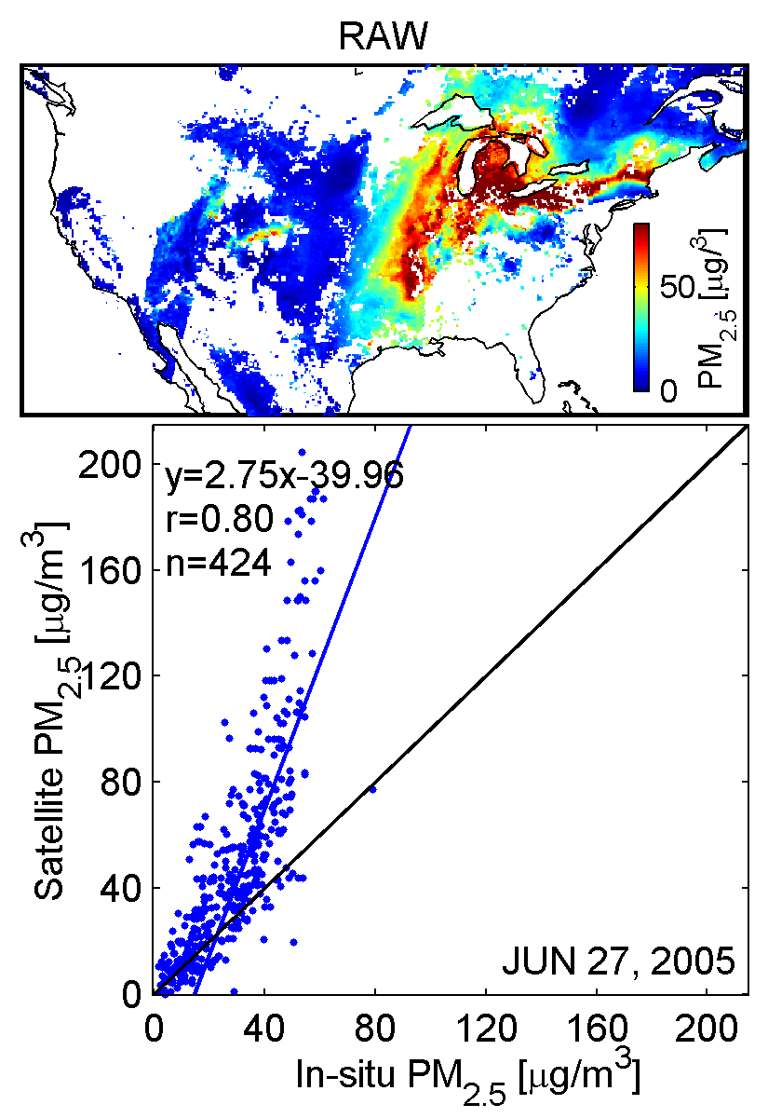
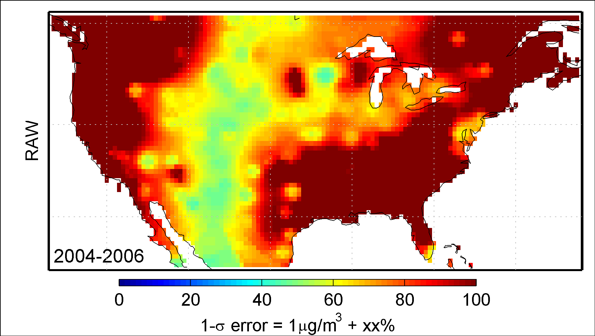
RAW Has Limited Daily Skill
Mean daily error can exceed 100%!
Aaron van Donkelaar

Slide 11
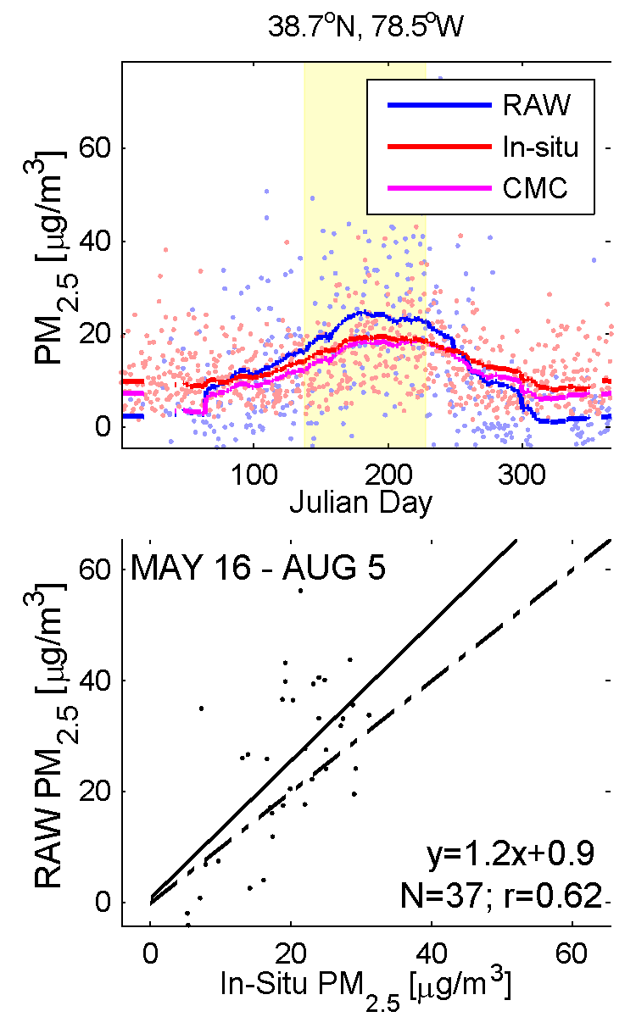
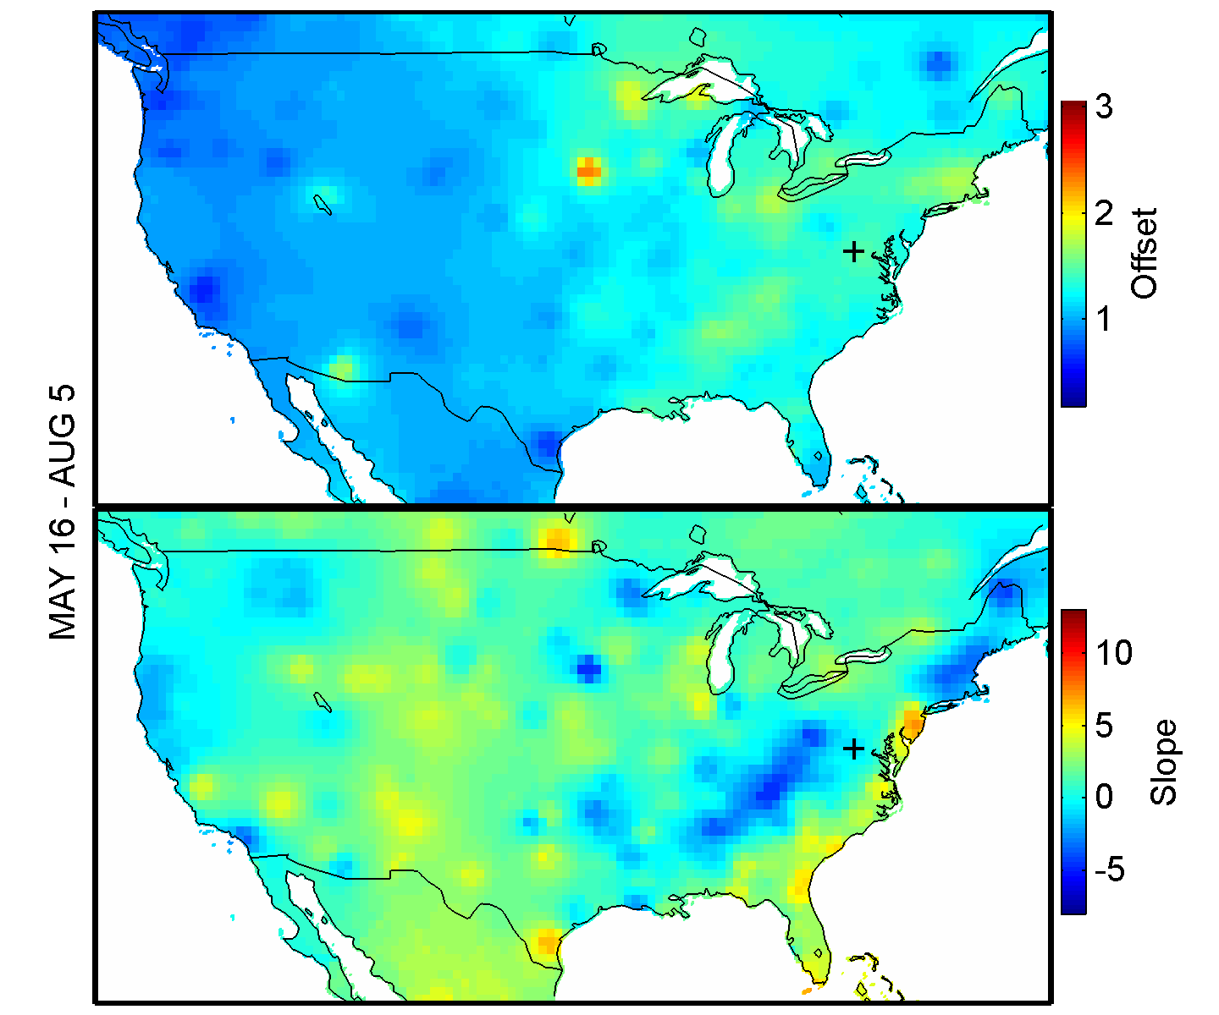
Climatological Monitor Correction (CMC) to Correct Bias
Regress 90-day running comparisons
Make correction surface using IDW² weighted average

Slide 12
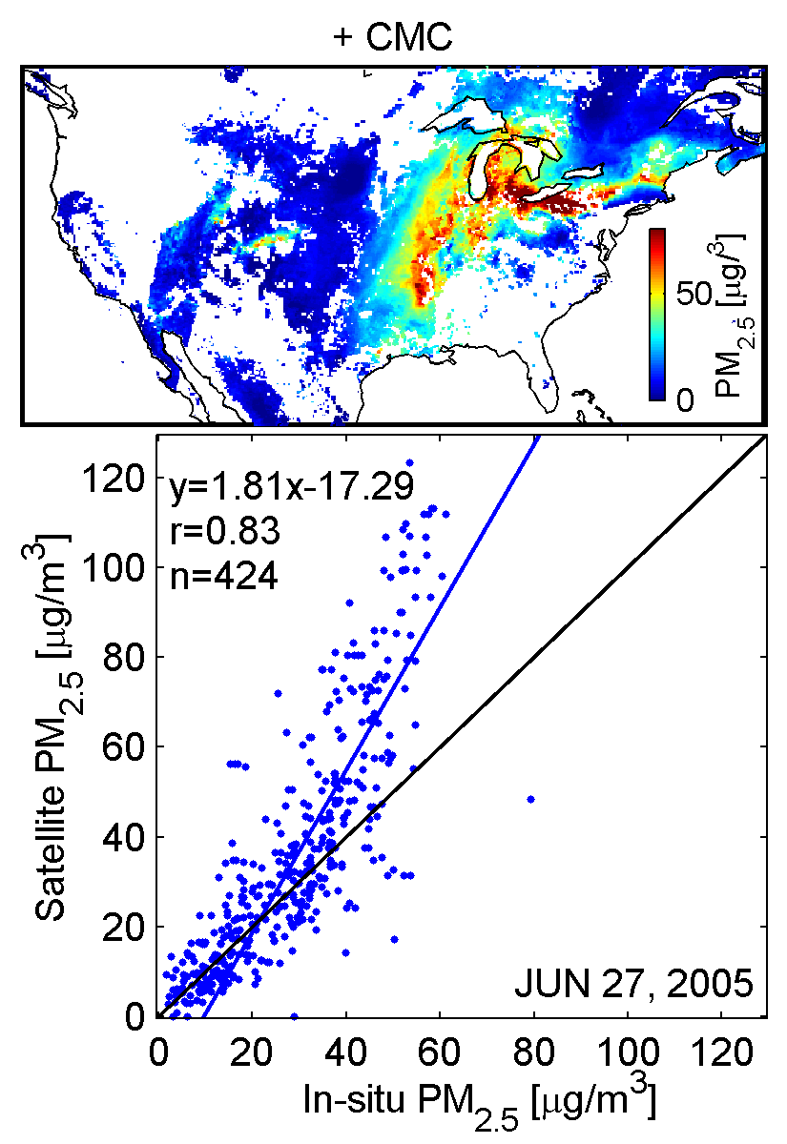
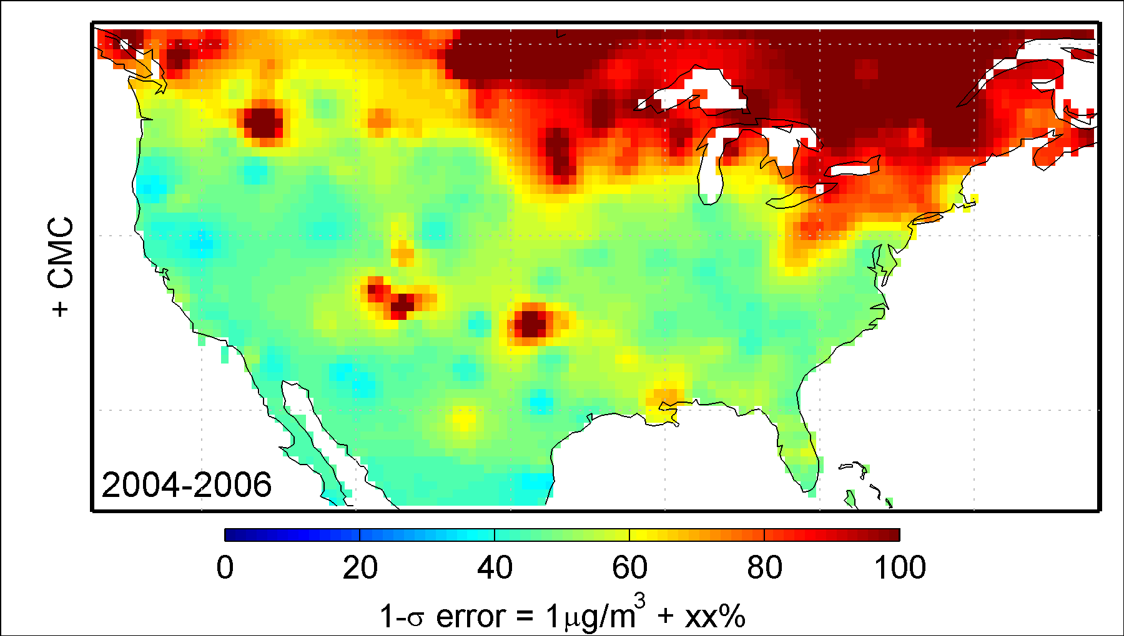
CMC Improves Daily Accuracy
Reduces effects of climatological bias
Reduces mean daily error to 40-60%
Aaron van Donkelaar

Slide 13
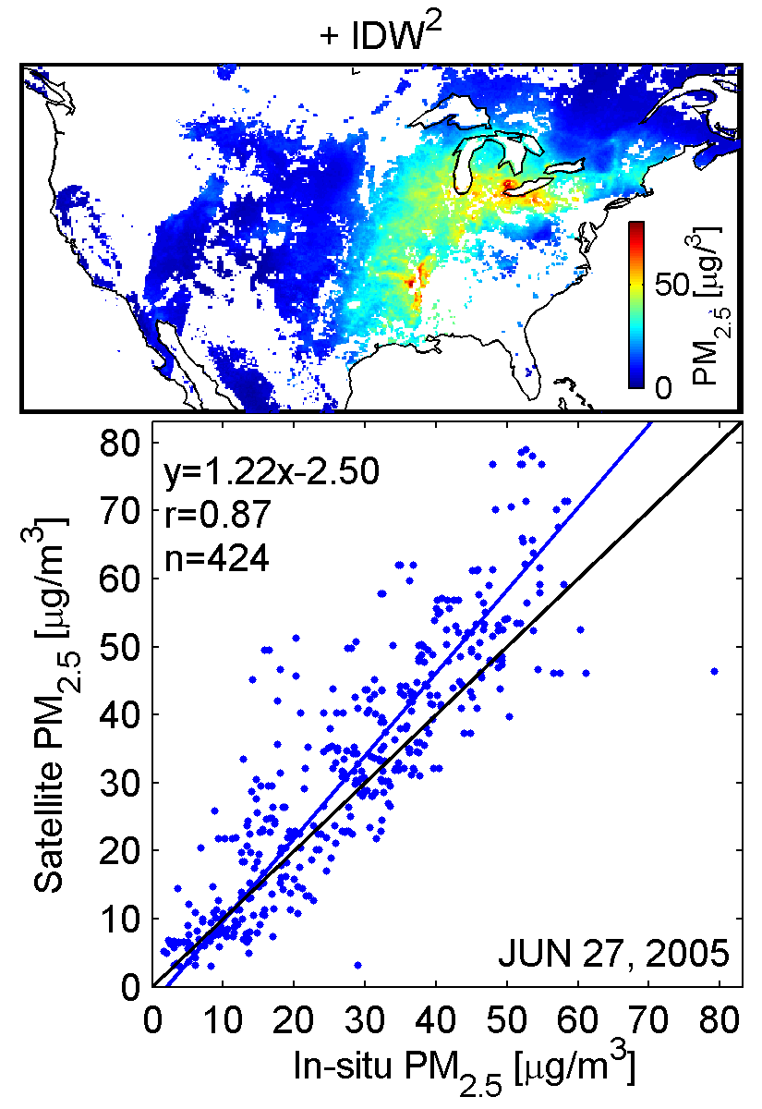
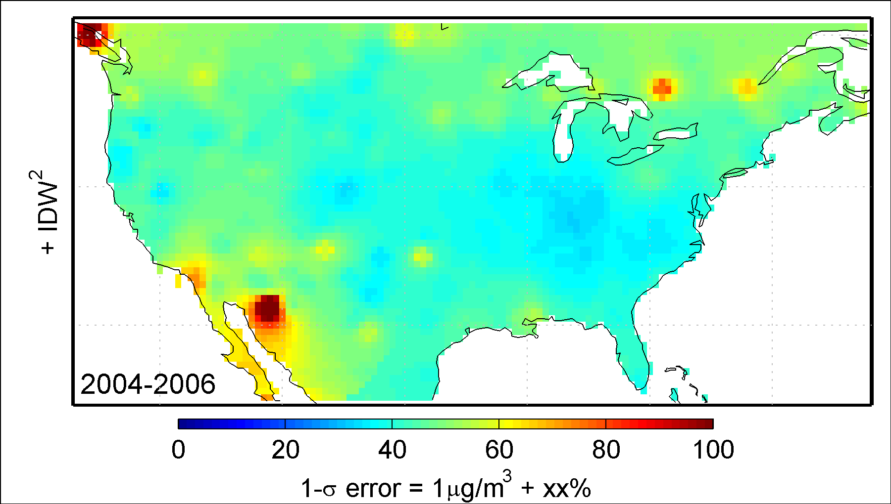
IDW Inverse Distance Weighting of Satellite Estimate Improves Skill by Reducing Spatial Noise
Regional mean daily error now ~40%
Aaron van Donkelaar

